Slide 1
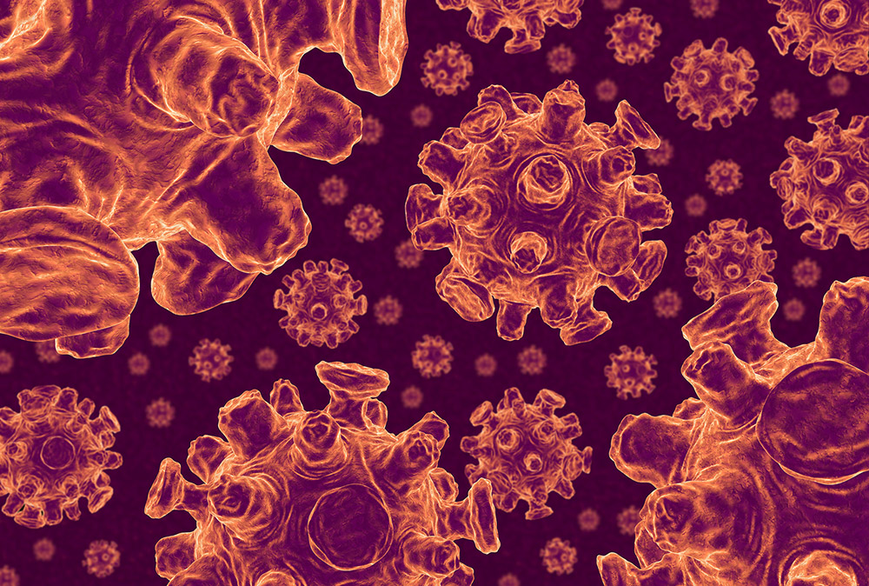
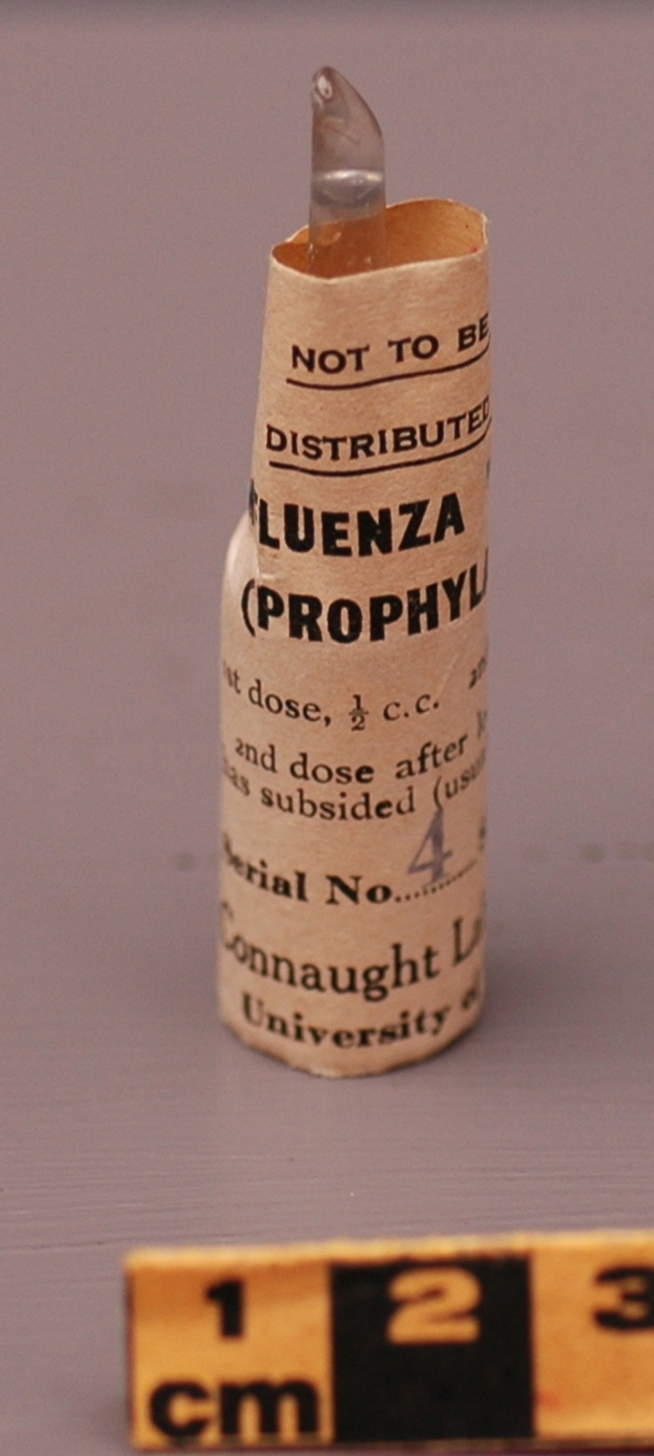
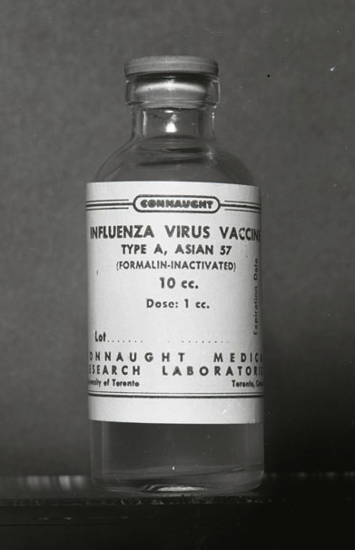
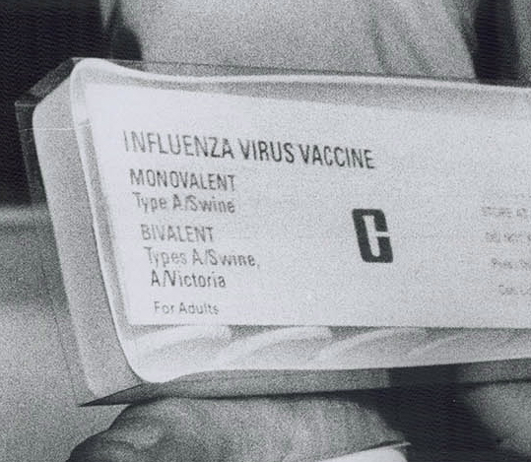
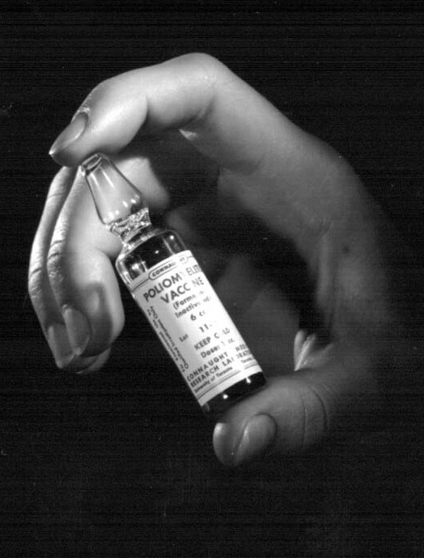
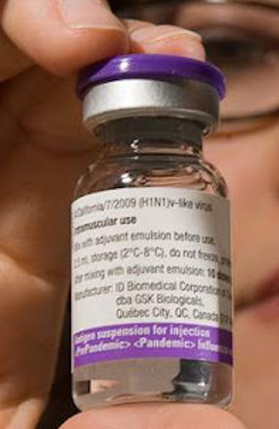
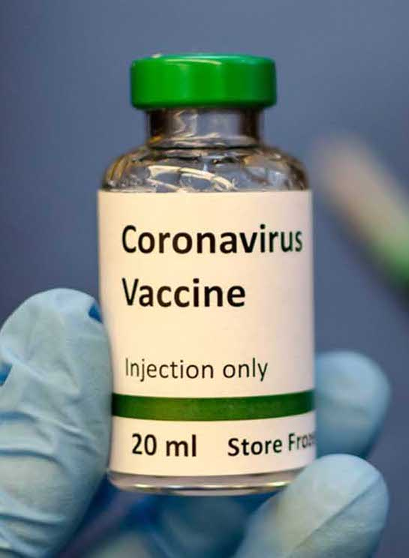
Emergency Responses:
Canada’s Vaccine Legacy;
Influenza, Polio & COVID-19 Vaccine(s)
By Christopher J. Rutty, Ph.D., Medical/Public Health Historian; Adjunct Professor, Dalla Lana School of Public Health, University of Toronto
Canadian Society for the History of Medicine: Pandemic Histories series; “Vaccine Viewpoints: From Polio to Pandemic Influenza" July 7, 2020

Slide 2
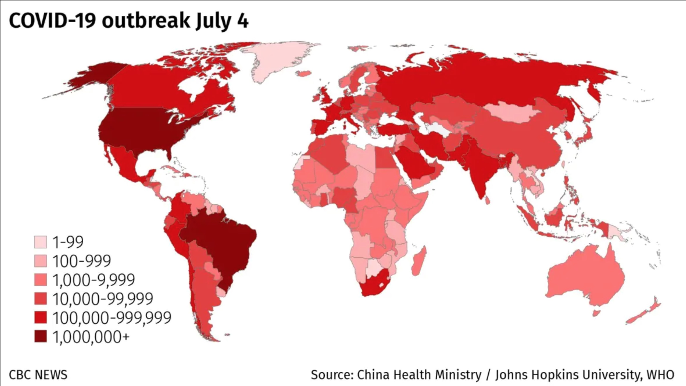
After more than 6 months of a global pandemic, and with no end in sight, great hopes and resources are being invested in a variety of potential COVID-19 vaccine candidates

Slide 3
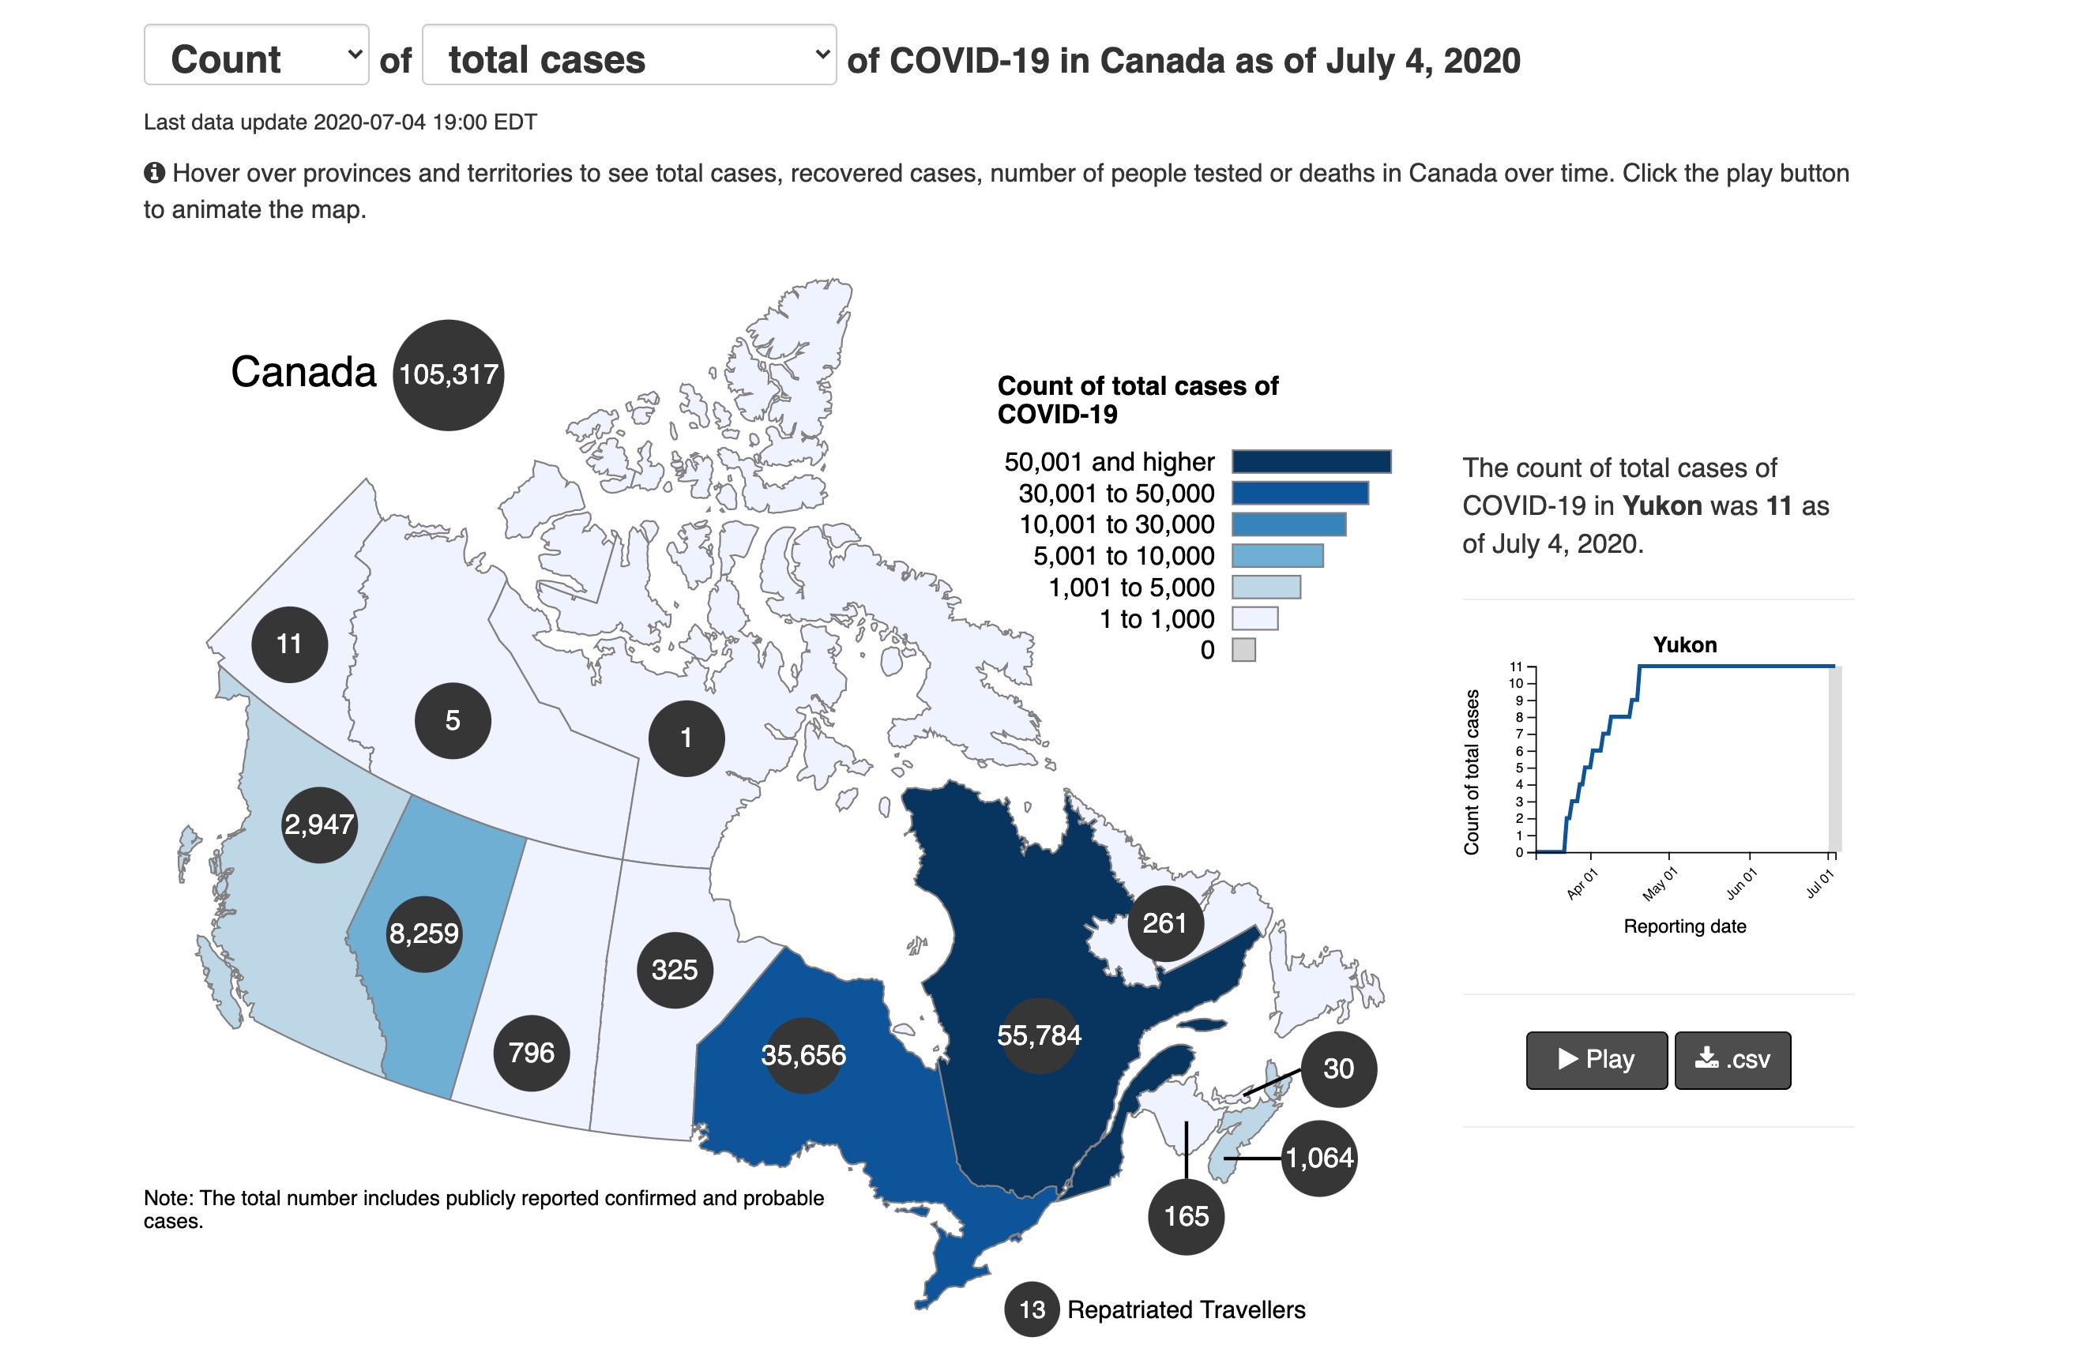
From a Canadian historical perspective, the COVID-19 pandemic experience resonates closely with the 1918 influenza pandemic, but also with major polio epidemics of the early 1950s

Slide 4
In terms of mounting an emergency response through the development, production and distribution of vaccines, Canada has a distinctive legacy
Most evident during influenza pandemics in 1918, 1957, 1976 (an abortive pandemic), and 2009
And in the essential role Canada played in expediting the development, production and distribution of polio vaccines
I would like to highlight these Canadian emergency vaccine responses and how they can relate to potential COVID-19 vaccines

Slide 5
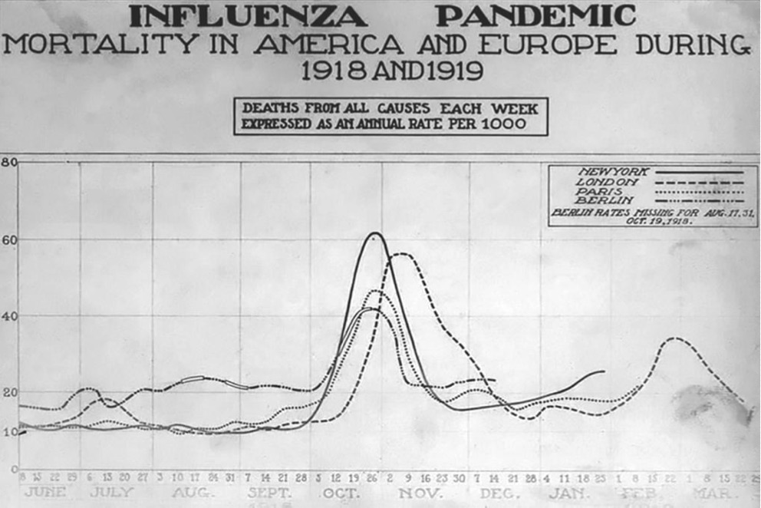

Slide 6
During the 1918 “Spanish” influenza pandemic, a sixth of the Canadian population, mostly young adults, was attacked by the flu, leading to some 50,000 deaths

Slide 7
During the 1918 “Spanish” influenza pandemic, a sixth of the Canadian population, mostly young adults, was attacked by the flu, leading to some 50,000 deaths
With little understanding of the viral cause of the disease (influenza virus first isolated in 1933) there was very little that could be done to prevent, control, or treat it

Slide 8
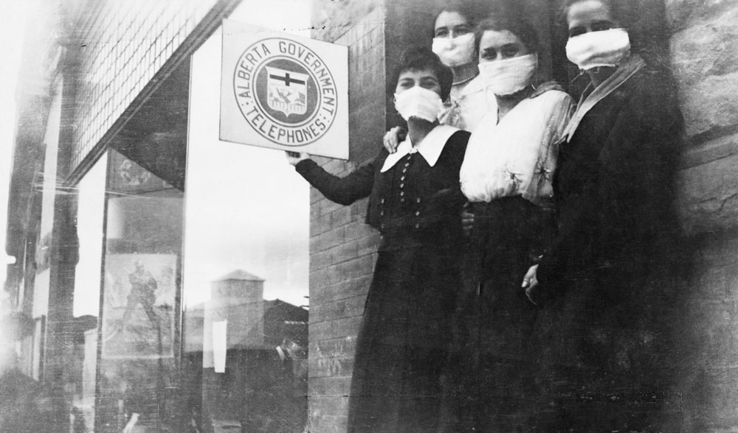

Slide 9
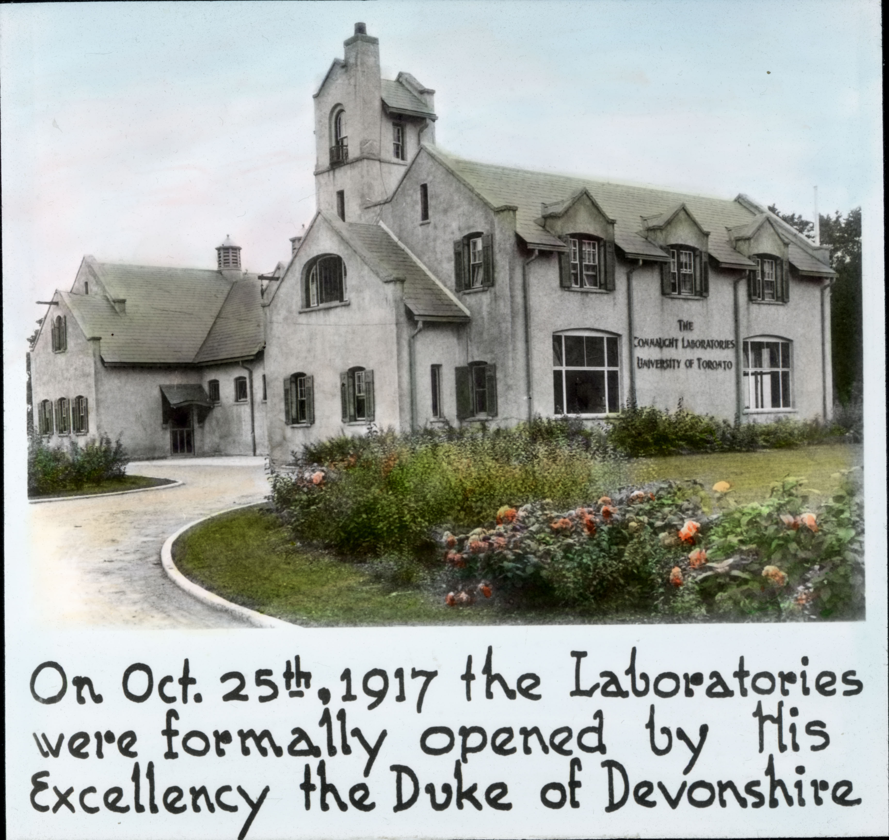
Oct 1918 - Nevertheless, early in the devastating 2nd wave of the pandemic, Connaught Laboratories, part of University of Toronto from 1914 to 1972 (Sanofi Pasteur Canada today), launched a heroic effort to prepare a vaccine based on the prevailing view that Bacillus influenza was causing the disease
Sanofi Pasteur Canada Archives

Slide 10
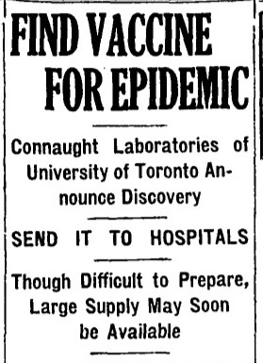
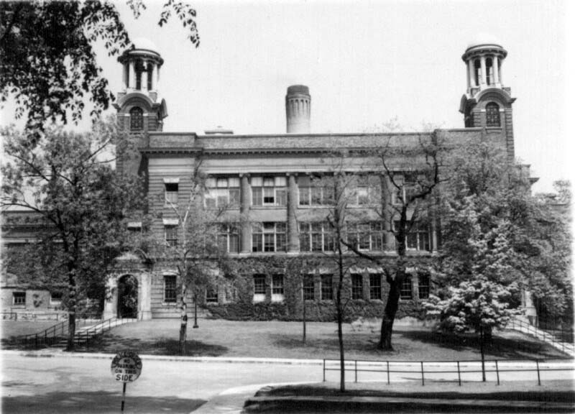
Connaught was soon able to distribute vaccine in large quantities free of charge to provincial health departments, hospital, medical and nursing staff, the military and other public health services across Canada
The influenza vaccine was prepared in Connaught’s lab facilities in the basement of the Medical Building, University of Toronto (Sanofi Pasteur Canada Archives)
The Globe, Oct 21, 1918, p. 1

Slide 11
Due to this unprecedented emergency, no claims for the effectiveness of the vaccine were made, but it did no apparent harm and the Lab’s efforts were widely appreciated
Ampoule of Connaught’s 1918 influenza vaccine held in collection of the Canada Science & Technology Museum, Ottawa
The Globe, Oct 21, 1918, p. 1

Slide 12
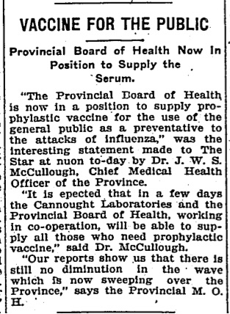
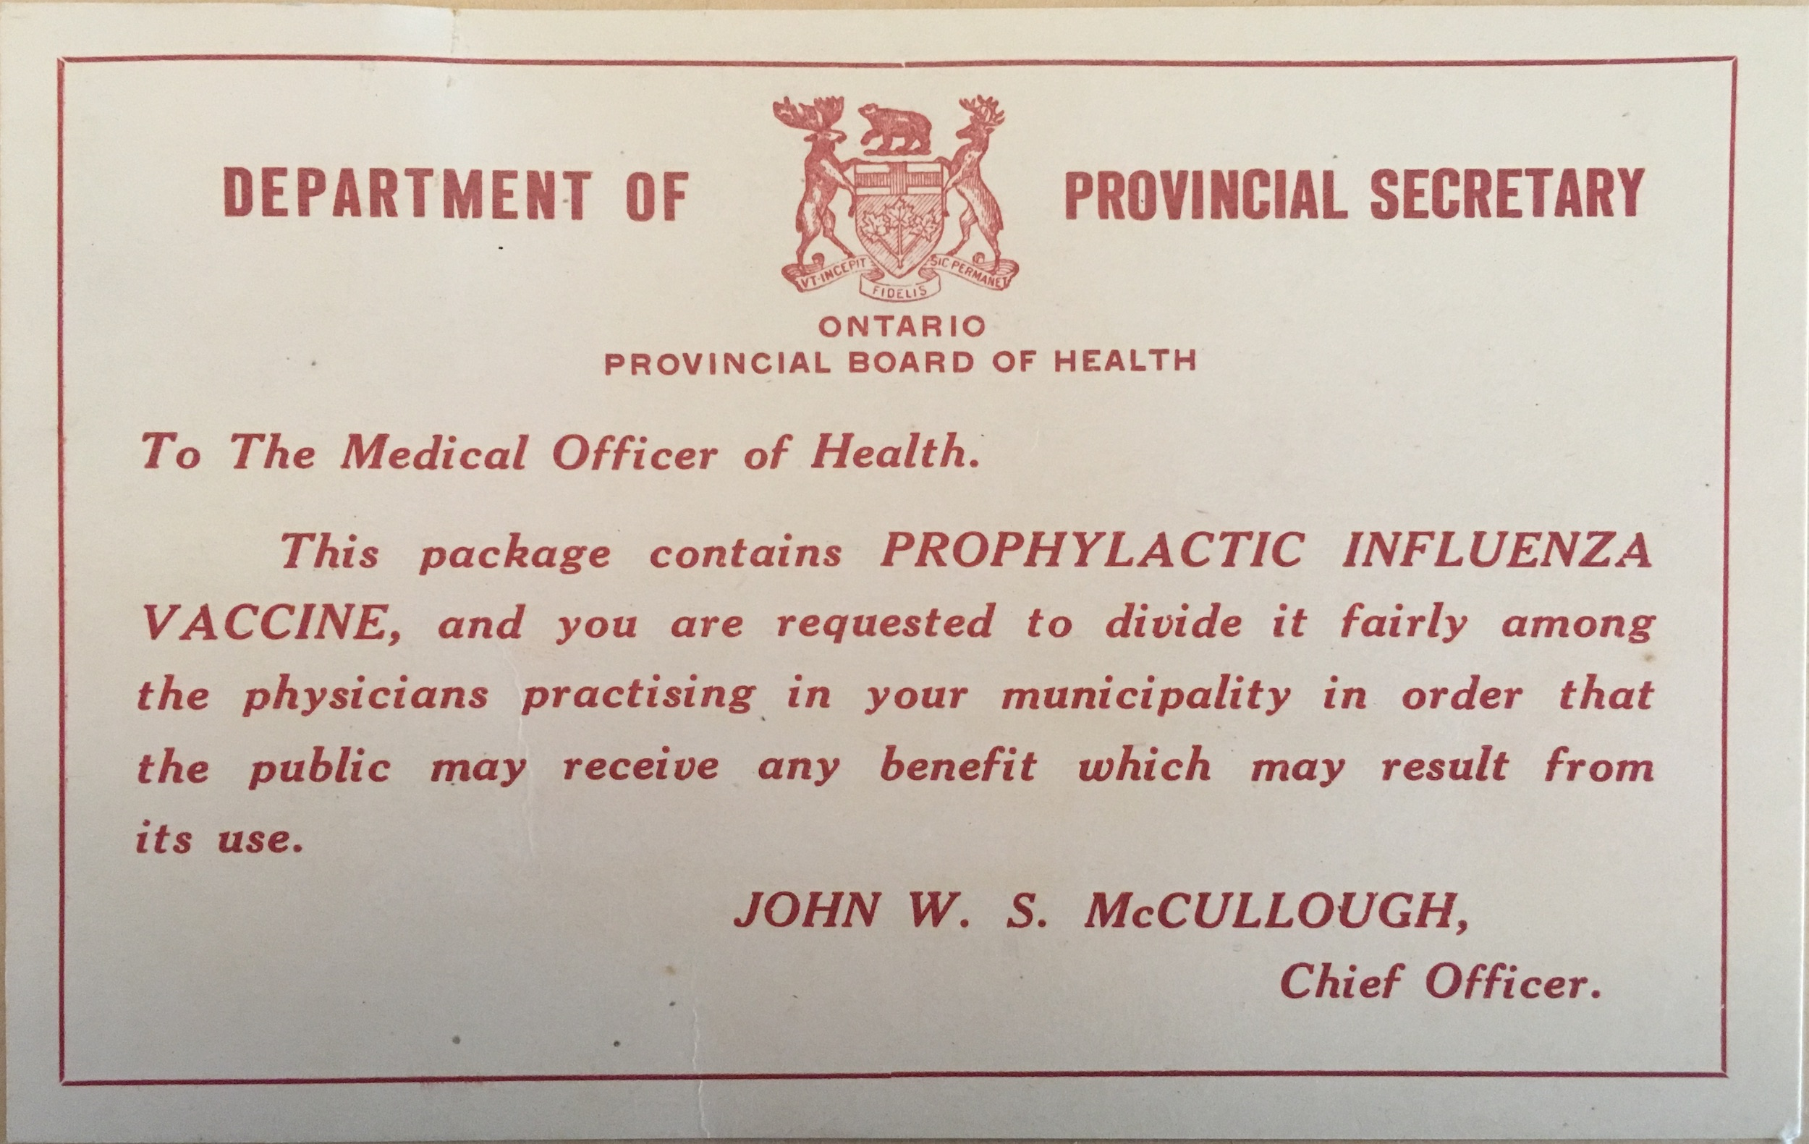
Archives of Ontario, RG8-5-B226479-Box73
Connaught’s vaccine was supplemented by a supply prepared by the Ontario Provincial Board of Health Laboratories
Toronto Star, Oct 21, 1918, p. 2

Slide 13
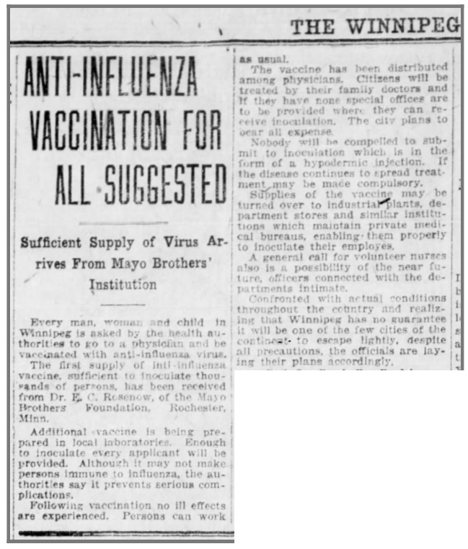
There were also other influenza vaccine production initiatives elsewhere in Canada, most notably in Winnipeg and Kingston
Winnipeg Tribune, Oct 23, 1918, p. 3

Slide 14
Similar desperation today for a COVID-19 vaccine, but in 1918 few effective vaccines existed beyond smallpox vaccine, and preparation efforts were quite localized and unregulated
There were also other influenza vaccine production initiatives elsewhere in Canada, most notably in Winnipeg and Kingston
Winnipeg Tribune, Oct 23, 1918, p. 3
For more on the 1918 influenza vaccine story, see my article: https://definingmomentscanada.ca/the-spanish-flu/research/

Slide 15
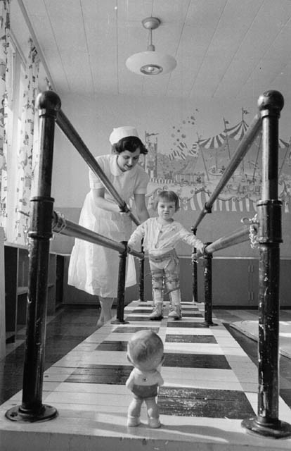
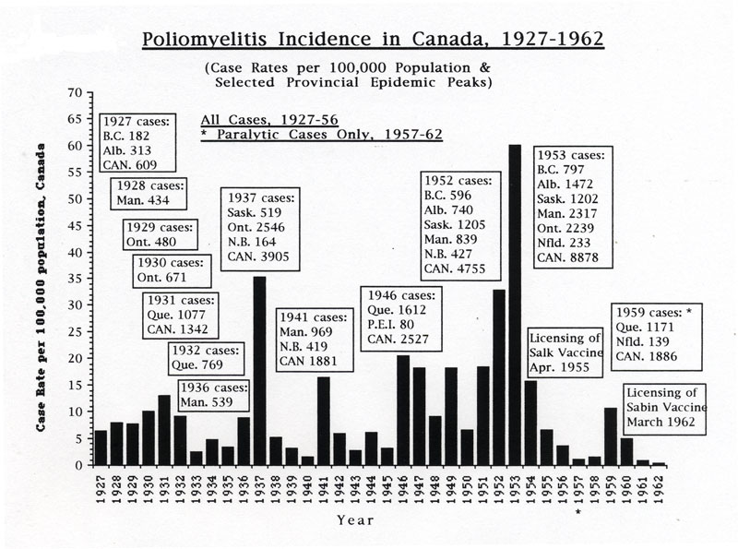
By the late 1920s, as smallpox faded, and there was significant progress in preventing diphtheria (led by Connaught), the opposite was happening with poliomyelitis in Canada
COVID-19 story most closely echoes the Canadian experience with polio epidemics
Library & Archives Canada
Rutty, C.J., Poliomyelitis in Canada, 1927-1962, Ph.D. Thesis, University of Toronto, 1995), p. 395

Slide 16
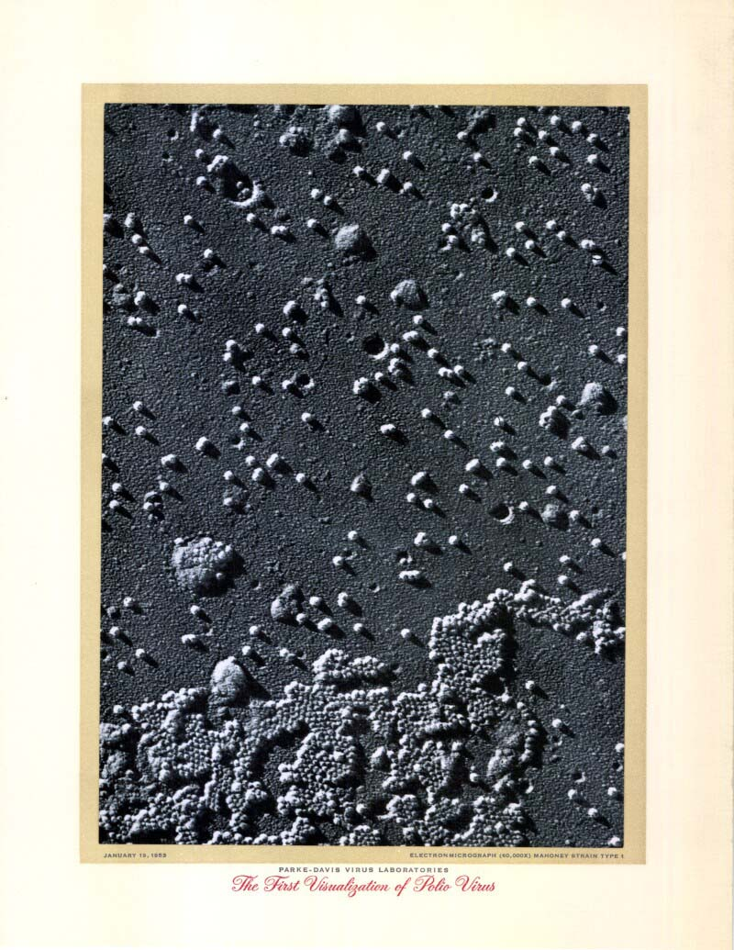
Poliomyelitis virus can damage motor-neurons in the spinal cord, causing varying degrees of muscle weakness or paralysis
Chest muscle weakness could impair breathing, requiring “iron lung” support
Polio disease variability a common feature with COVID-19
Sanofi Pasteur Canada Archives

Slide 17
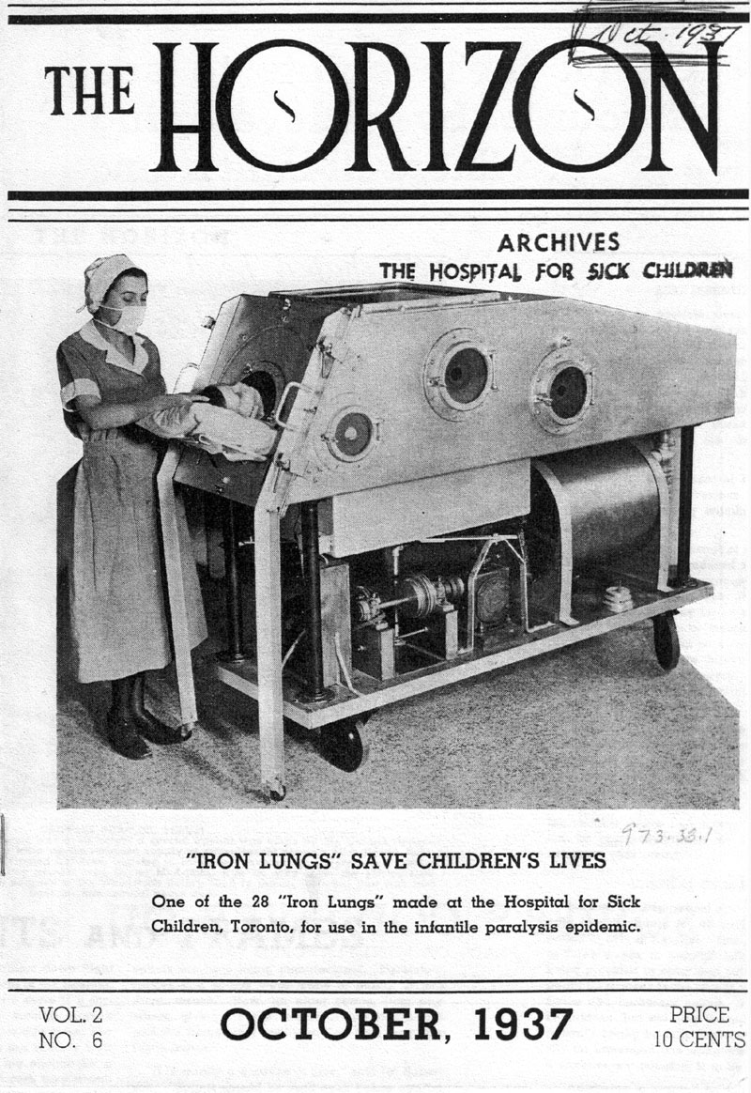
1920s-50s - Polio outbreaks and epidemics relentlessly increased until polio vaccines were widely available
For unique epidemiological reasons, the middle class was particularly vulnerable
However, during the polio epidemic era, much remained mysterious and misunderstood about “the crippler”

Slide 18
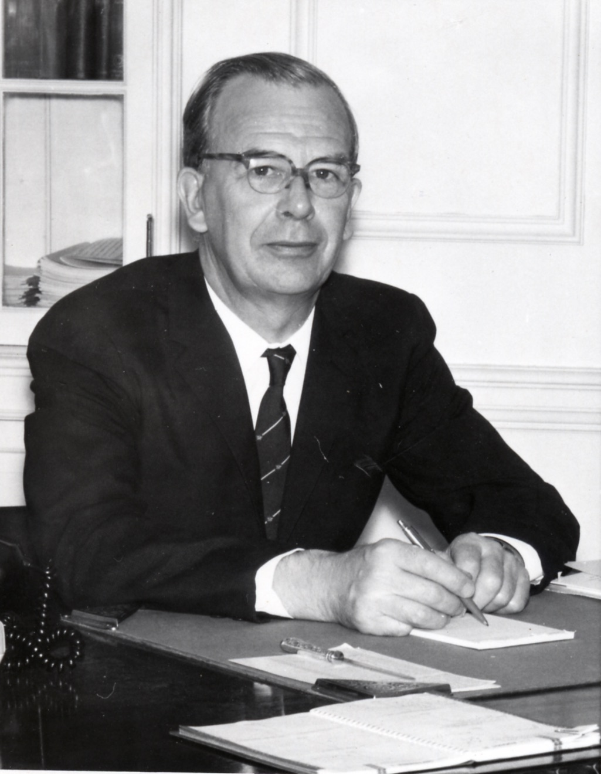
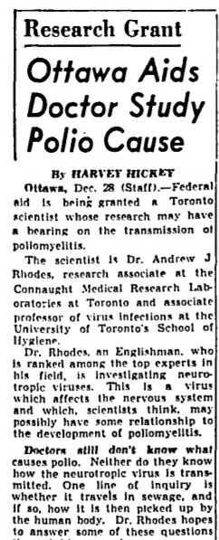
1947-48 - Dr. Andrew J Rhodes, a leading virologist specializing in polio, was recruited from the UK to lead a comprehensive research program at Connaught Medical Research Laboratories to investigate the virology, epidemiology and clinical diagnosis of polio
Sanofi Pasteur Canada Archives
Rhodes’ research was funded by the National Foundation for Infantile Paralysis (U.S. March of Dimes), Canadian Life Insurance Companies, and newly established Federal Public Health Research Grants
Globe & Mail, Dec. 29, 1948, p. 11

Slide 19
Fueled by substantial “March of Dimes” funds, a series of key discoveries accelerated progress towards a possible polio vaccine
1949 – Boston research team discovered method to cultivate poliovirus in tissue cultures
1949 – Connaught Labs research team developed “Medium 199”, the first synthetic tissue culture medium, originally for nutritional studies of cancer cells
1951 – Rhodes’ polio research team at Connaught discovered that “Medium 199” could be used to cultivate poliovirus in monkey kidney cells
Globe & Mail, Sept. 25, 1951

Slide 20
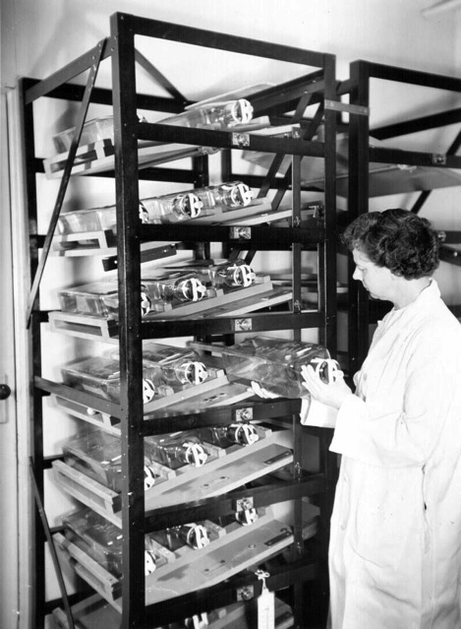
1951 – Jonas Salk showed a formaldehyde-inactivated poliovirus vaccine could prevent polio in monkeys; used a traditional animal serum-based medium that would be unsafe for a human vaccine
1952 – Salk learned of “Medium 199”, which enabled the first human use of polio vaccine; successful test, but only on lab scale
1952-53 – Connaught biochemist, Dr. Leone Farrell (right), developed “Toronto Method” for large scale poliovirus cultivation
July 1953 – Connaught began to prepare poliovirus fluids for an unprecedented vaccine field trial
Sanofi Pasteur Canada Archives

Slide 21
1951 – Jonas Salk showed a formaldehyde-inactivated poliovirus vaccine could prevent polio in monkeys; used a traditional animal serum-based medium that would be unsafe for a human vaccine
1952 – Salk learned of “Medium 199”, which enabled the first human use of polio vaccine; successful test, but only on lab scale
1952-53 – Connaught biochemist, Dr. Leone Farrell (right), developed “Toronto Method” for large scale poliovirus cultivation
July 1953 – Connaught began to prepare poliovirus fluids for an unprecedented vaccine field trial
Sanofi Pasteur Canada Archives
Canada’s worst polio epidemic year was just starting…

Slide 22
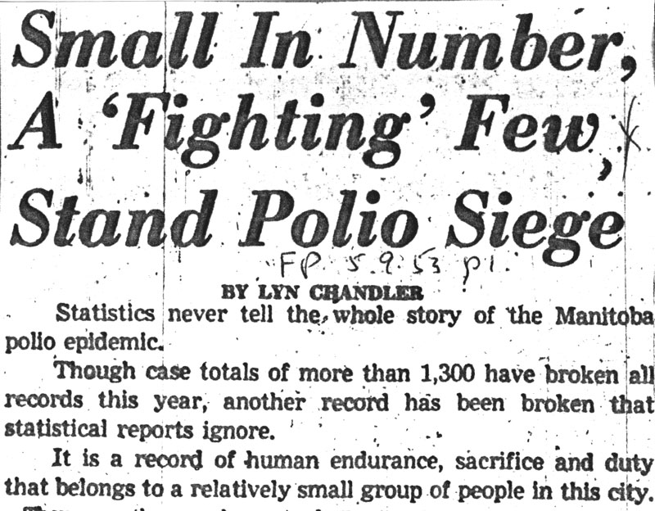
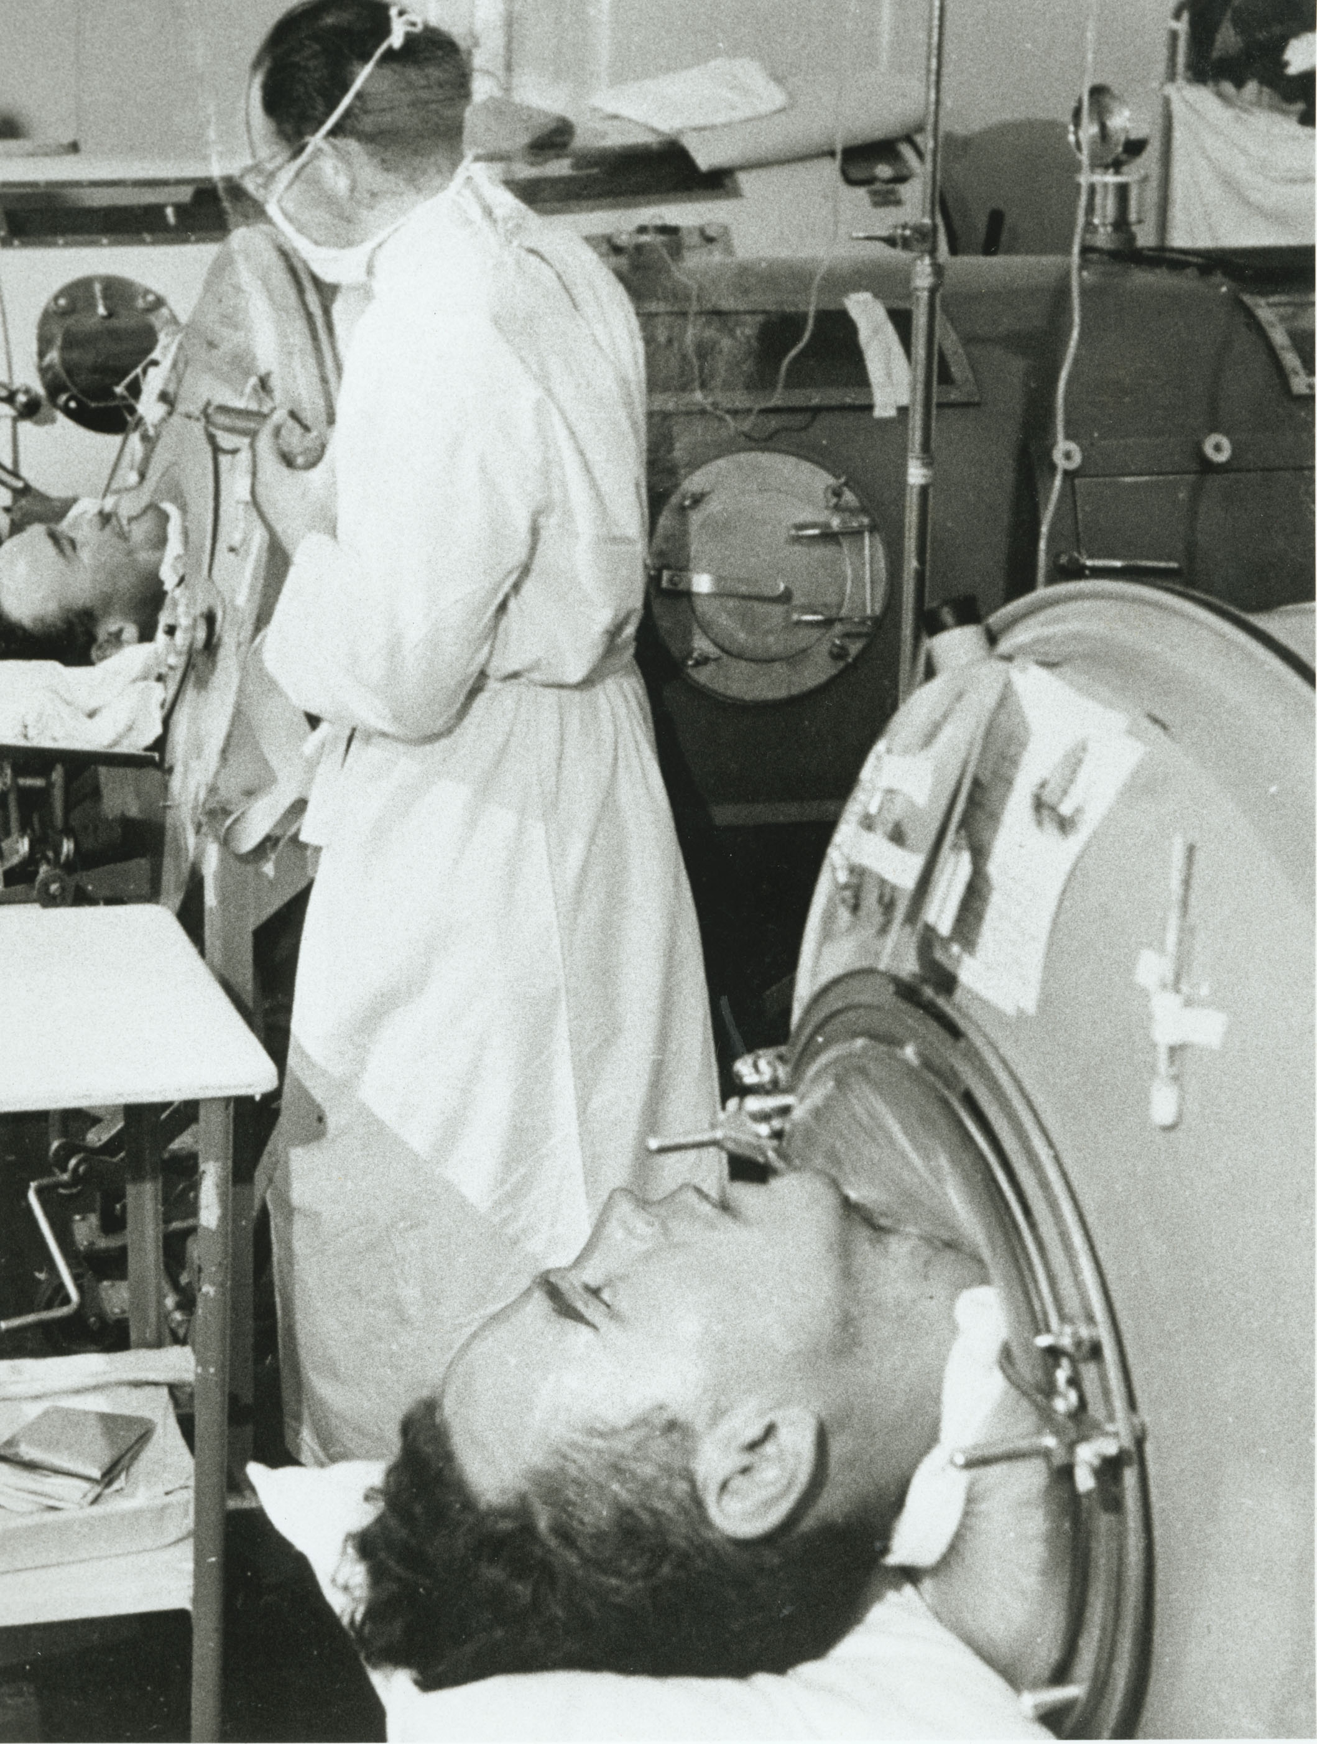
From Manitoba west, especially, every province felt the full effects of epidemic polio at record or near record levels
Prior to COVID-19, polio in 1953 was Canada’s last epidemic national emergency
Manitoba faced the worst crisis in the country, if not in the history of this disease
Winnipeg Free Press, Sept 5, 1953, p. 1
National polio numbers:
9,000 cases (59.9 per 100,000)
500 deaths
Manitoba:
2,317 cases (286.4/100,000)
91 deaths
Winnipeg:
763 cases (318/100,000)
Riverview Health Centre Archive, Winnipeg

Slide 23
From Manitoba west, especially, every province felt the full effects of epidemic polio at record or near record levels;
Prior to COVID-19, polio in 1953 was Canada’s last epidemic national emergency
Manitoba faced the worst crisis in the country, if not in the history of this disease
Winnipeg Free Press, Sept 5, 1953, p. 1
In many ways the challenges associated with securing sufficient supplies of ventilators to manage COVID-19 patients very closely echoes the 1953 polio epidemic crisis and the urgent demand for iron lungs
Riverview Health Centre Archive, Winnipeg

Slide 24
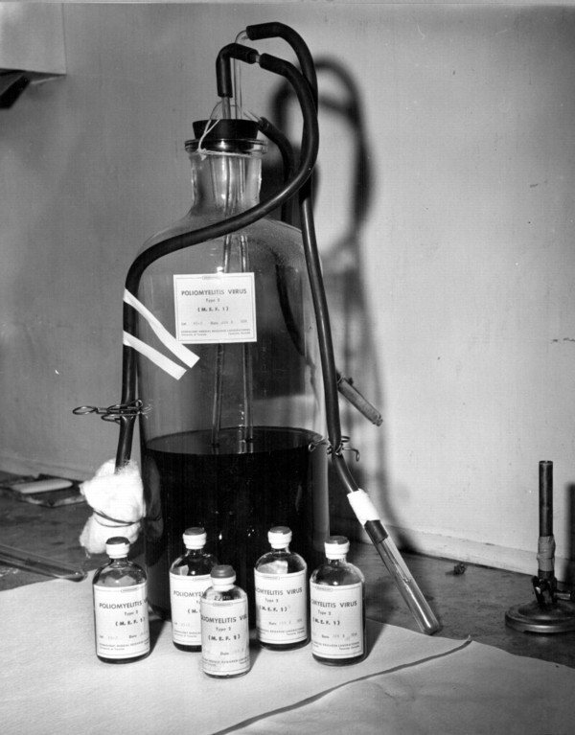
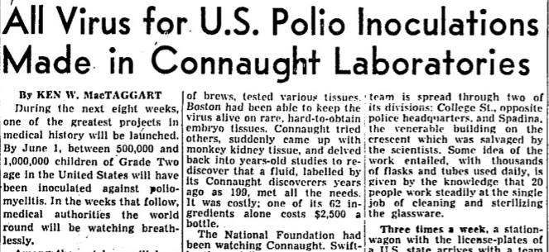
1953-54 - While the polio emergency worsened, Connaught undertook -- as Salk described it -- the “herculean task” of producing over 3,000 litres of poliovirus fluids for what would be the largest vaccine field trial ever attempted
The poliovirus fluids were shipped to two U.S. pharmaceutical firms for inactivation and processing into the finished vaccine
Sanofi Pasteur Canada Archives
Globe & Mail, April 5, 1954, p. 21

Slide 25
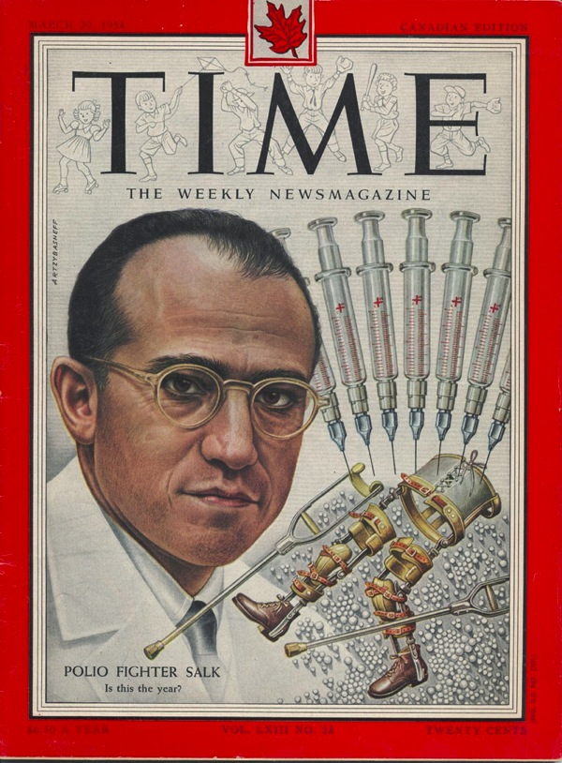
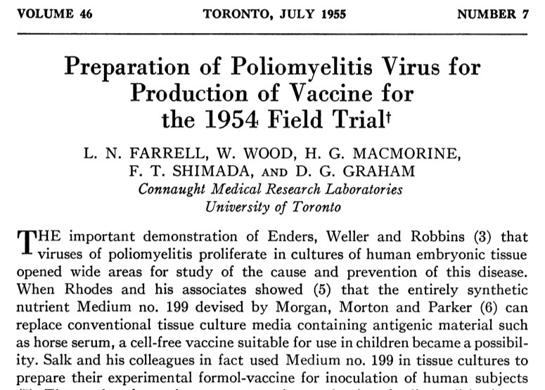
April 24, 1954 – Trial began with 1,800,000 “polio pioneer” children enrolled across 44 U.S. states; Alberta, Manitoba and Halifax later joined the trial
For this triple-blind field trial, children received either the vaccine, a placebo of Medium 199, or were observed
Canadian Journal of Public Health, July 1955, p. 265
Time (Canadian Edition), March 29, 1954

Slide 26
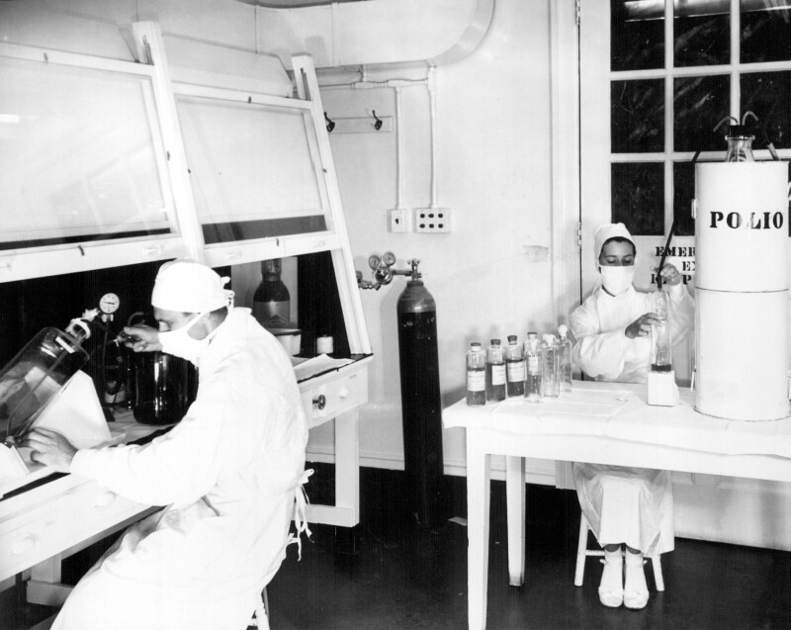
Meanwhile, Connaught prepared the full vaccine while the federal and provincial governments planned an all-Canadian observed-controlled trial that would start in April 1955, regardless of the U.S. results
Sanofi Pasteur Canada Archives

Slide 27
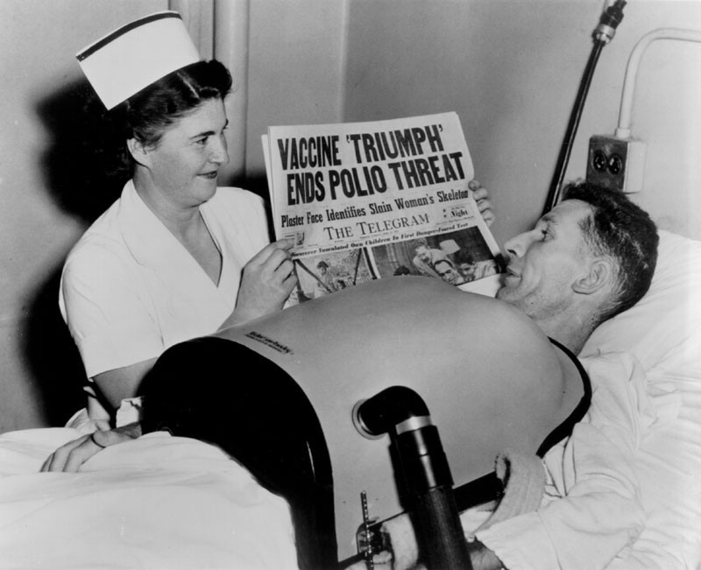
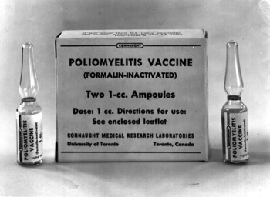
March of Dimes Canada Archives
April 12, 1955 – Unprecedented media attention to announcement of field trial results; vaccine proved to be 60-90% effective against the three antigenic types of poliovirus
Vaccine immediately licensed in U.S. and Canada
In Canada, Salk vaccine distributed through a special federal-provincial free program for children and subjected to further study of its effectiveness
For more on the Canadian polio vaccine story see my articles (#7 and #8) in this series: http://connaught.research.utoronto.ca/history/
Sanofi Pasteur Canada Archives

Slide 28
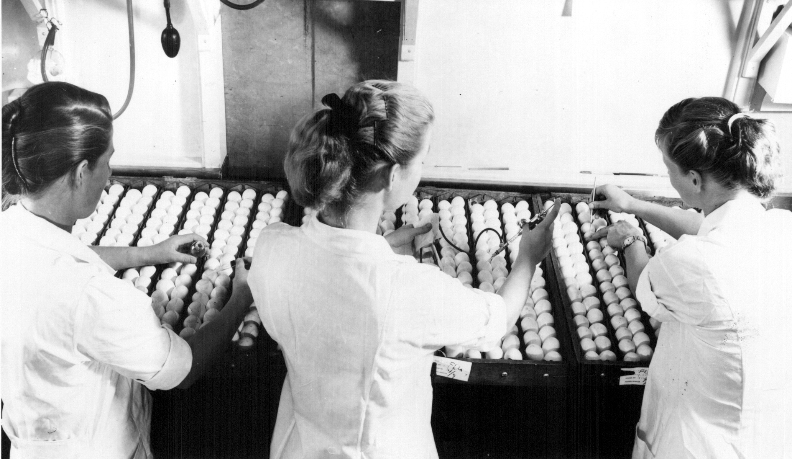
Sanofi Pasteur Canada Archives

Slide 29
1956-57 - A new pandemic strain of influenza virus quickly spread from Asia, prompting the first pandemic since 1918 and high global demand for influenza vaccine
Sanofi Pasteur Canada Archives

Slide 30
Improved influenza vaccine production methods enabled larger, but still limited, supplies in the face of sudden high public demand; the main limiting factor was sourcing the large numbers of eggs necessary to grow the virus
Sanofi Pasteur Canada Archives

Slide 31
Summer 1957 – Concerned about limited vaccine availability, the Canadian government called Connaught with an urgent request for 500,000 doses to be used on a priority basis to protect armed forces and health services personnel
Toronto Star, Aug 17, 1957, p. 1

Slide 32
Summer 1957 – Concerned about limited vaccine availability, the Canadian government called Connaught with an urgent request for 500,000 doses to be used on a priority basis to protect armed forces and health services personnel
The Institute of Microbiology at the University of Montreal was also asked to contribute to the urgent request for vaccine
Toronto Star, Aug 17, 1957, p. 1

Slide 33
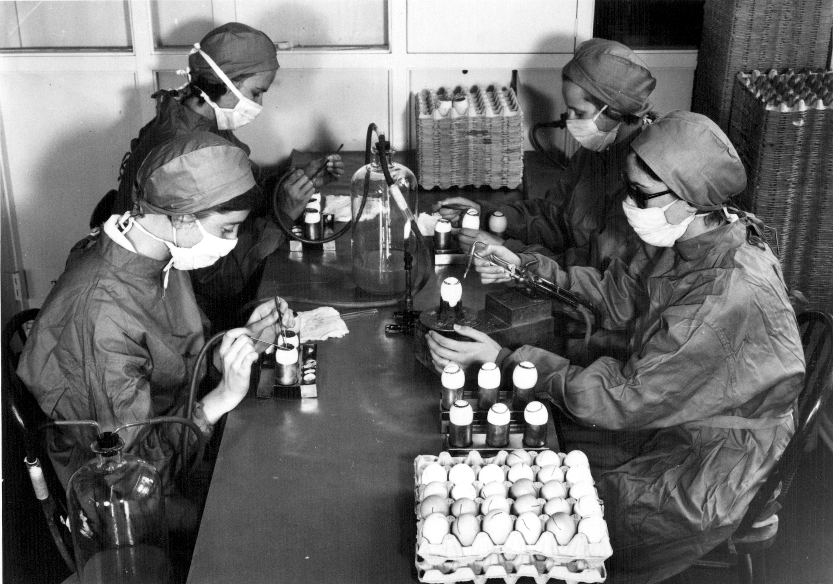
Sanofi Pasteur Canada Archives

Slide 34
July 1957 – Connaught did not routinely produce influenza vaccine, but quickly assembled a team that normally prepared veterinary vaccines to cultivate the A/Asia/57 virus in large numbers of specially secured fertile hen’s eggs
Sanofi Pasteur Canada Archives

Slide 35
After producing some 10,000 doses per week, the first vaccine was delivered to the provinces by early October
Sanofi Pasteur Canada Archives

Slide 36
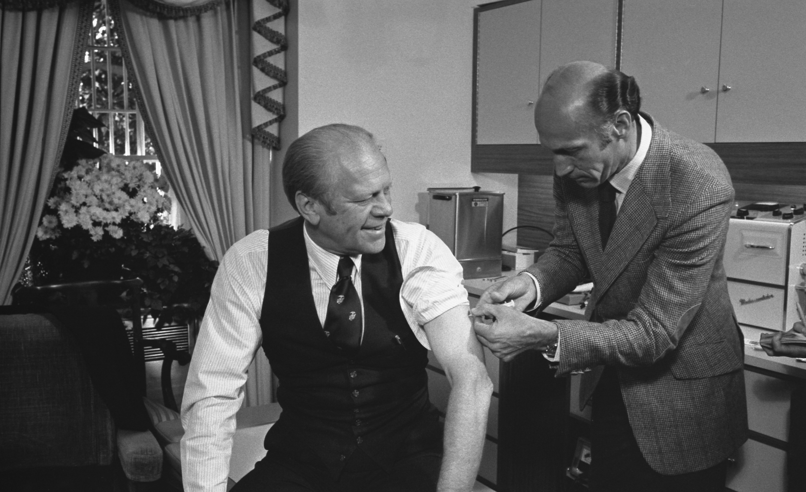
https://www.fordlibrarymuseum.gov/avproj/swineflu.asp

Slide 37
Feb 1976 - A new strain of Influenza A virus, popularly referred to as “swine flu,” caused an outbreak in among 273 of the 1,321 new army recruits at Fort Dix, New Jersey, with one death
https://www.fordlibrarymuseum.gov/avproj/swineflu.asp

Slide 38
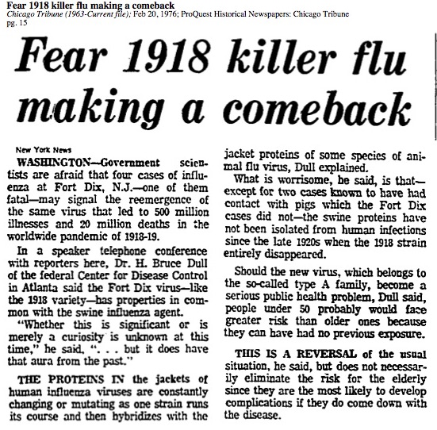
Feb 1976 - A new strain of Influenza A virus, popularly referred to as “swine flu,” caused an outbreak in among 273 of the 1,321 new army recruits at Fort Dix, New Jersey, with one death
There were fears that the strain isolated from the fatal case was related to the one responsible for the 1918 pandemic, and that the young and middle-aged had little or no immunity
https://www.fordlibrarymuseum.gov/avproj/swineflu.asp
Chicago Tribune,Feb 20, 1976, p. 15

Slide 39
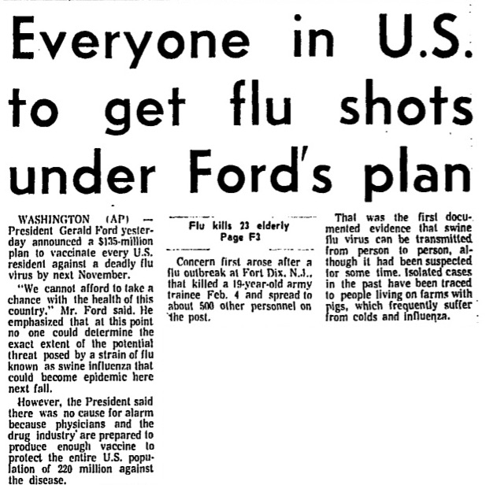
March 1976 – Taking advantage of a rare opportunity to mount a pre-emptive strike, President Gerald Ford committed the U.S. government to an unprecedented plan to immunize every American citizen against swine flu before November
Globe & Mail, March 25, 1976, p. 1
https://www.fordlibrarymuseum.gov/avproj/swineflu.asp

Slide 40
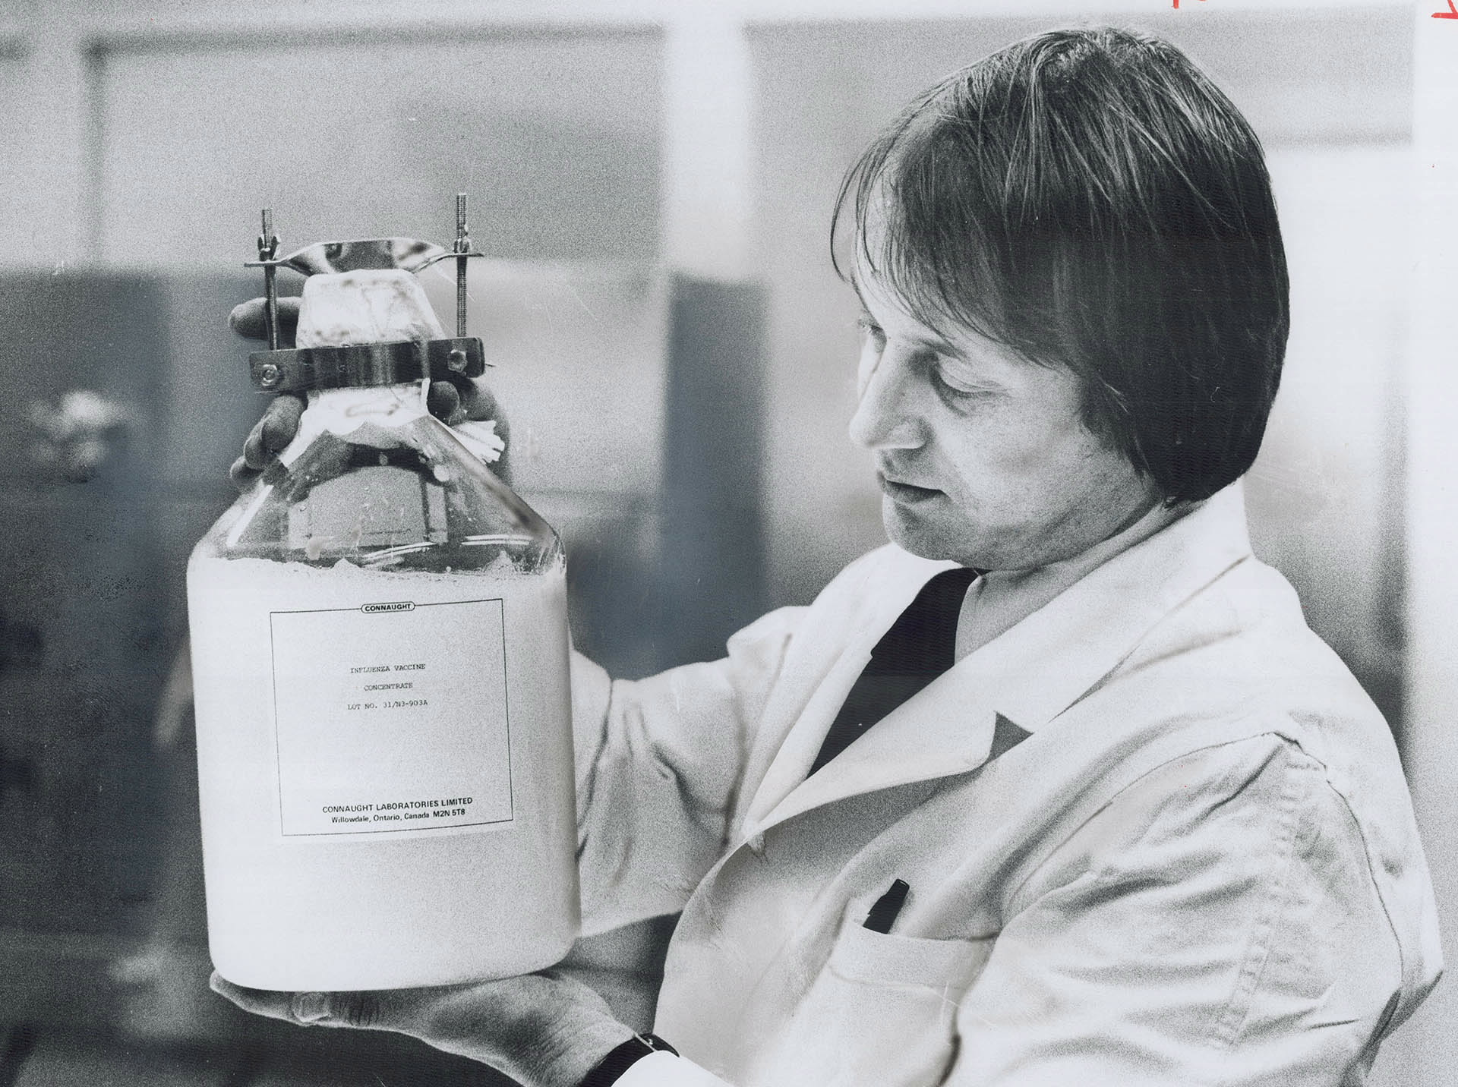
Toronto Star Archives; Toronto Public Library

Slide 41
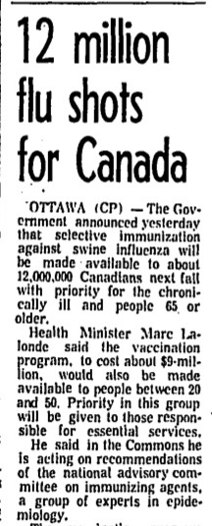
In Canada, federal health minister, Marc Lalonde, followed suit and approved an expedited swine flu immunization program, ordering 12 million shots, primarily for the chronically ill and people over 65 years-of-age
Toronto Star Archives; Toronto Public Library
Globe & Mail, March 31, 1976, p. 1

Slide 42
Connaught Labs was asked to provide vaccine, but limited time and equipment led to a plan to import vaccine in concentrated bulk form from vaccine companies in Europe and Australia, and then Connaught would process, test and fill it
Toronto Star Archives; Toronto Public Library

Slide 43
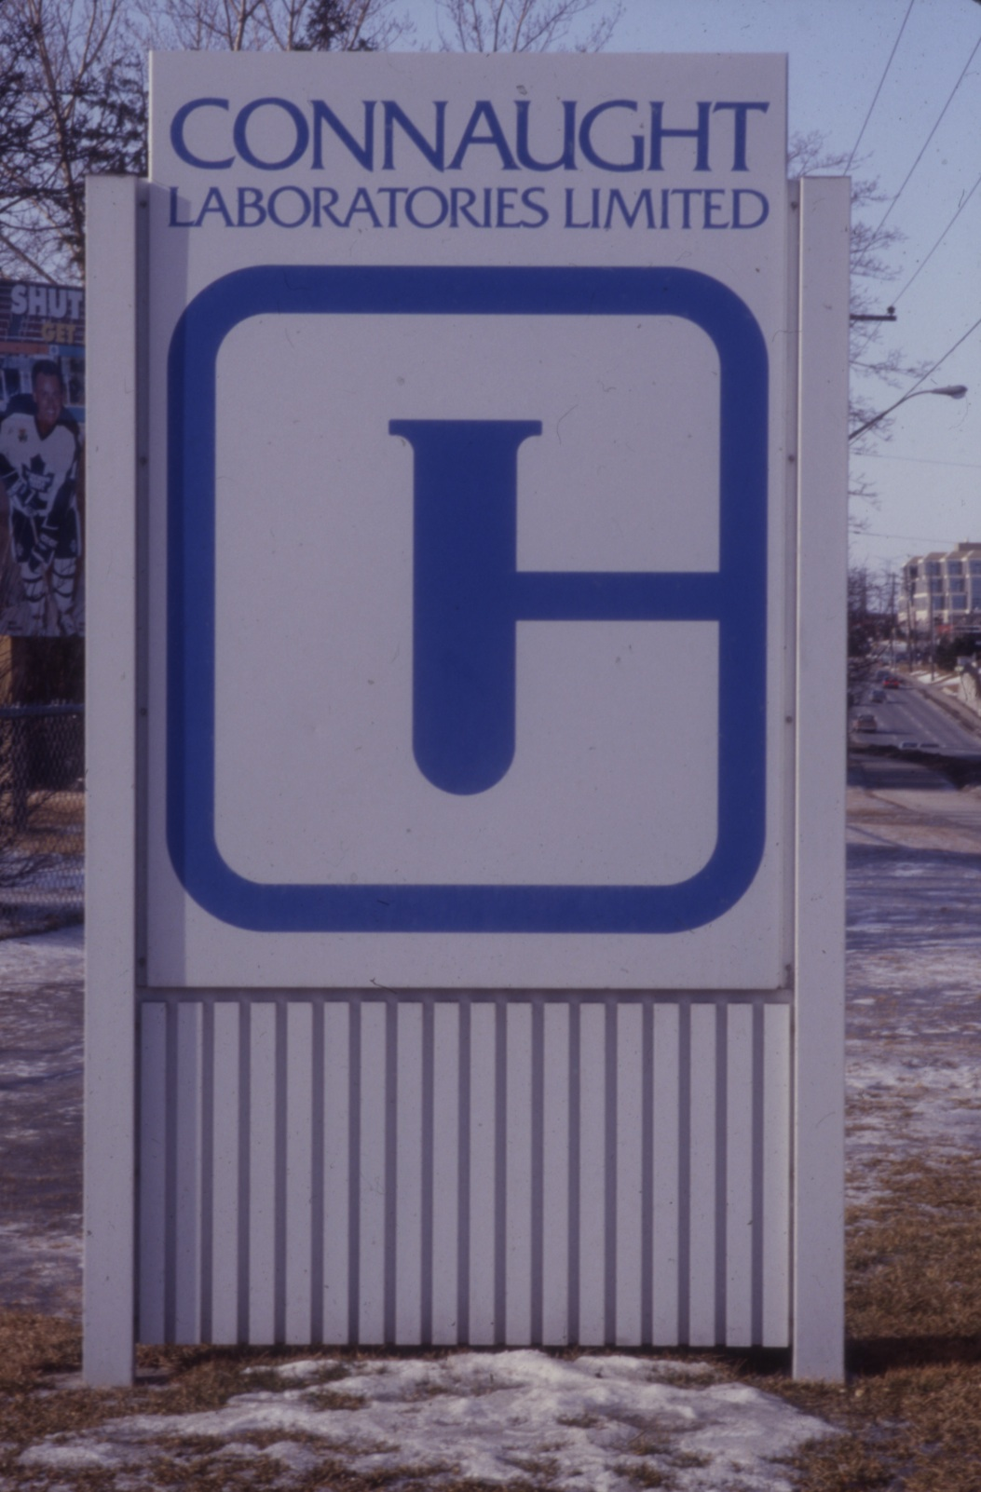
Connaught Labs was asked to provide vaccine, but limited time and equipment led to a plan to import vaccine in concentrated bulk form from vaccine companies in Europe and Australia, and then Connaught would process, test and fill it
Connaught had been sold by the University of Toronto in 1972 to the Canada Development Corporation and was now “Connaught Laboratories Limited”
Toronto Star Archives; Toronto Public Library

Slide 44
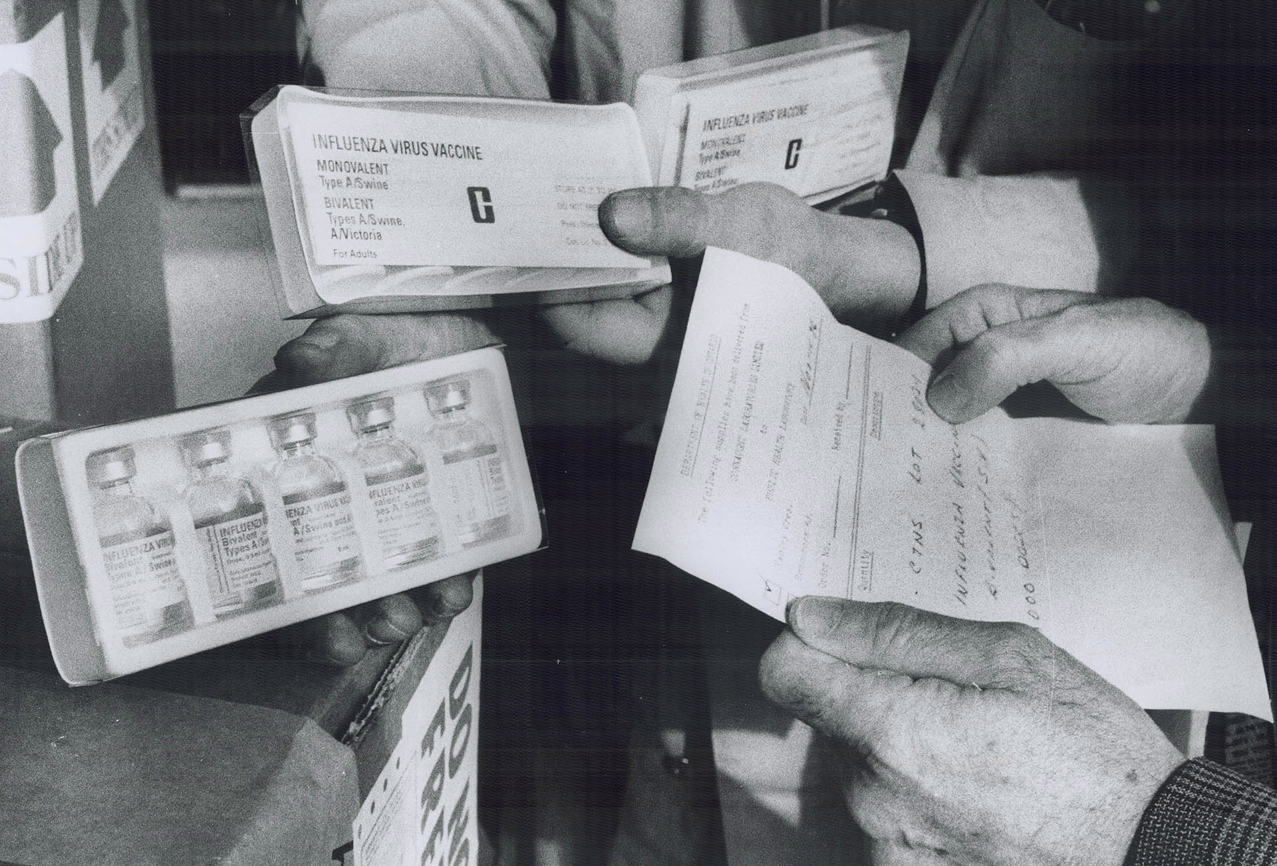
Toronto Star Archives; Toronto Public Library

Slide 45
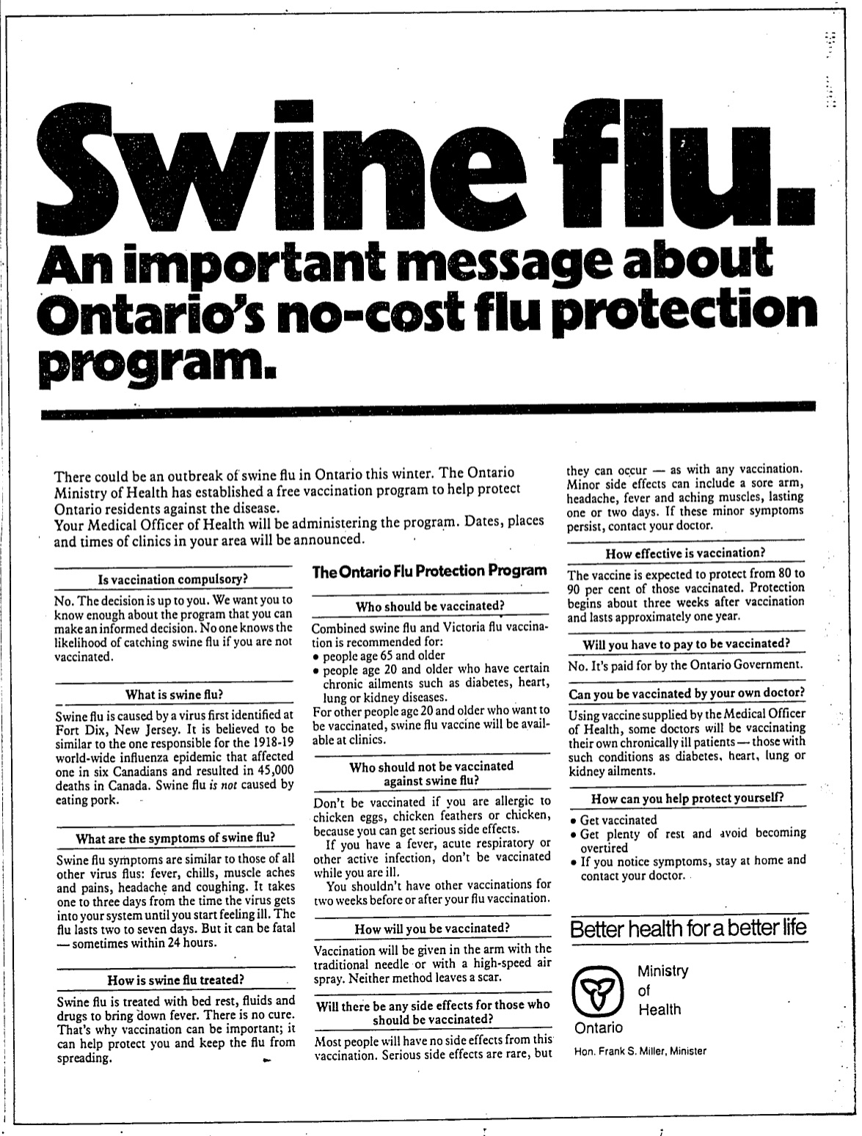
Toronto Star, Nov. 25, 1976, p. B10
Fortunately the “Swine Flu” emergency did not materialize, but this unprecedented mass vaccination initiative encountered numerous obstacles on both sides of the border, ie: production delays; securing liability insurance; public resistance; and rare but disturbing adverse reactions
Toronto Star Archives; Toronto Public Library

Slide 46
Toronto Star, Nov. 25, 1976, p. B10
In the end, out of the 10 million doses that were ultimately available in Canada, only about 800,000 received the vaccine
Toronto Star Archives; Toronto Public Library

Slide 47
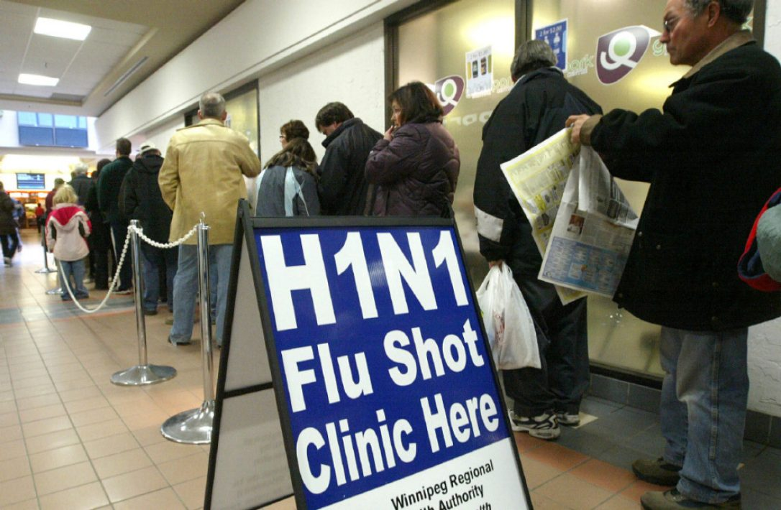

Slide 48
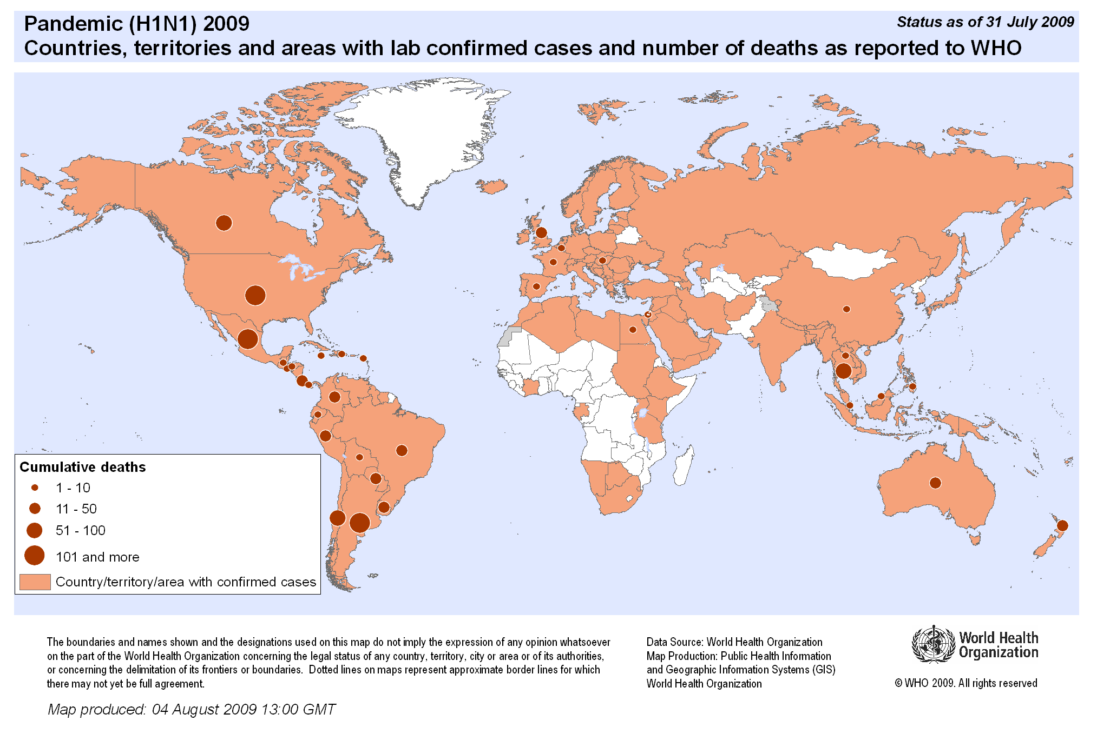
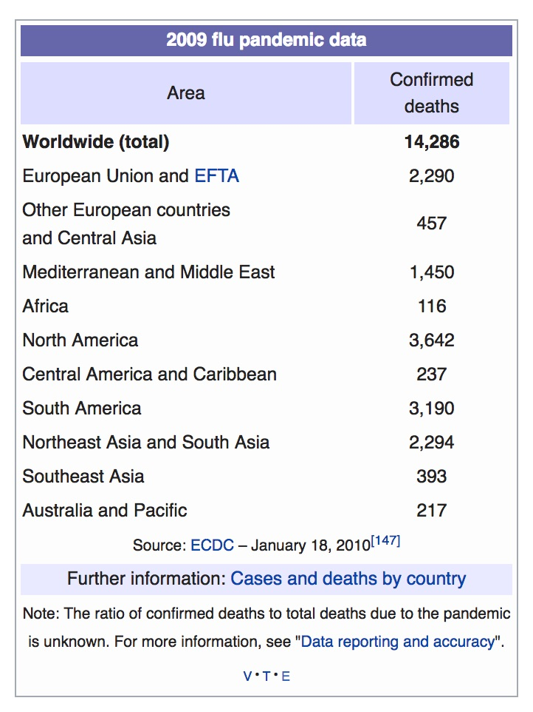
2009 – While the pandemic threat of “Swine Flu” did not materialize in 1976, the “H1N1” strain of “swine flu” very much did materialize globally and had a significant impact in Canada

Slide 49
2009 – While the pandemic threat of “Swine Flu” did not materialize in 1976, the “H1N1” strain of “swine flu” very much did materialize globally and had a significant impact in Canada
In Canada, there were over 10,000 confirmed cases and 428 deaths during the pandemic

Slide 50
As in previous pandemics, a major focus of public health, political and popular attention was on expediting the production and distribution of a vaccine before the worst effects of the pandemic hit; timing was everything

Slide 51
As in previous pandemics, a major focus of public health, political and popular attention was on expediting the production and distribution of a vaccine before the worst effects of the pandemic hit; timing was everything
April 24 – First confirmed H1N1 case in Canada
May 8 – First confirmed death in Canada from H1N1
June 10 – World Health Organization declared H1N1 a pandemic

Slide 52
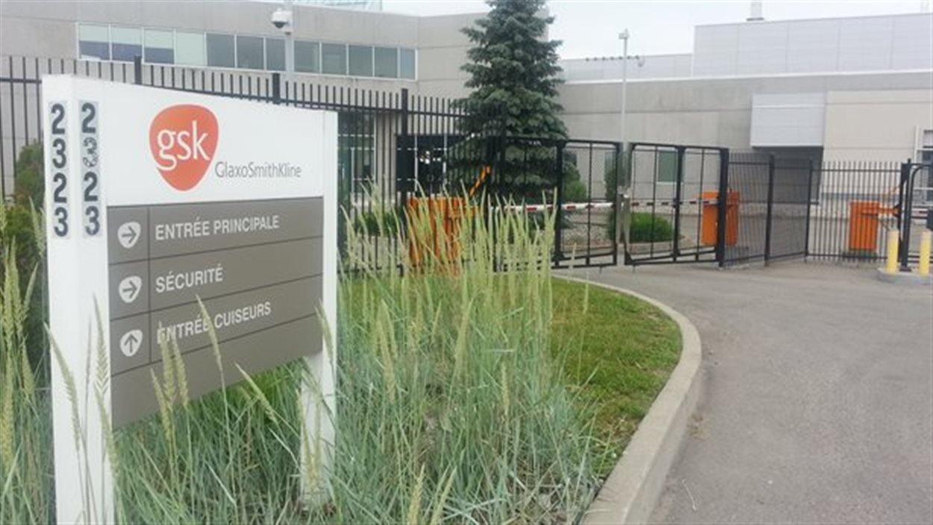
May 27 – H1N1 virus seed strain provided to GSK Canada to begin vaccine production at its facility in Quebec
Under the Canadian pandemic plan, GSK granted the full contract to supply pandemic influenza vaccine

Slide 53
July – Initial H1N1 vaccine production slowed by low yields, pushing first vaccine delivery to September/October
Globe & Mail, July 14, 2009, p. A6

Slide 54
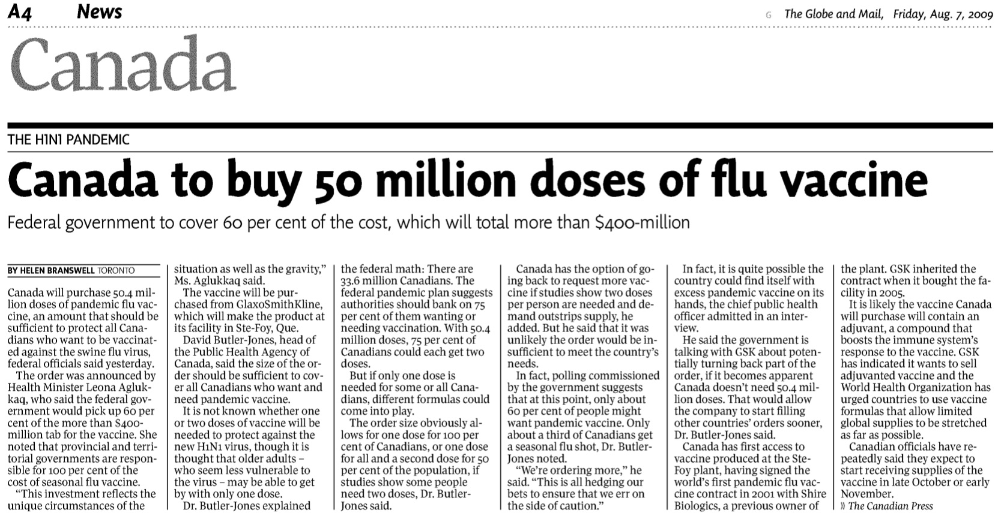
Aug 6 – Health Canada formally places order for 50.4 million doses at a total cost of $400 million (paid 60% federal gov’t/40% provinces)
The delays coupled with continuing spread of the pandemic, raised public expectations and many questions about the vaccine’s safety and effectiveness once given, especially if the pandemic had passed by then

Slide 55
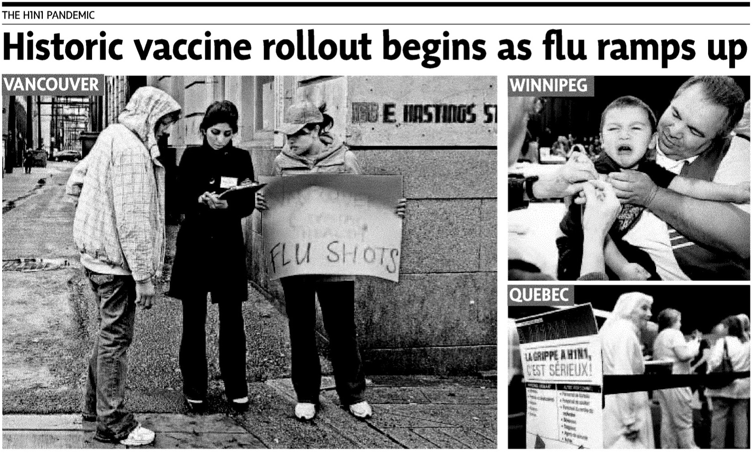
Oct 21 – Health Canada approves GSK’s H1N1 vaccine just as a second wave of H1N1 cases hit
Oct 26 – The first H1N1 immunization clinics open across Canada; the largest immunization effort in Canadian history
Globe & Mail, Oct 27, 2009, p. A1

Slide 56
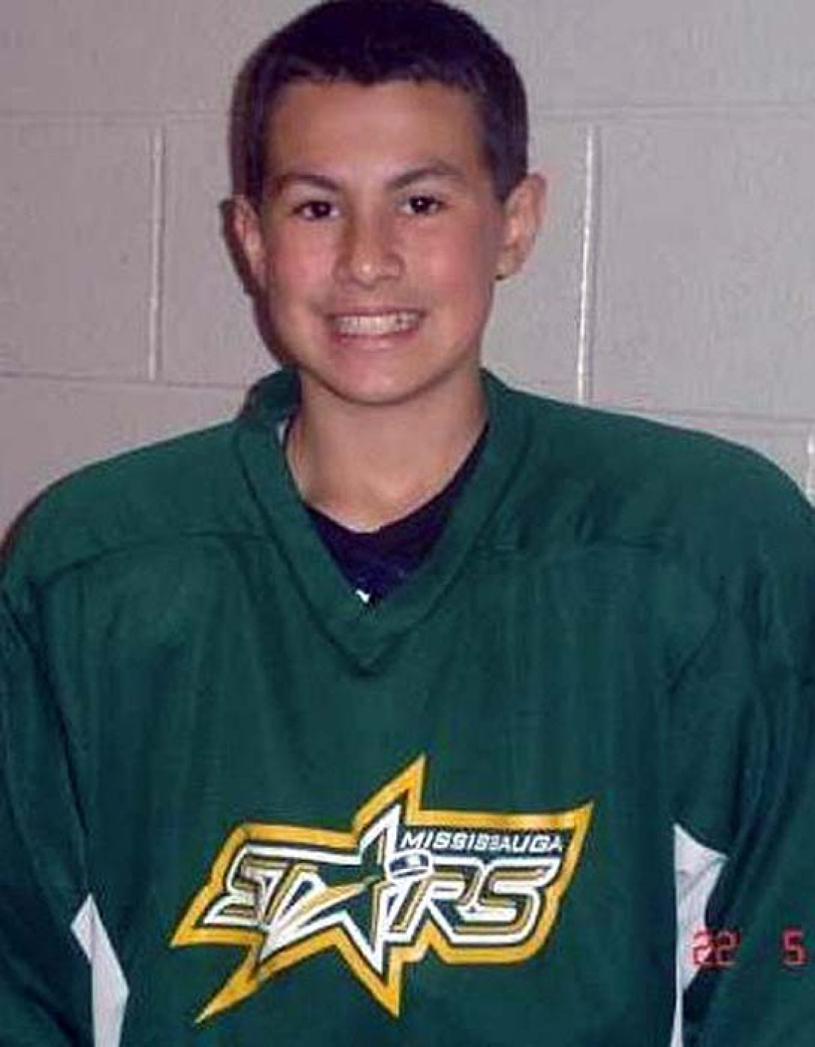
Oct 27 – Sudden death in Toronto of an otherwise “healthy as can be” 13-year-old boy due to H1N1 galvanized media and public attention to the threat of H1N1 and sharply boosted vaccine uptake
Globe & Mail, Oct 28, 2009, p. A17

Slide 57
Ultimately, only 40% of Canadians received the H1N1 vaccine, although it was one of the highest uptakes in the world
Globe & Mail, Oct 29, 2009, p. A1

Slide 58
This unprecedented effort also highlighted many issues, particularly related to the pandemic vaccine supply in Canada and the issue of vaccine hesitancy, especially among young adults
Globe & Mail, Nov 6, 2009, p. A1

Slide 59
Canada’s Emergency Vaccine Responses Legacy
Polio Vaccine
Highlights a strong and bold legacy of innovation and collaboration in vaccine development that persists in Canada
Also persistent, however, are limits in vaccine production capacity and efficiencies to meet the emergency challenges surrounding providing a potential COVID-19 vaccine(s)
Influenza 1918
Broad willingness to be bold in the face of a pandemic emergency and limited knowledge
Influenza 1957
Federal leadership to secure vaccine, yet limited capacity to produce it quickly
Influenza 1976
Heightened U.S./Canadian cross-border sensitivities surrounding potential pandemic threat and rapid large-scale vaccine response
Influenza 2009
Strong Canadian vaccine initiative complicated by slow production and roll-out that enabled public hesitations to grow

