Slide 1
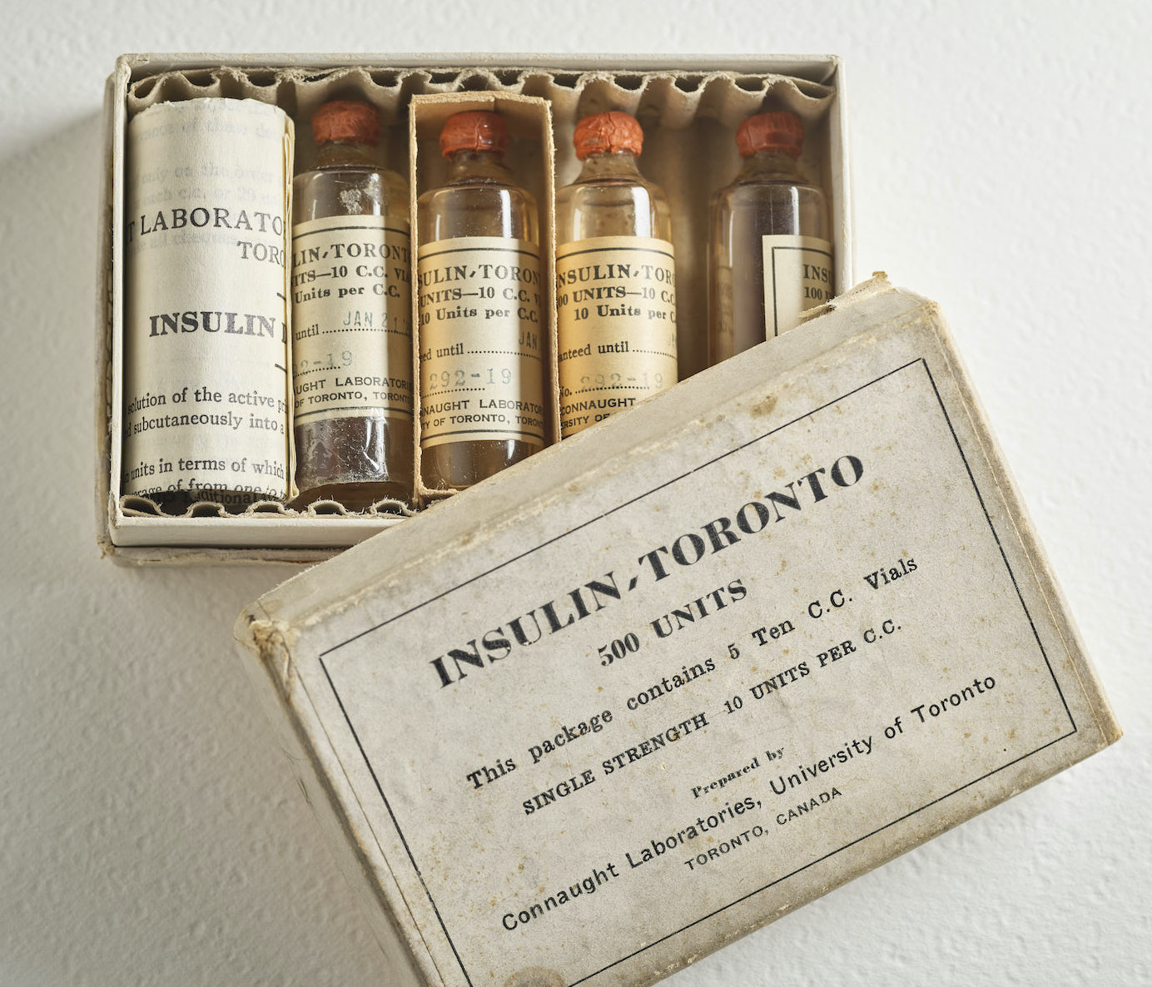
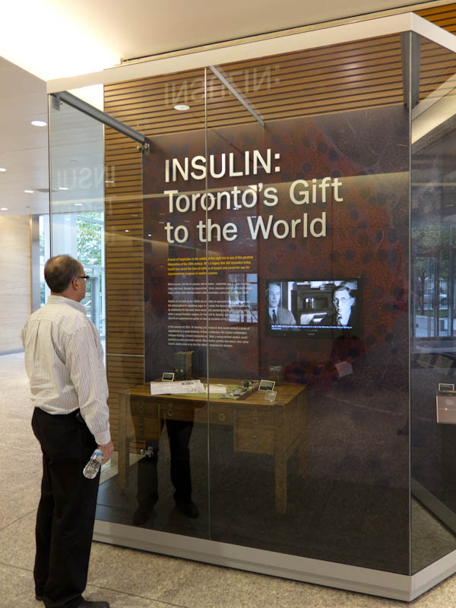
The Discovery of Insulin:
What is the Definitive History?
By Christopher J. Rutty, Ph.D.
Professional Medical/Public Health Historian
Health Heritage Research Services
http://healthheritageresearch.com
& Adjunct Professor
Dalla Lana School of Public Health,
University of Toronto
Emirates Diabetes Society, Insulin 100th Webinar
World Diabetes Day
November 14, 2020

Slide 2
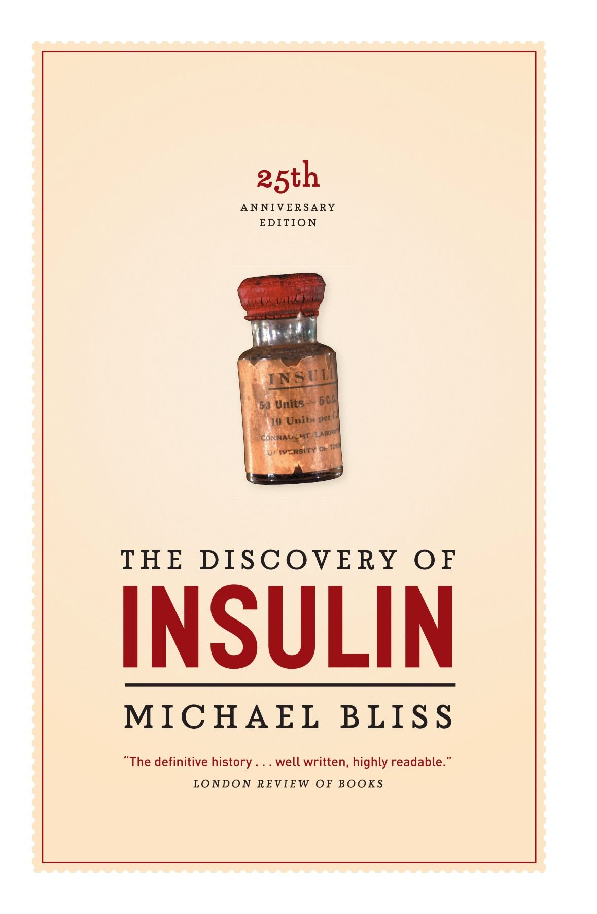
Introduction
I was asked to give a presentation about the discovery of insulin and answer the question:
What is the definitive history?
The short answer is quite easy
Michael Bliss’ book, The Discovery of Insulin, first published in 1982, certainly remains the definitive history
Although the late Professor Bliss was my Ph.D. supervisor, colleague, friend, and at times my unofficial agent, I’m aware of no other histories that challenge its authority
What I would like to do is recount key parts of the discovery story and highlight the many unique challenges of transitioning from the discovery of insulin to its development and production in order to expedite its equitable accessibility to diabetics globally
C.J. Rutty – “The Discovery of Insulin: What is the Definitive History?” – Insulin 100th Webinar, Emirate Diabetes Society, World Diabetes Day, Nov 14, 2020

Slide 3
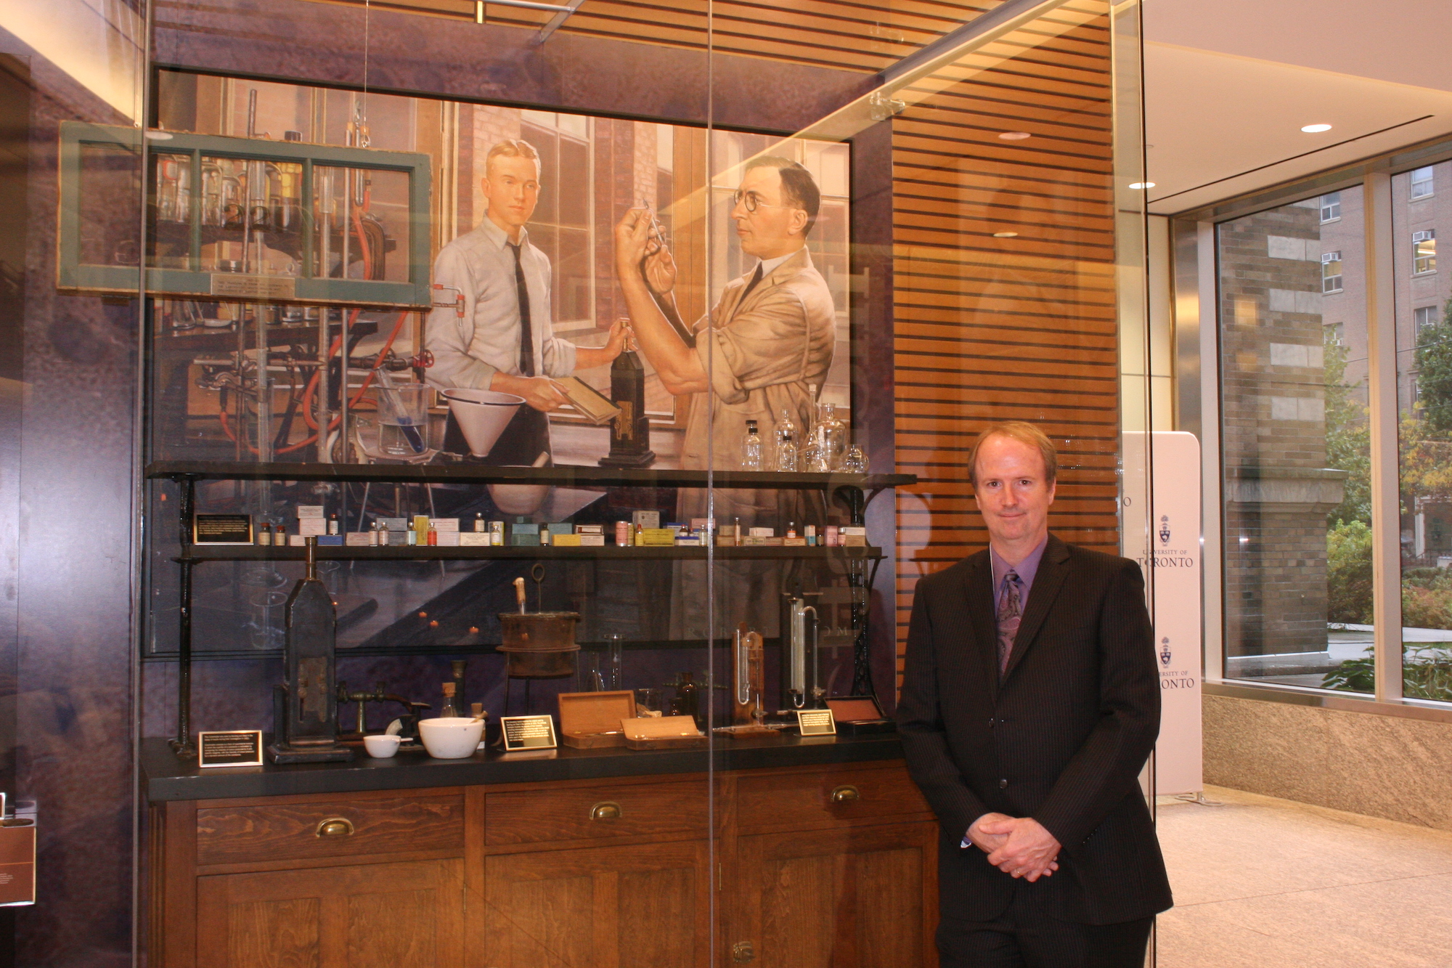
Introduction
My Ph.D. with Prof. Bliss was about the history of polio in Canada, not insulin
Since 1996 - Insulin 75th – I’ve conducted my own insulin historical research and curated several exhibits, such as “Insulin: Toronto’s Gift to the World” for the University of Toronto Faculty of Medicine to mark the Insulin 90th
C.J. Rutty – “The Discovery of Insulin: What is the Definitive History?” – Insulin 100th Webinar, Emirate Diabetes Society, World Diabetes Day, Nov 14, 2020

Slide 4
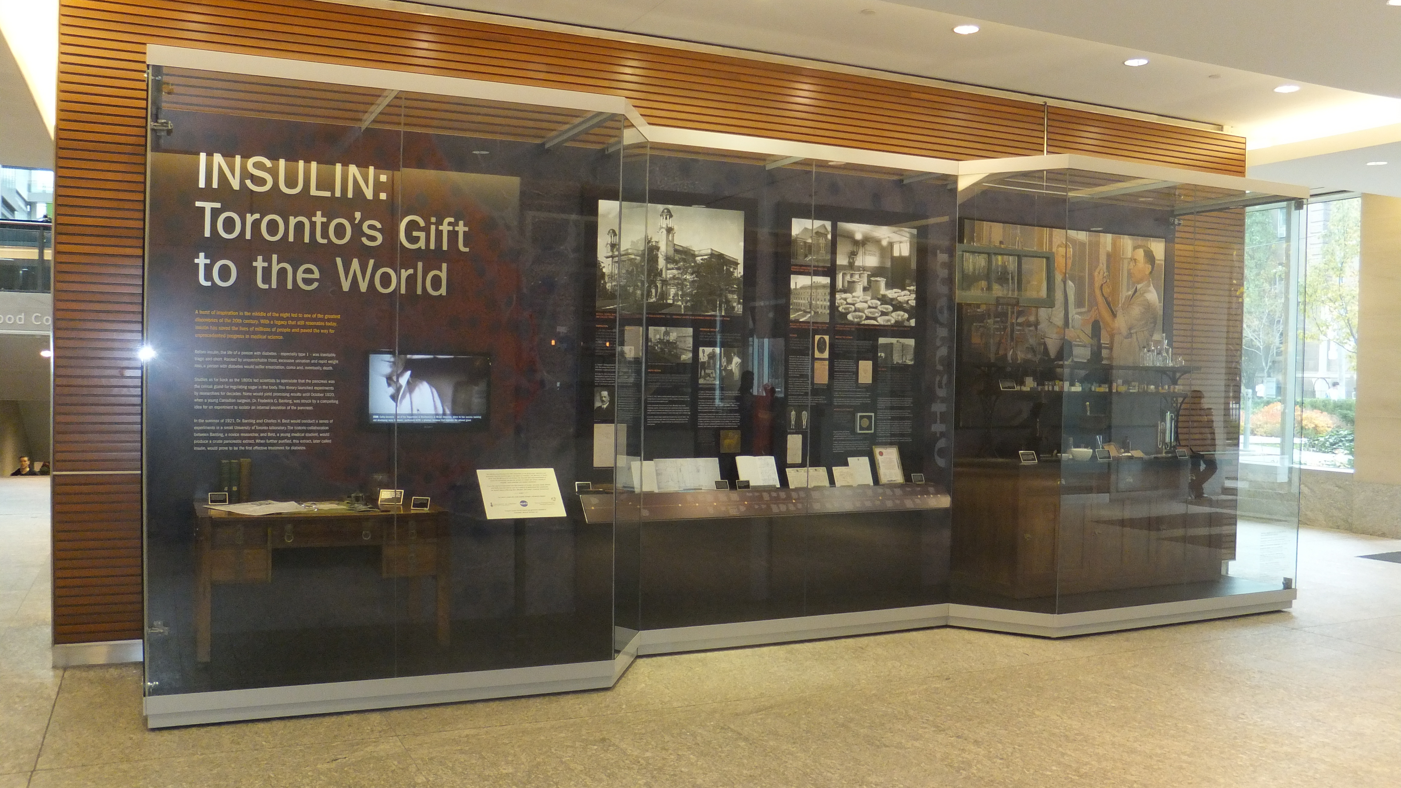
Introduction
My Ph.D. with Prof. Bliss was about the history of polio in Canada, not insulin
Since 1996 - Insulin 75th – I’ve conducted my own insulin historical research and curated several exhibits, such as “Insulin: Toronto’s Gift to the World” for the University of Toronto Faculty of Medicine to mark the Insulin 90th
C.J. Rutty – “The Discovery of Insulin: What is the Definitive History?” – Insulin 100th Webinar, Emirate Diabetes Society, World Diabetes Day, Nov 14, 2020

Slide 5
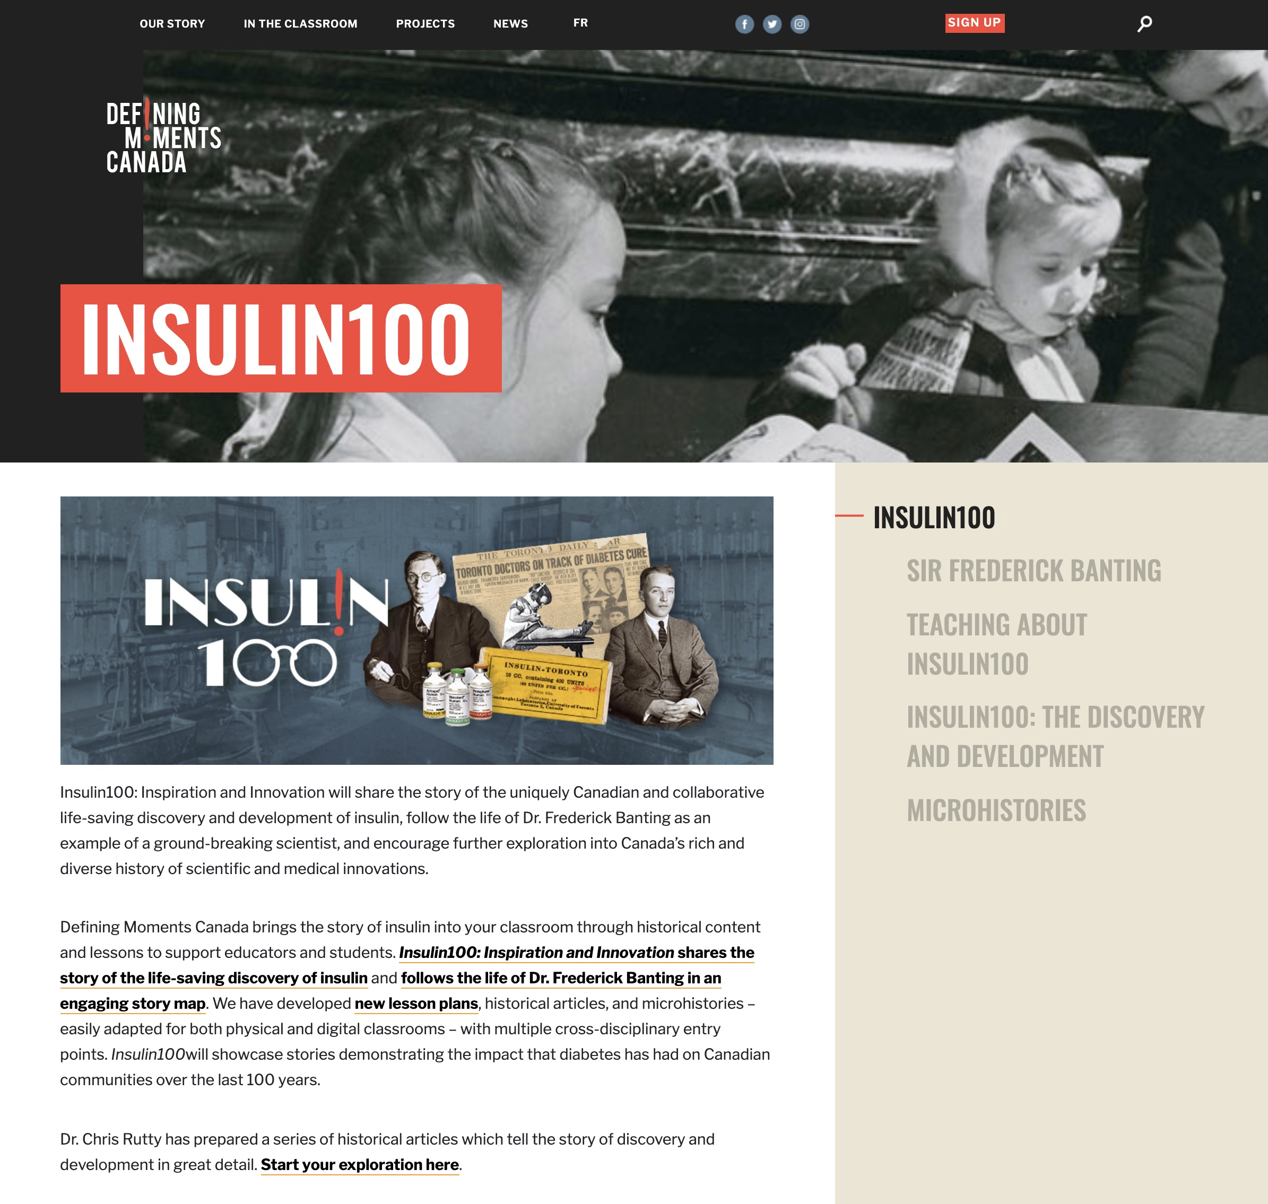
Introduction
I’m currently working as “Lead Historian” for the Defining Moments Canada “Insulin 100” national digital commemoration project
My work has recently been focused on preparing a series of 14 articles that provide the core historical content for the site’s online exhibition
Currently, the first 8 of the 14 articles are posted
https://definingmomentscanada.ca/insulin100/
C.J. Rutty – “The Discovery of Insulin: What is the Definitive History?” – Insulin 100th Webinar, Emirate Diabetes Society, World Diabetes Day, Nov 14, 2020

Slide 6
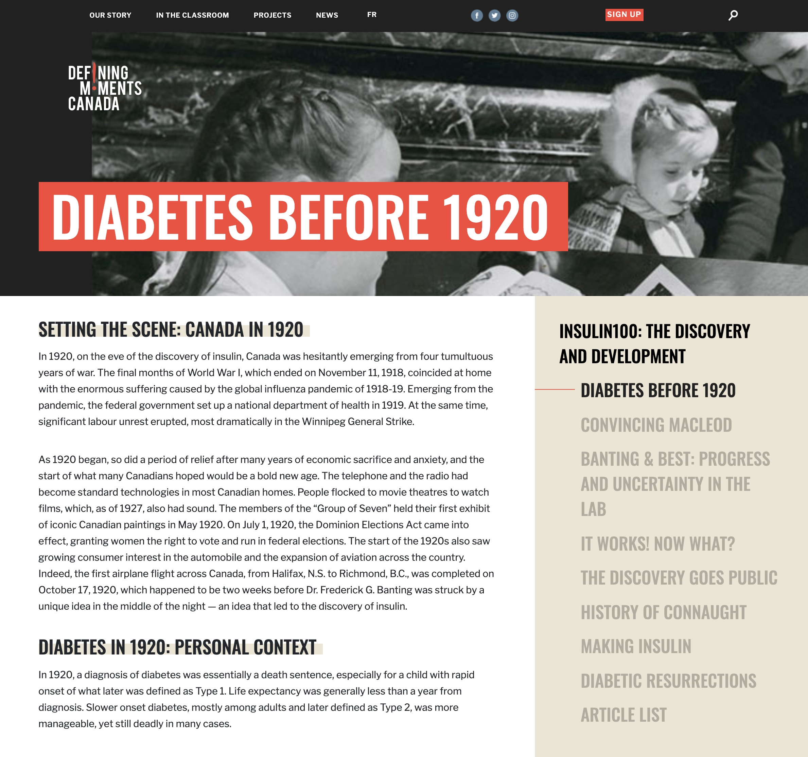
Introduction
I’m currently working as “Lead Historian” for the Defining Moments Canada “Insulin 100” national digital commemoration project
My work has recently been focused on preparing a series of 14 articles that provide the core historical content for the site’s online exhibition
Currently, the first 8 of the 14 articles are posted
Coming soon:
”Patent Protection”
”Eli Lilly”
”Making Insulin 2”
”Novo Nordisk”
”Nobel Prize: Canada’s Gift to the World”
”Better Insulin, Nothing Better Than Insulin”
https://definingmomentscanada.ca/insulin100/timeline/context/
C.J. Rutty – “The Discovery of Insulin: What is the Definitive History?” – Insulin 100th Webinar, Emirate Diabetes Society, World Diabetes Day, Nov 14, 2020

Slide 7
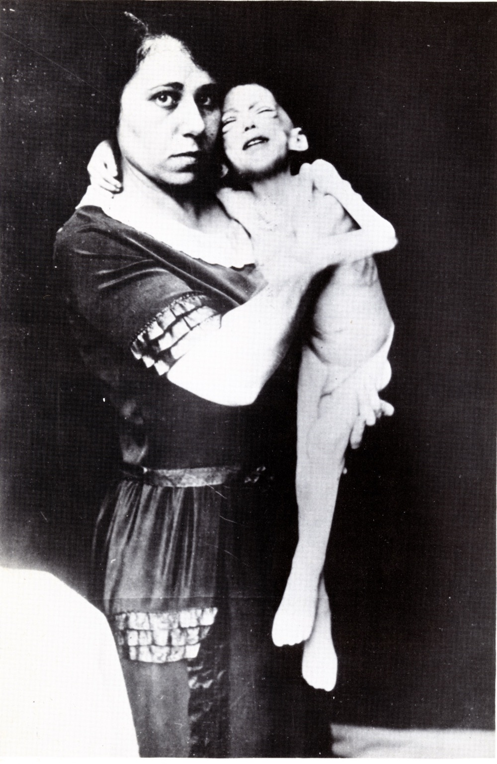
Deadly Diabetes, Before Insulin
Before Insulin, the life of a person with diabetes, especially a child with type 1, was inevitably tragic and short, dominated by unquenchable thirst, starvation diets and a body that ultimately feeds on itself
Beyond strict dietary control, very little could be done to prevent death, despite the claims of patent medicines and others offering dubious cures
C.J. Rutty – “The Discovery of Insulin: What is the Definitive History?” – Insulin 100th Webinar, Emirate Diabetes Society, World Diabetes Day, Nov 14, 2020

Slide 8
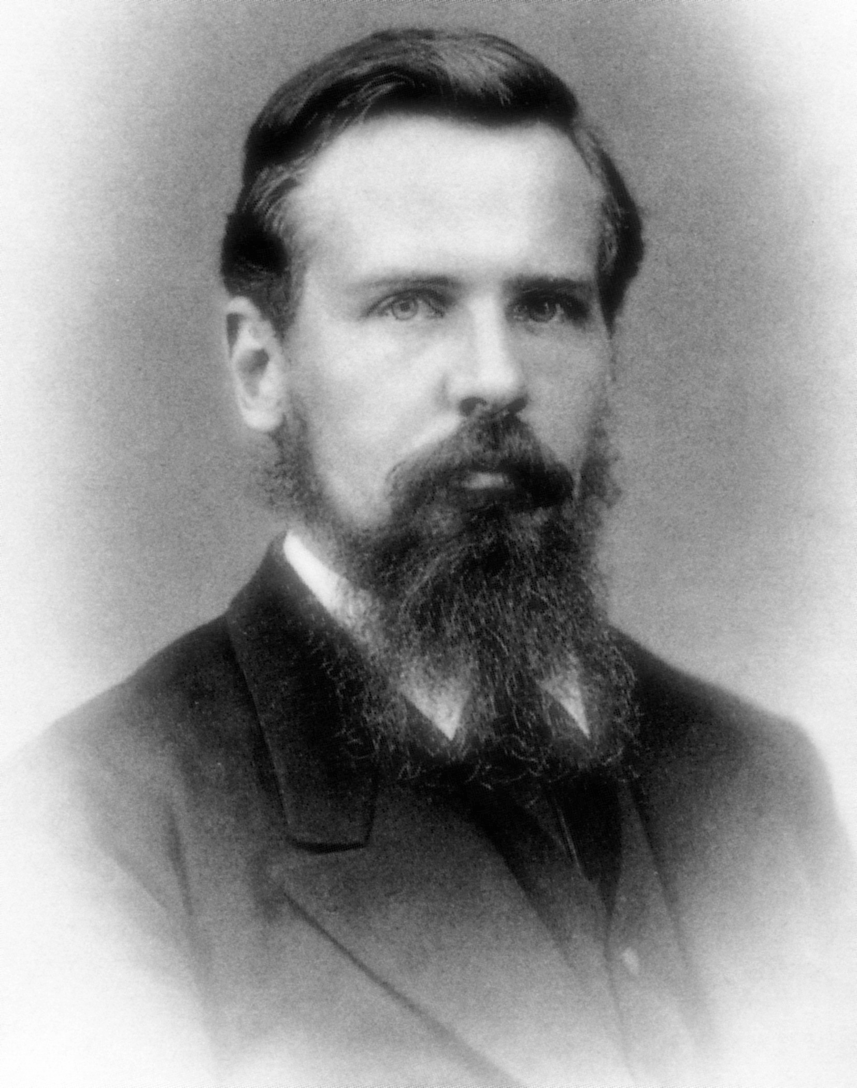
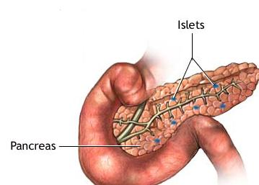
Deadly Diabetes, Before Insulin
250 B.C. – First use of “diabetes” (from the Greek “to pass through”)
1675 – “diabetes mellitus” term first used (“mellitus” Latin for honey or sweet)
1869 – Paul Langerhans (right) identifies “insulin”-producing “islets of Langerhans” in pancreas
1889 – Role of pancreas in diabetes discovered; diabetes developed in dogs when pancreas removed
1910 – Discovered that diabetes caused by the lack of “insulin” in the pancreas
This work led researchers to conduct a variety of insulin extraction experiments, but with none yielding promising results until a young Canadian surgeon was struck by a compelling idea in October 1920
C.J. Rutty – “The Discovery of Insulin: What is the Definitive History?” – Insulin 100th Webinar, Emirate Diabetes Society, World Diabetes Day, Nov 14, 2020

Slide 9
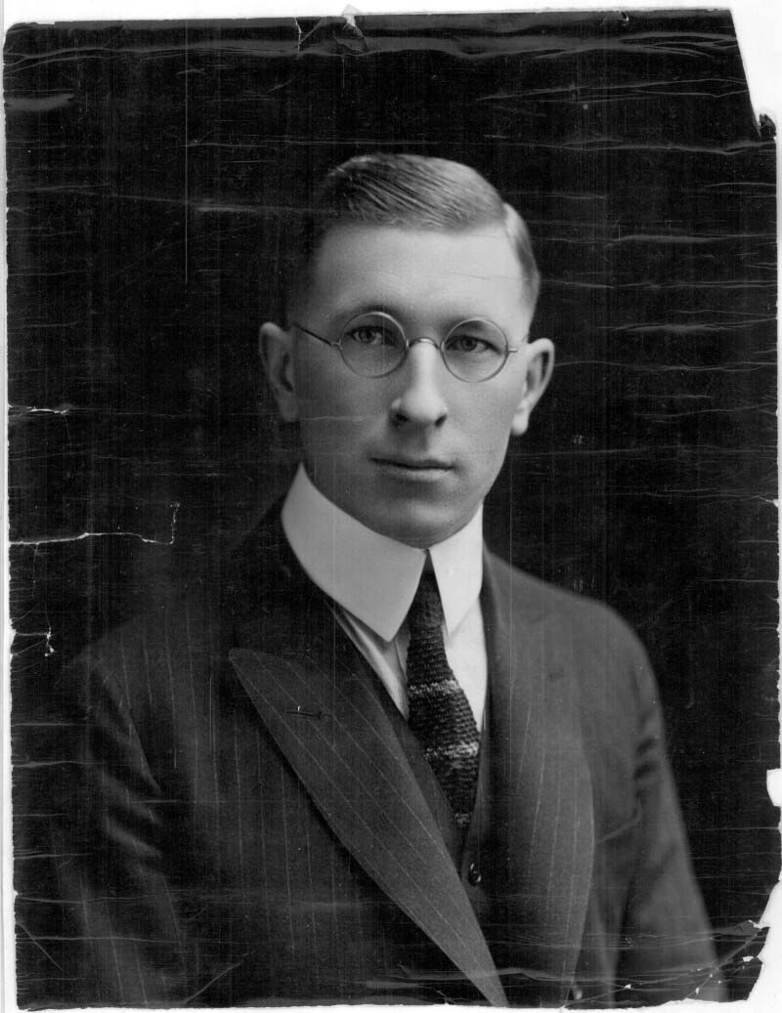
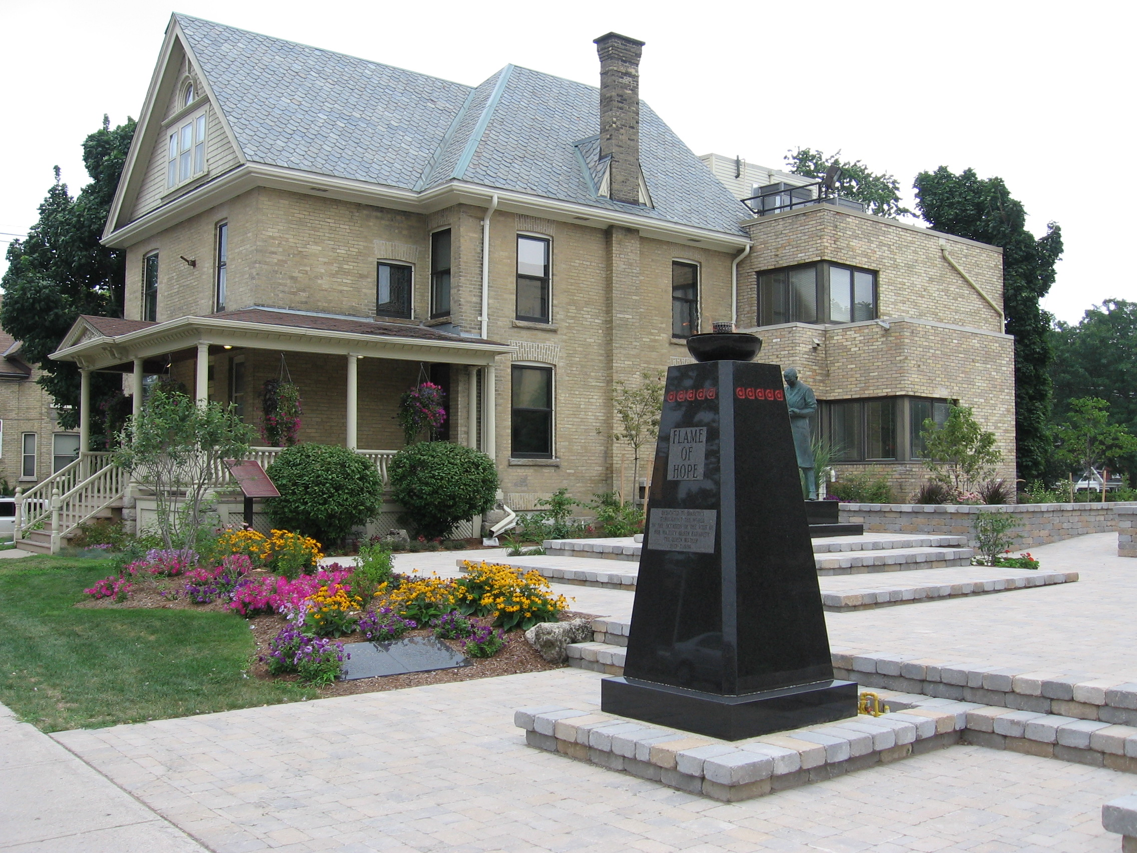
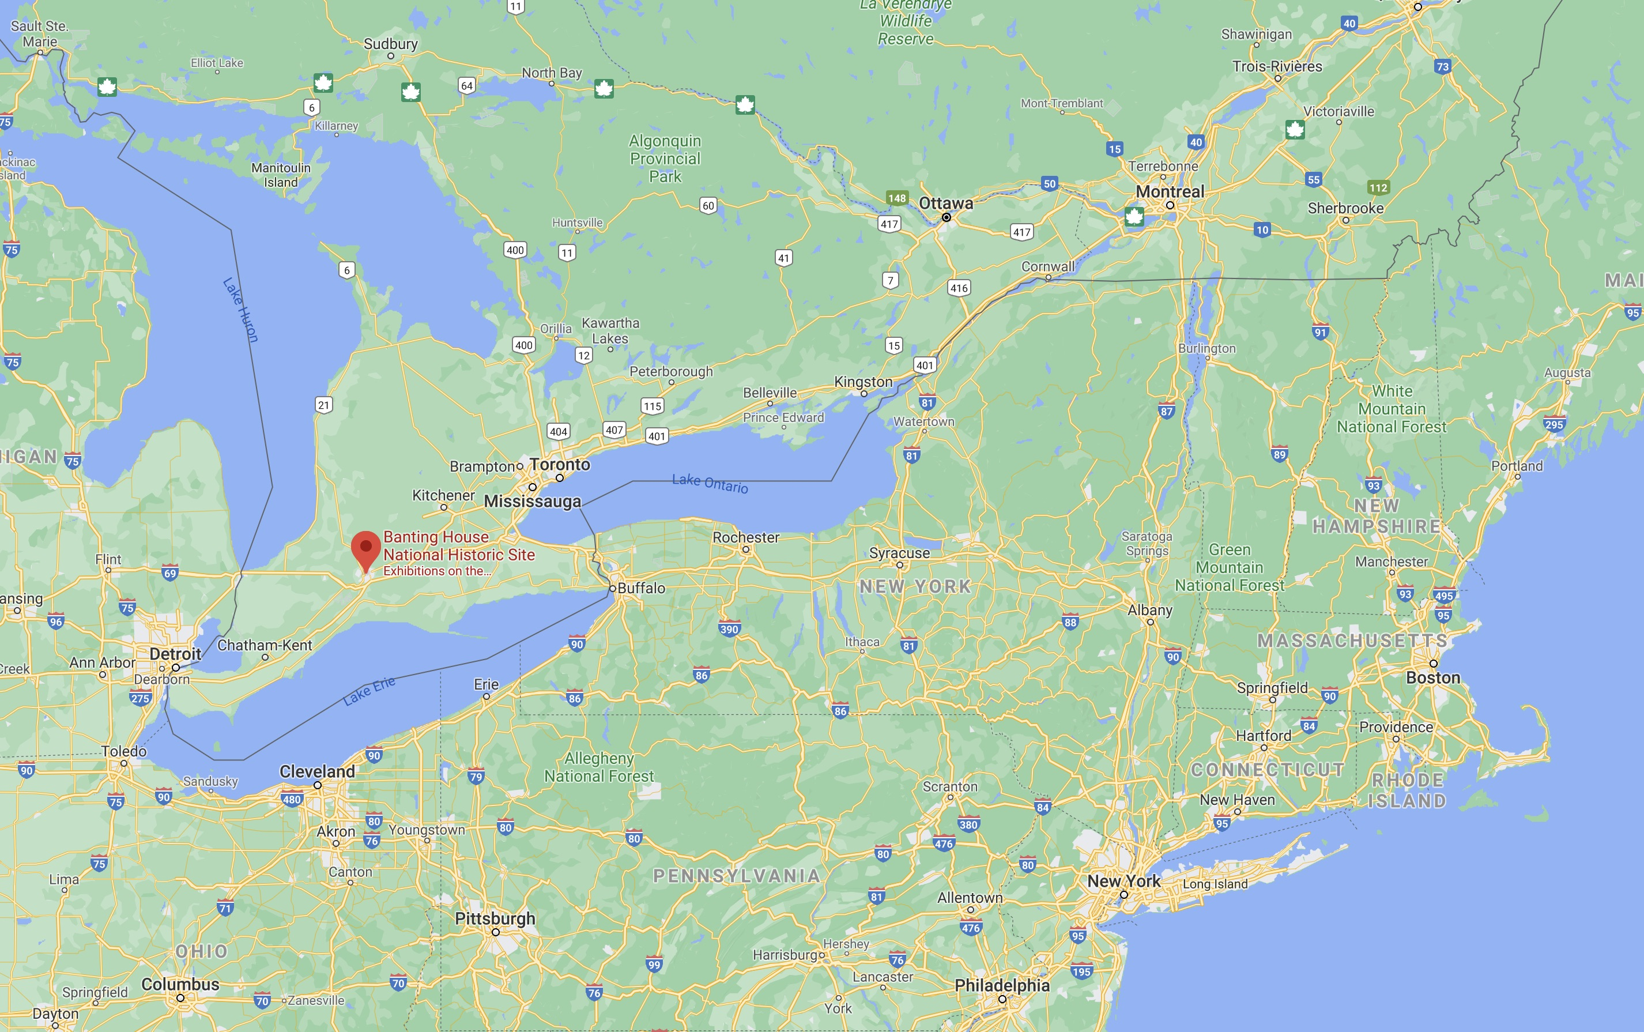
Banting’s Idea
Oct. 31, 1920 (2:00 am) - The Insulin story began in London, Ontario, when Dr. Frederick Banting awoke with a compelling idea…
Toronto
London, ON
New York City
C.J. Rutty – “The Discovery of Insulin: What is the Definitive History?” – Insulin 100th Webinar, Emirate Diabetes Society, World Diabetes Day, Nov 14, 2020

Slide 10
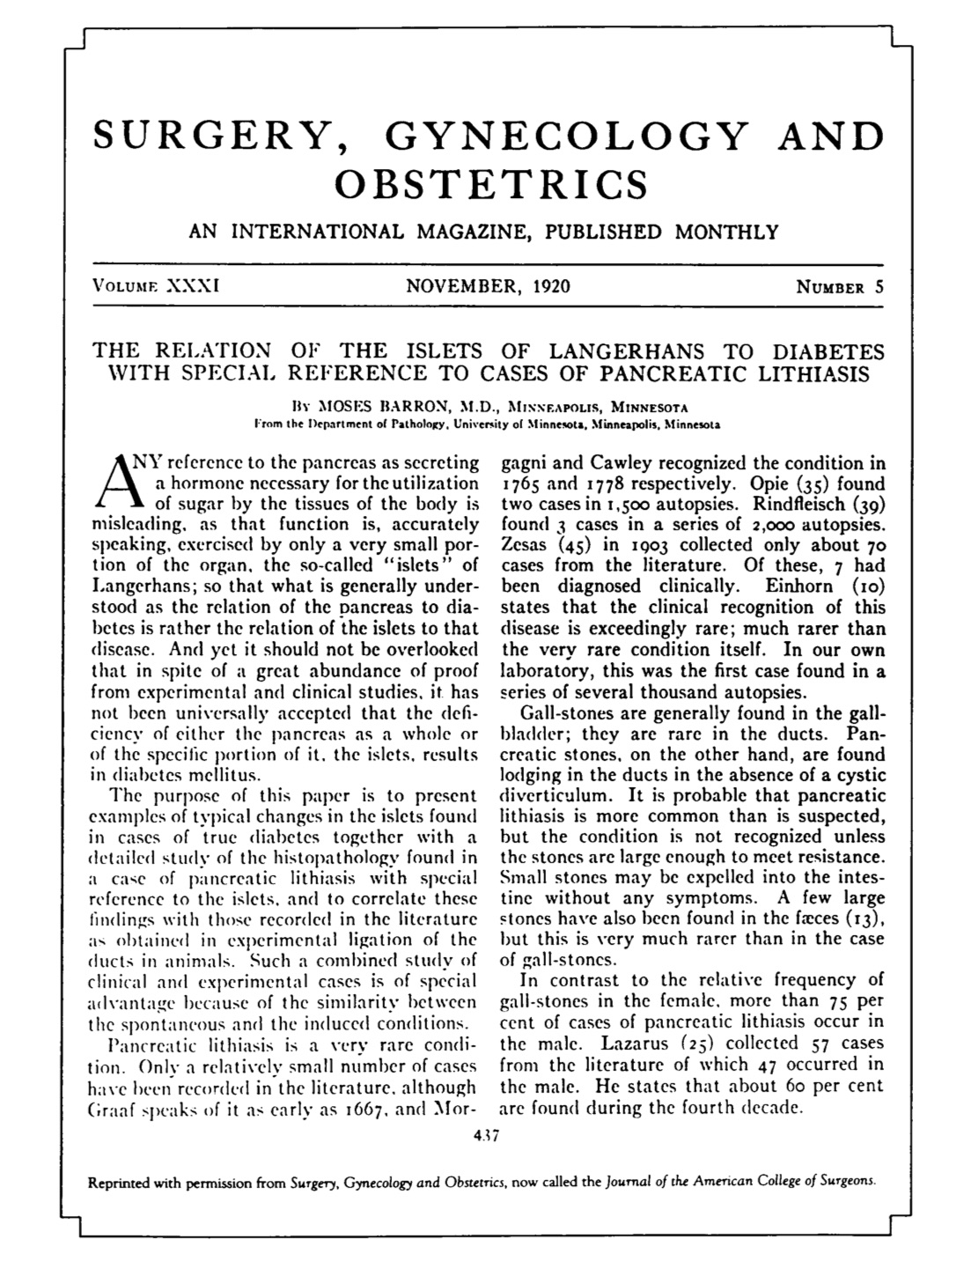
Banting’s Idea
Banting had read an article by Moses Baron about the pancreas for a lecture he was preparing at the University of Western Ontario about carbohydrate metabolism
Baron discussed a rare case of formation of a pancreatic stone that completely obstructed the main pancreatic duct
The blocked duct led to atrophy of the main pancreatic tissue, but the internal islet cells survived
Baron noted that the effect of the blocked duct was similar to the effect of ligating, or tying off the duct, and supported the hypothesis that the health of the islet cells was the key factor in the development of diabetes
C.J. Rutty – “The Discovery of Insulin: What is the Definitive History?” – Insulin 100th Webinar, Emirate Diabetes Society, World Diabetes Day, Nov 14, 2020

Slide 11
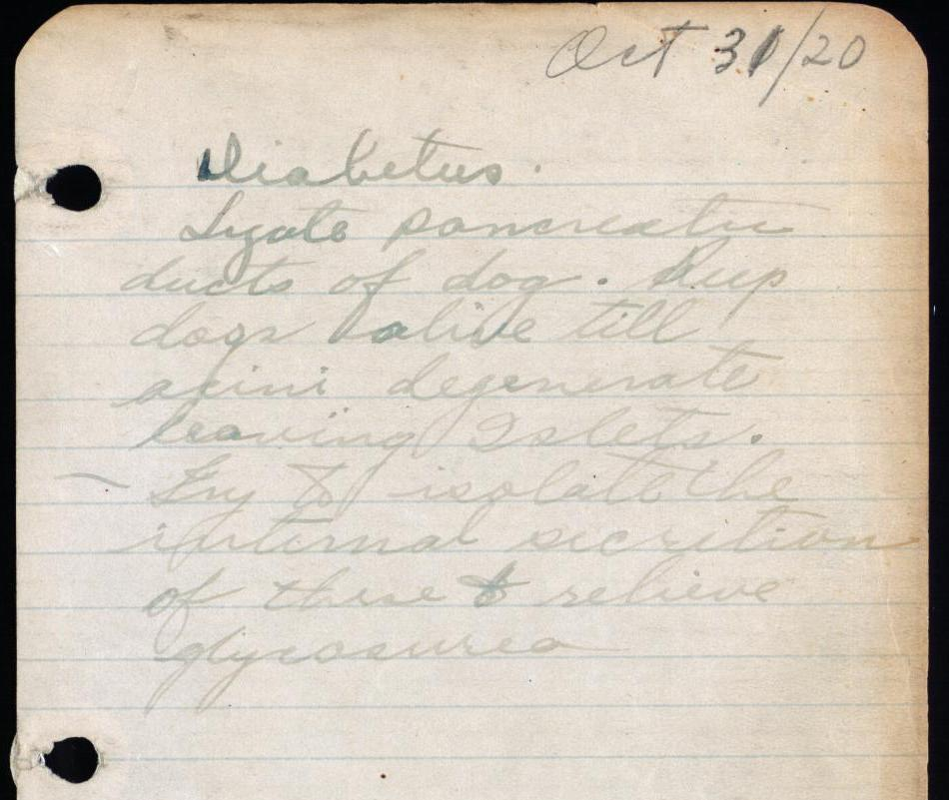
Banting’s Idea
https://insulin.library.utoronto.ca/
Banting fell asleep after reading this article, and also after studying about carbohydrate metabolism and diabetes
At about 2:00 am he suddenly woke up with an idea for a novel surgical method and experiment to isolate the internal secretion from the pancreas that might control diabetes
He jotted down in a notebook,
“Diabetus: Ligate pancreatic ducts of dog. Keep dogs alive till acini degenerate leaving Islets. Try to isolate the internal secretion of these and relieve glycosurea”
C.J. Rutty – “The Discovery of Insulin: What is the Definitive History?” – Insulin 100th Webinar, Emirate Diabetes Society, World Diabetes Day, Nov 14, 2020

Slide 12
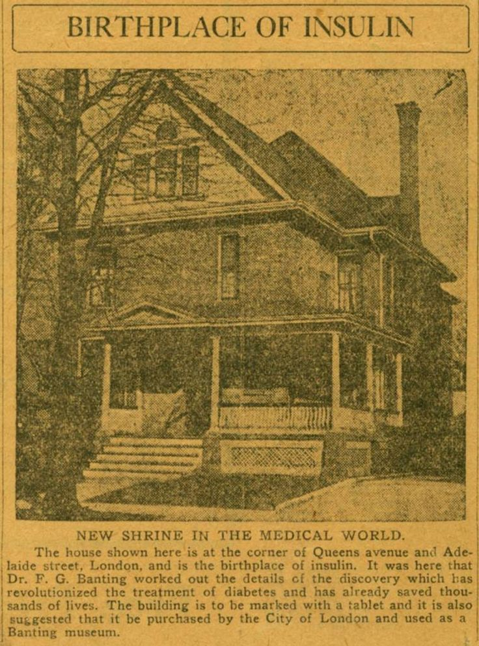
Banting’s Idea
Born on November 14, 1891 (now World Diabetes Day) in Alliston, Ontario, Dr. Frederick G. Banting brought a surgeon’s perspective to the problem of diabetes
1912 - He entered the University of Toronto and graduated with an expedited class because of WWI
After the war, he worked at the Hospital for Sick Children in Toronto before moving to London, Ontario
1920 - Banting started his own practice, but lack of patients led him to work as a demonstrator in the University of Western Ontario medical school’s physiology department
https://bantinghousenhsc.wordpress.com/
C.J. Rutty – “The Discovery of Insulin: What is the Definitive History?” – Insulin 100th Webinar, Emirate Diabetes Society, World Diabetes Day, Nov 14, 2020

Slide 13
Banting’s Idea
Today, Banting’s London home and medical practice in 1920 is known as “Banting House,” which includes a museum and a diabetes education centre operated by Diabetes Canada
A prominent feature of Banting House is the “Flame of Hope,” which will burn until a cure for diabetes is found
https://bantinghousenhsc.wordpress.com/
C.J. Rutty – “The Discovery of Insulin: What is the Definitive History?” – Insulin 100th Webinar, Emirate Diabetes Society, World Diabetes Day, Nov 14, 2020

Slide 14
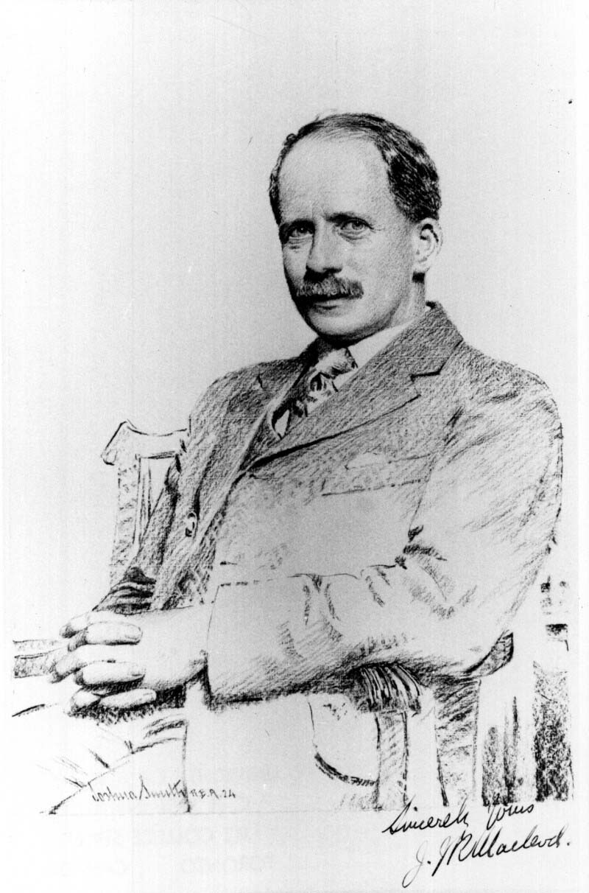
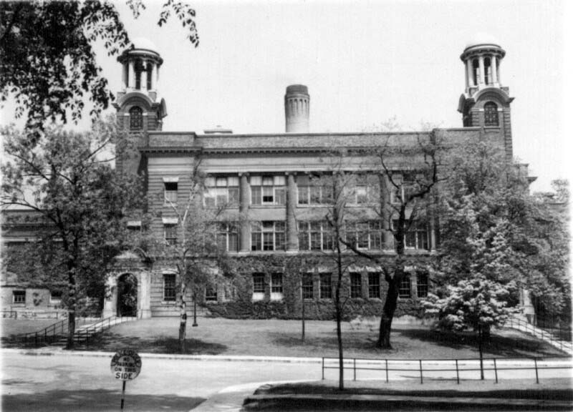
Banting’s Idea
Nov. 6, 1920 – Banting took his idea to the University of Toronto and presented it to Dr. J.J.R. Macleod, Professor of Physiology and a specialist in the study of diabetes
Early 1920s - The University of Toronto an ideal institution in which Banting could develop his idea, with its Medical Building, built in 1903, specially designed to support scientific research
C.J. Rutty – “The Discovery of Insulin: What is the Definitive History?” – Insulin 100th Webinar, Emirate Diabetes Society, World Diabetes Day, Nov 14, 2020

Slide 15
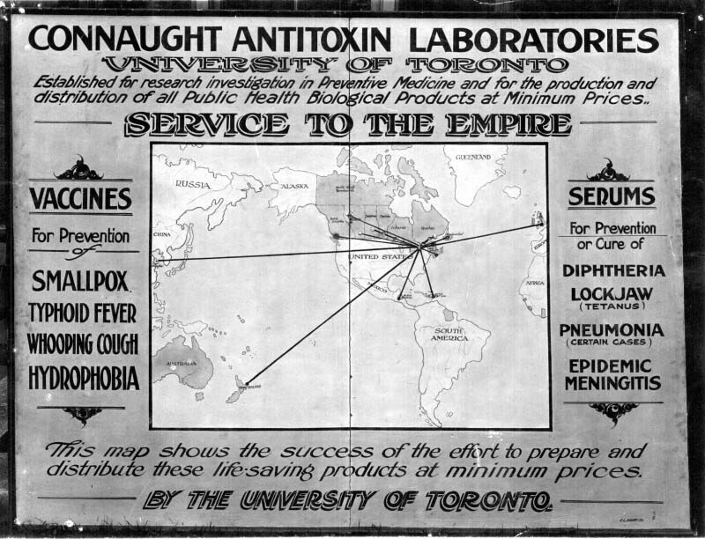
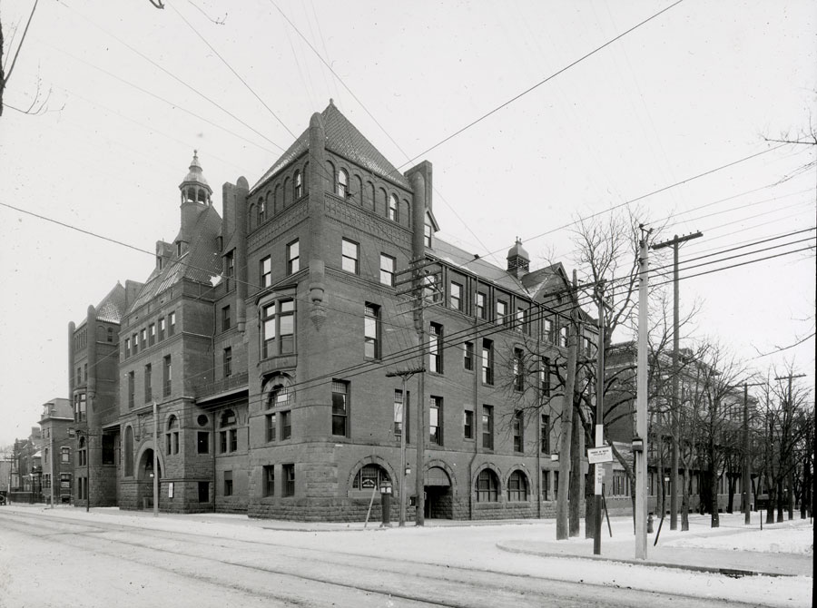
Banting’s Idea
U of T stood at the centre of a uniquely linked group of medical and scientific institutions -- Toronto General Hospital (r), the Hospital for Sick Children (l), and its singular public health biologicals producer, Connaught Antitoxin Laboratories -- each ready to play key roles in the insulin story
Sanofi Pasteur Canada Archives
C.J. Rutty – “The Discovery of Insulin: What is the Definitive History?” – Insulin 100th Webinar, Emirate Diabetes Society, World Diabetes Day, Nov 14, 2020

Slide 16
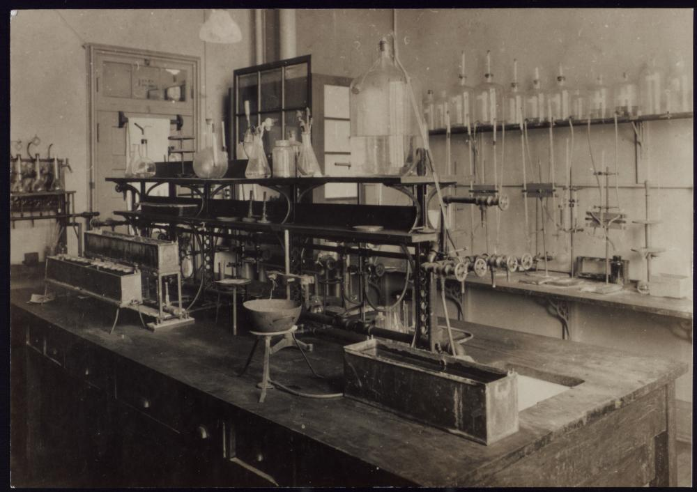
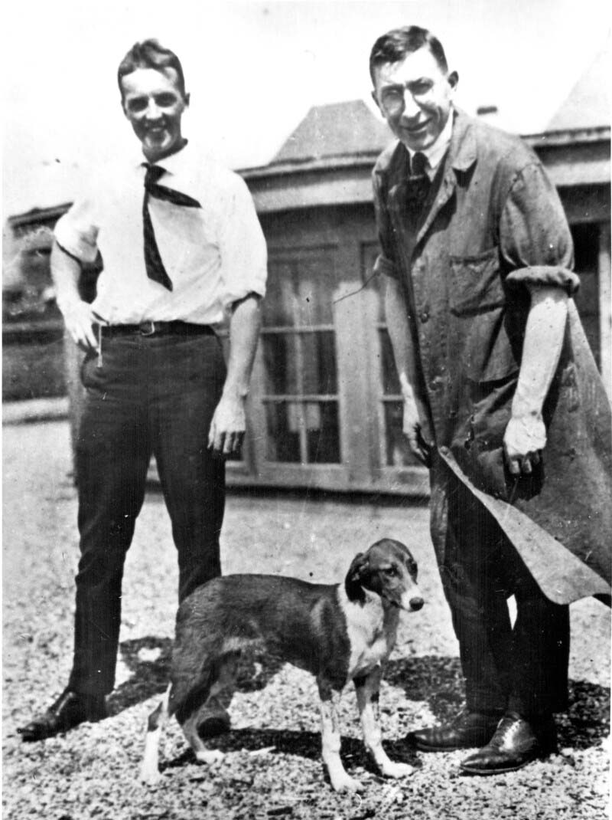
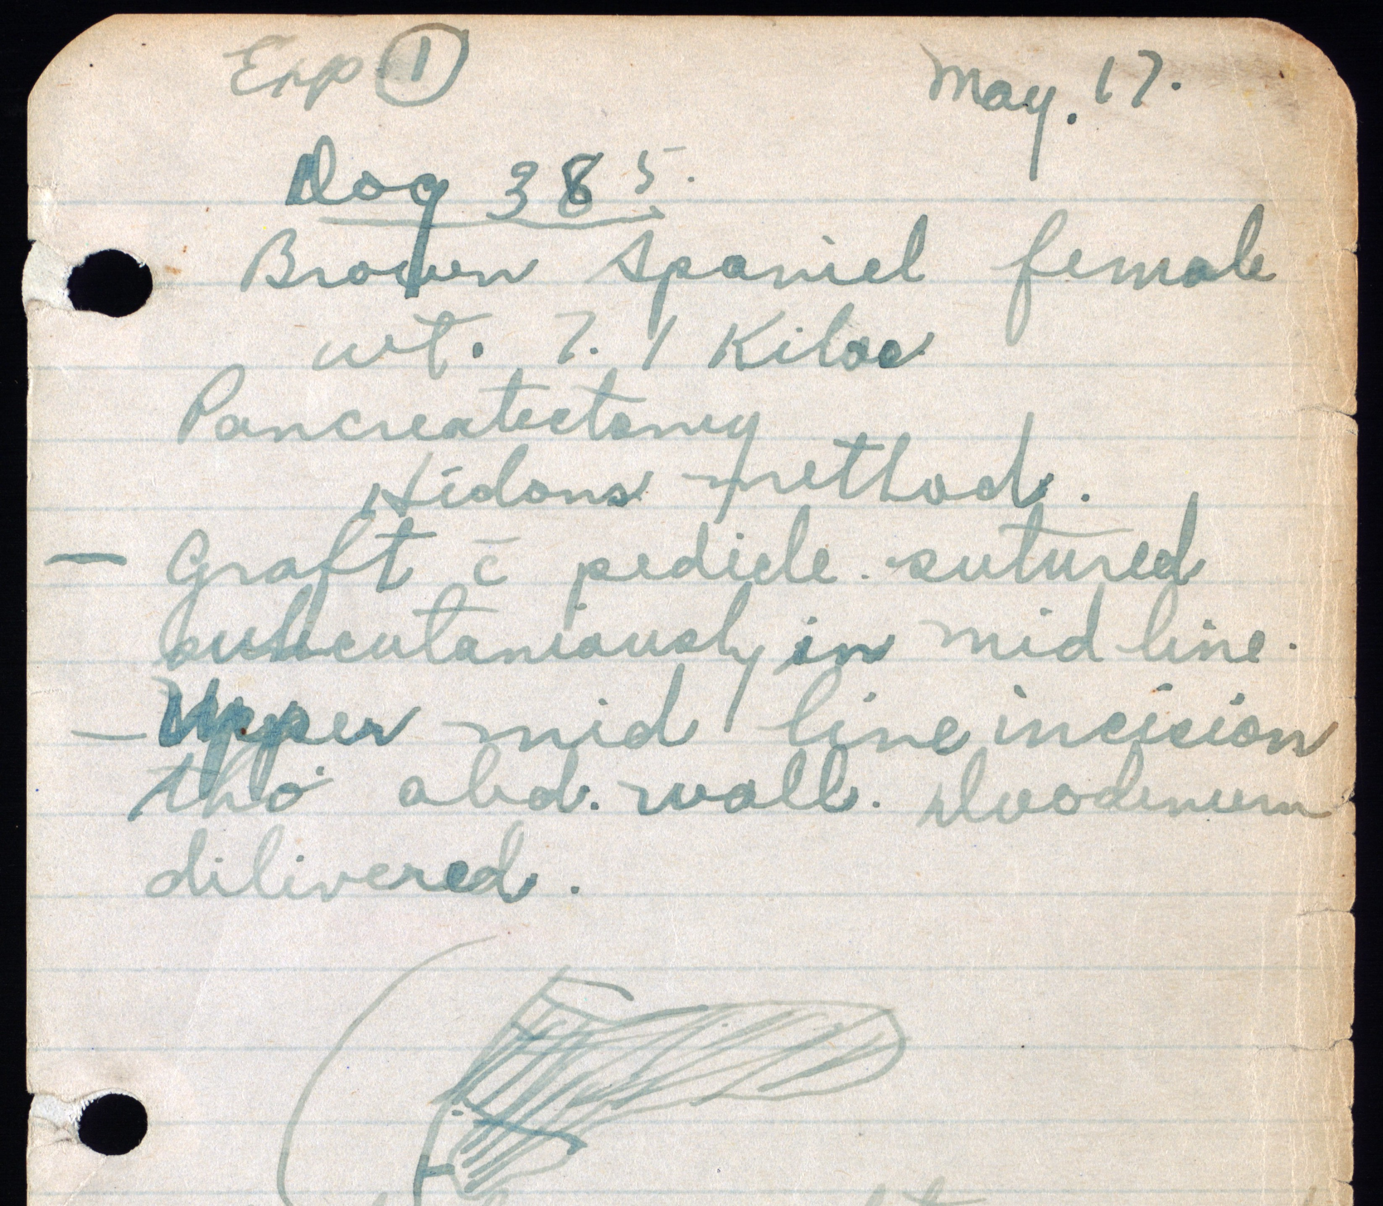
Discovering Insulin in Toronto
https://insulin.library.utoronto.ca/
After meeting Macleod, who was intrigued, though skeptical, Banting was soon given a small lab, access to experimental dogs, a $100 budget, and the assistance of Charles Best, a recent graduate in Physiology and Biochemistry
They got started on May 17, 1921
C.J. Rutty – “The Discovery of Insulin: What is the Definitive History?” – Insulin 100th Webinar, Emirate Diabetes Society, World Diabetes Day, Nov 14, 2020

Slide 17
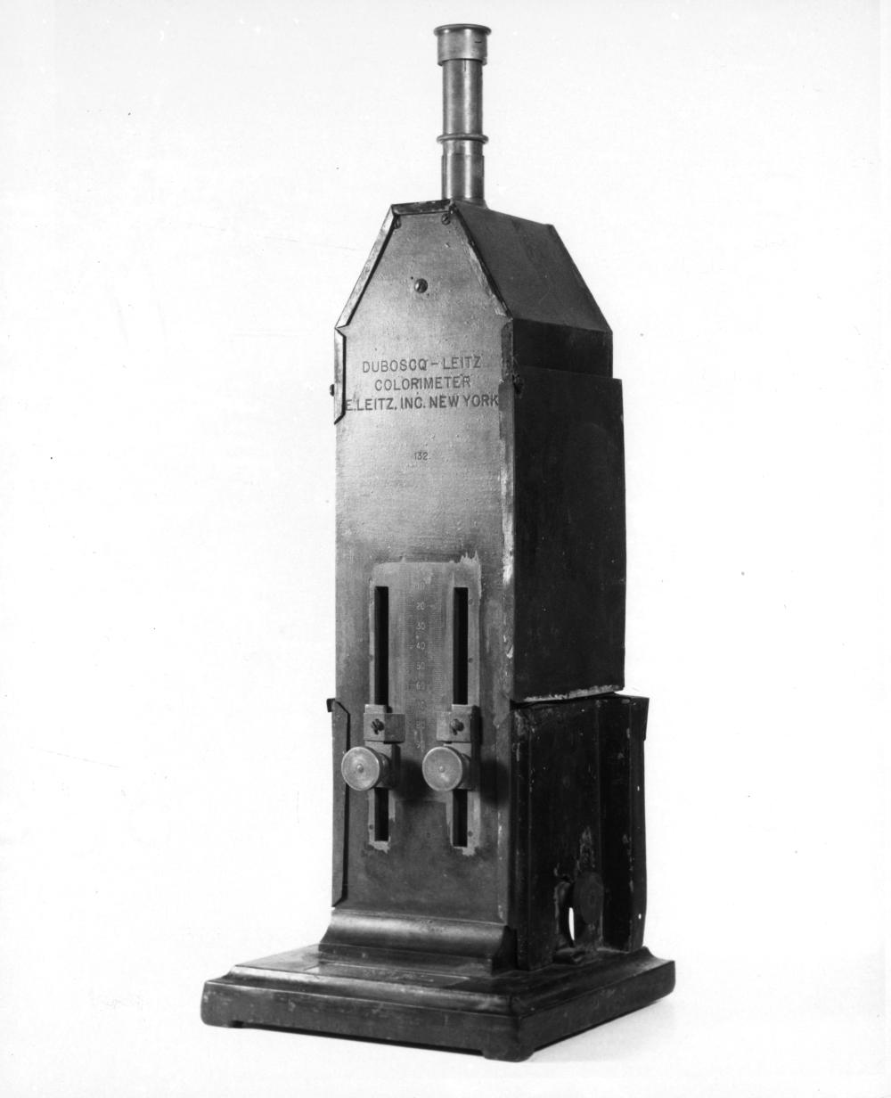
Discovering Insulin in Toronto
May-Aug 1921 – During an especially hot summer, Banting and Best reported encouraging results with a pancreatic extract controlling blood sugar levels in de-pancreatized dogs.
https://insulin.library.utoronto.ca/
C.J. Rutty – “The Discovery of Insulin: What is the Definitive History?” – Insulin 100th Webinar, Emirate Diabetes Society, World Diabetes Day, Nov 14, 2020

Slide 18
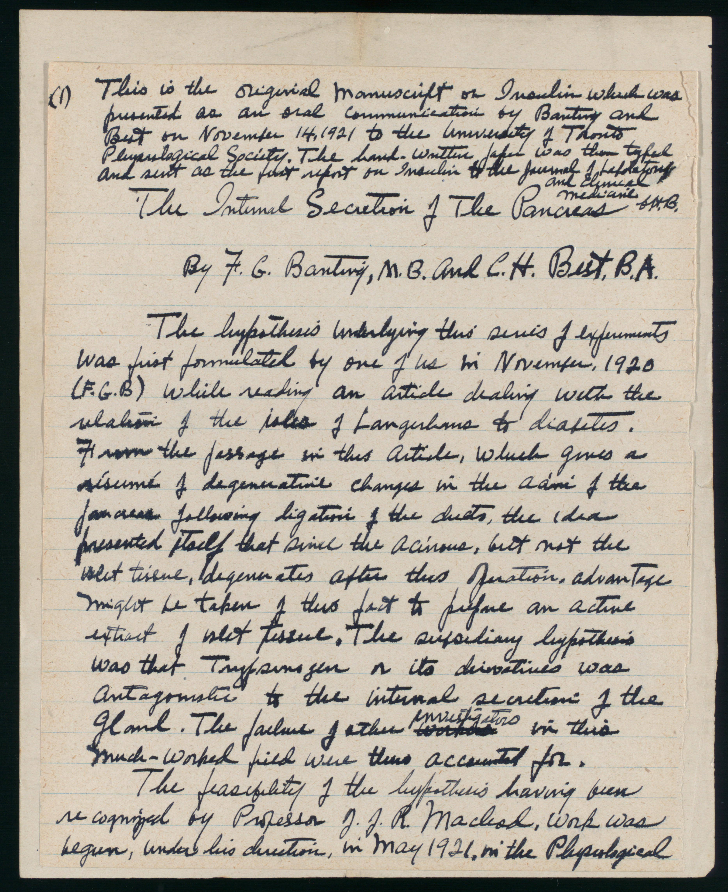
Discovering Insulin in Toronto
https://insulin.library.utoronto.ca/
Nov 14, 1921 – Banting and Best – on Banting’s 30th birthday -- gave the first presentation about their pancreatic extract research to the Journal Club of the U of T Department of Physiology
The presentation prompted a suggestion of a longevity experiment with the extract given regularly to a diabetic dog over an extended period
But where would the extract come from?
The duct-ligation process was time consuming and expensive on several levels, not least of which involved the reliance on dogs
There had to be a better way
C.J. Rutty – “The Discovery of Insulin: What is the Definitive History?” – Insulin 100th Webinar, Emirate Diabetes Society, World Diabetes Day, Nov 14, 2020

Slide 19
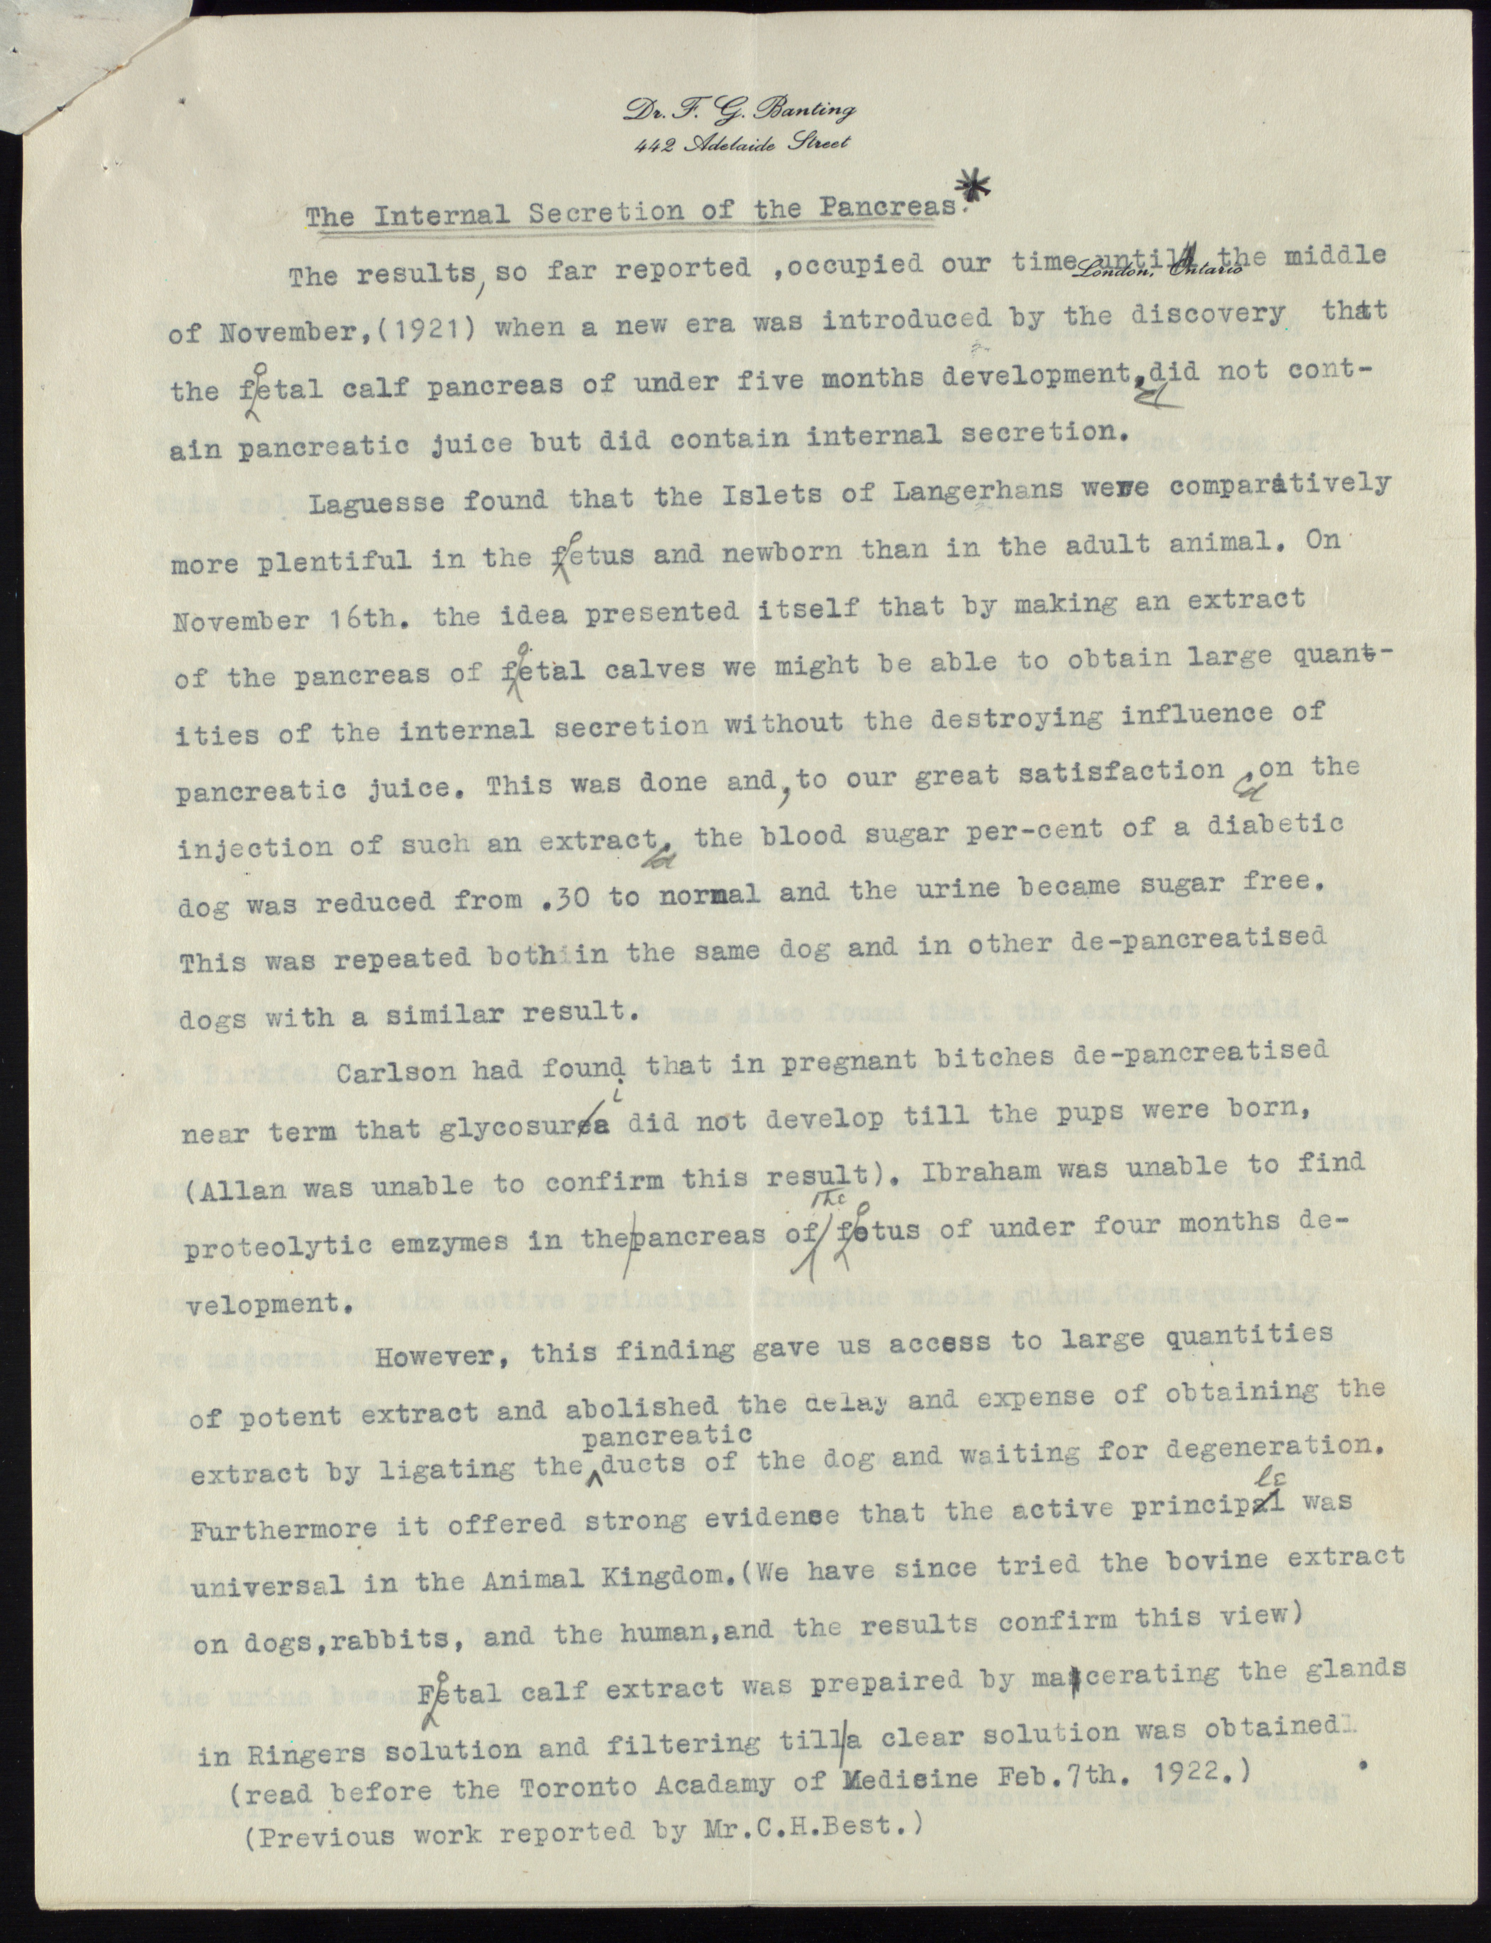
Discovering Insulin in Toronto
https://insulin.library.utoronto.ca/
November 16, 1921 - Banting was struck by another idea that led to preparing the extract from foetal calf pancreas
It soon became clear that fresh whole beef pancreas would prove to be a much more readily available source of the extract
C.J. Rutty – “The Discovery of Insulin: What is the Definitive History?” – Insulin 100th Webinar, Emirate Diabetes Society, World Diabetes Day, Nov 14, 2020

Slide 20
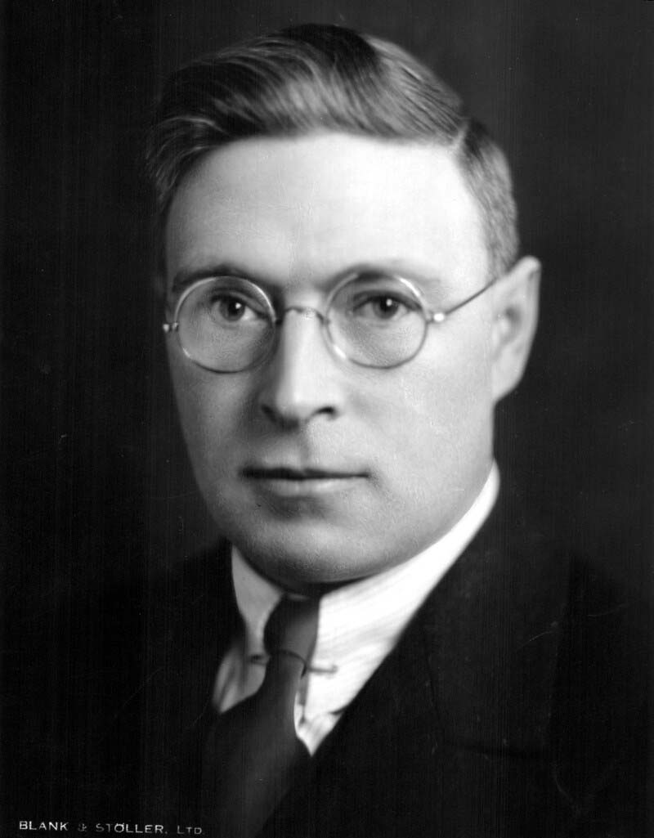
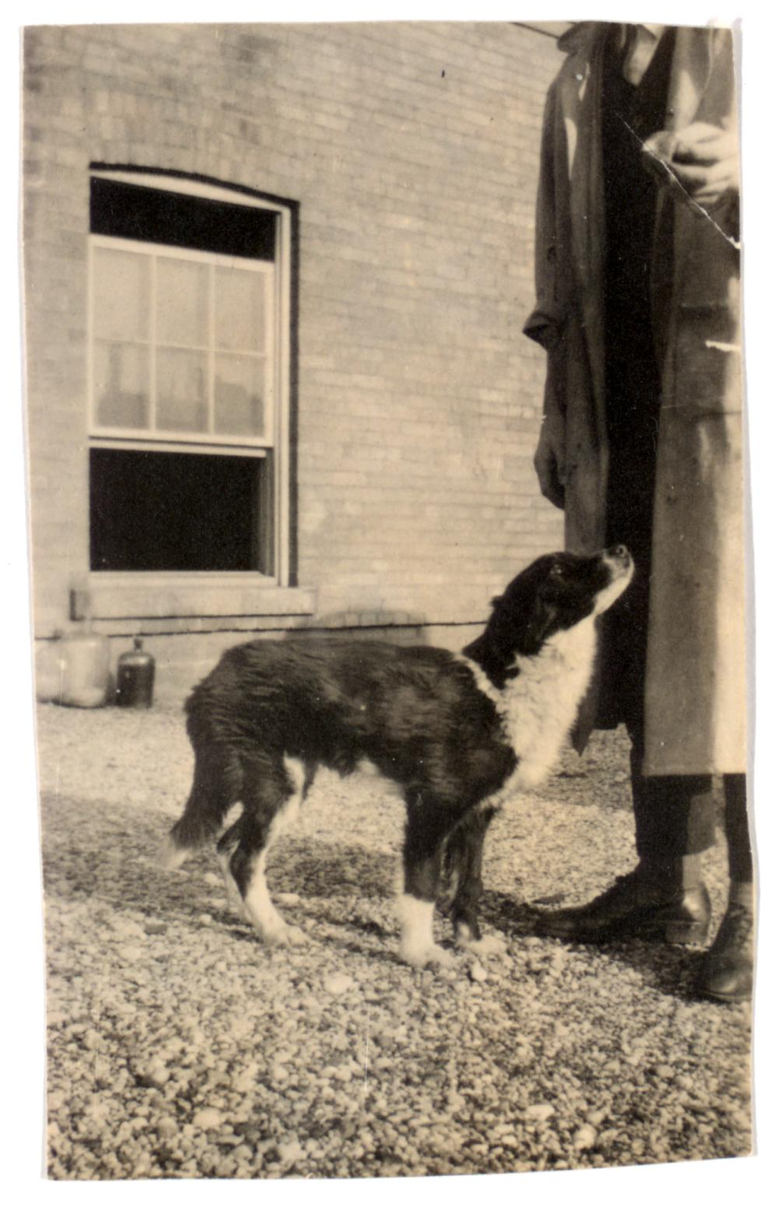
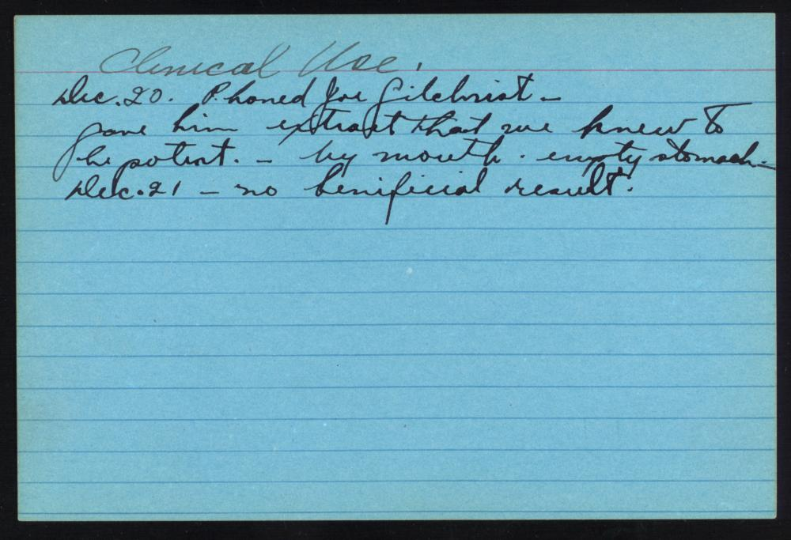
Sanofi Pasteur Canada Archives
Discovering Insulin in Toronto
Dec. 1921 - Dr. James Bertram Collip, a biochemist from the University of Alberta on sabbatical in Toronto, joins Banting and Best to help purify the extract.
Encouraging results with dog #33, “Marjorie,” lead to the extract’s first human use (administered orally), but it was unsuccessful
https://insulin.library.utoronto.ca/
C.J. Rutty – “The Discovery of Insulin: What is the Definitive History?” – Insulin 100th Webinar, Emirate Diabetes Society, World Diabetes Day, Nov 14, 2020

Slide 21
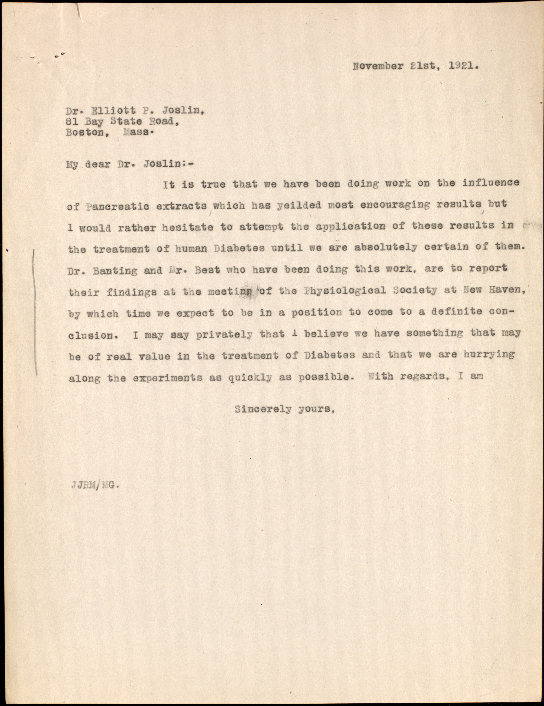
Discovering Insulin in Toronto
Dec. 30, 1921 –The work of the Toronto group presented at the Annual Meeting of the American Physiological Society in New Haven, CN, and attended by the leading diabetes specialists
Banting was nervous giving the presentation and Macleod stepped in to help answer questions
Dr. George Clowes, research director of Eli Lilly & Co, of Indianapolis was impressed with the work’s potential and closely followed its progress
https://insulin.library.utoronto.ca/
C.J. Rutty – “The Discovery of Insulin: What is the Definitive History?” – Insulin 100th Webinar, Emirate Diabetes Society, World Diabetes Day, Nov 14, 2020

Slide 22
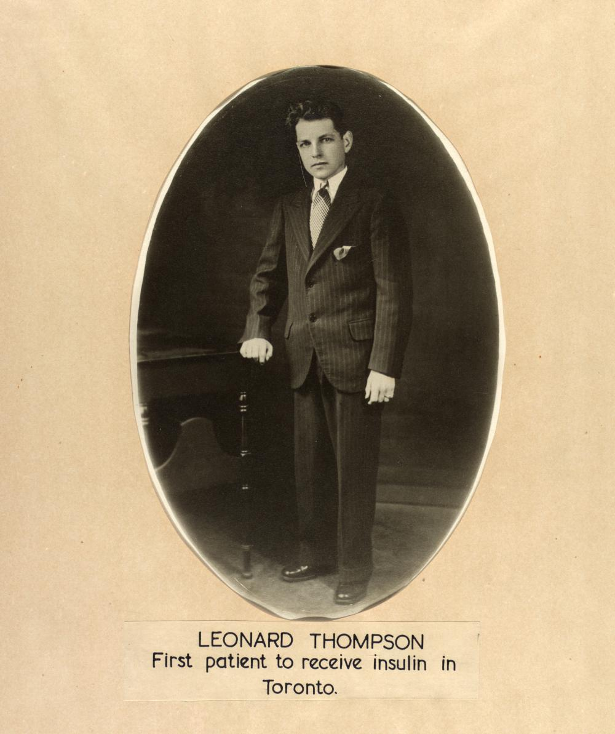
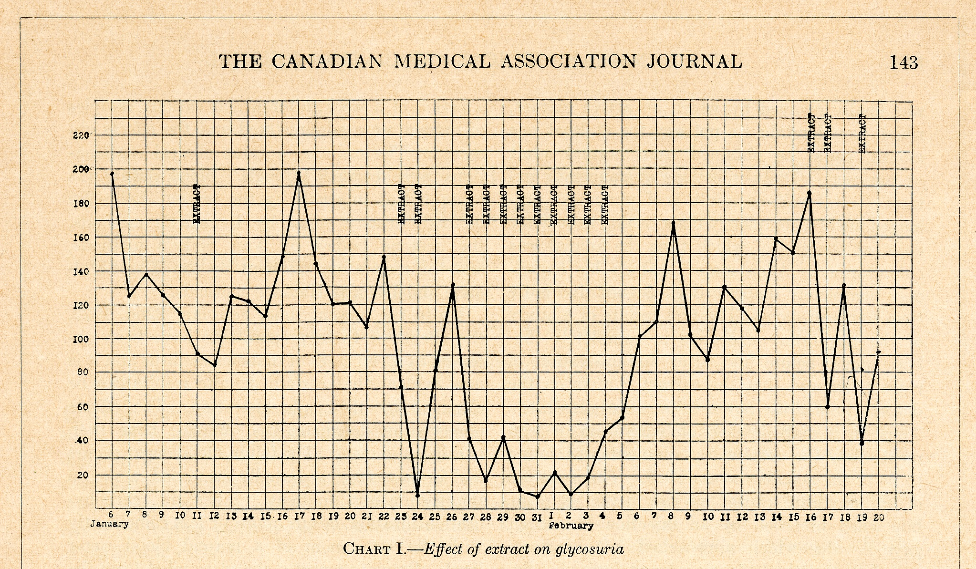
Discovering Insulin in Toronto
https://insulin.library.utoronto.ca/
Jan. 11, 1922 - 13-year-old Leonard Thompson is the first to receive an injection of the extract, but with limited effect, and with some reaction (abscesses)
Jan 23, 1922 – Leonard receives Collip’s more purified extract, with striking results
C.J. Rutty – “The Discovery of Insulin: What is the Definitive History?” – Insulin 100th Webinar, Emirate Diabetes Society, World Diabetes Day, Nov 14, 2020

Slide 23
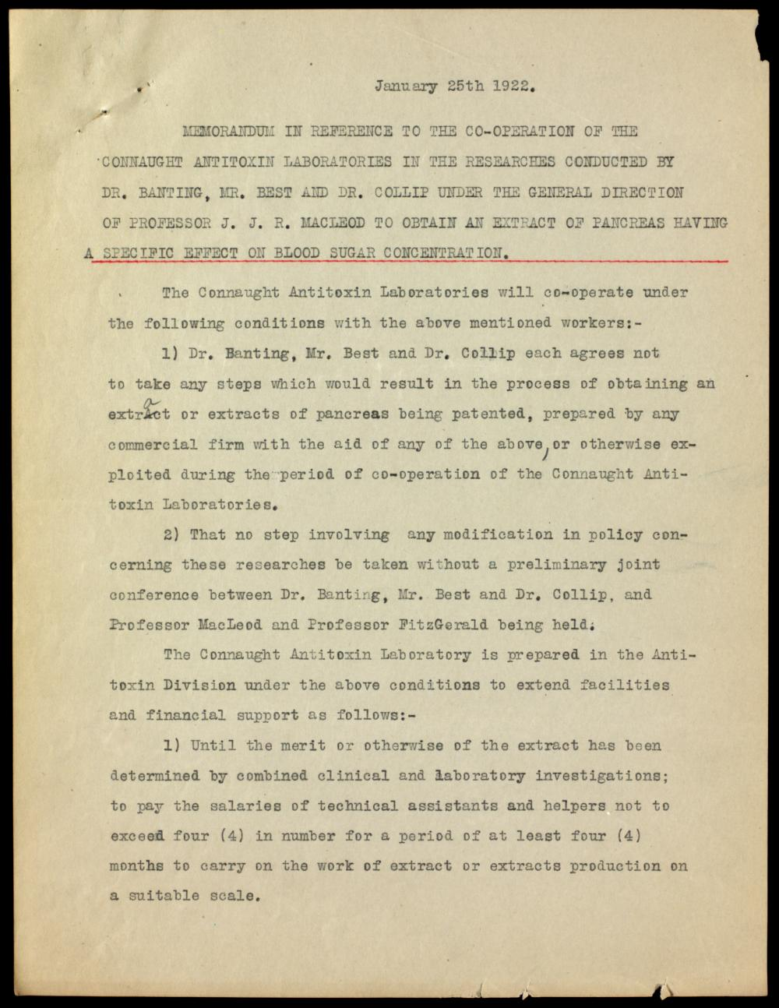
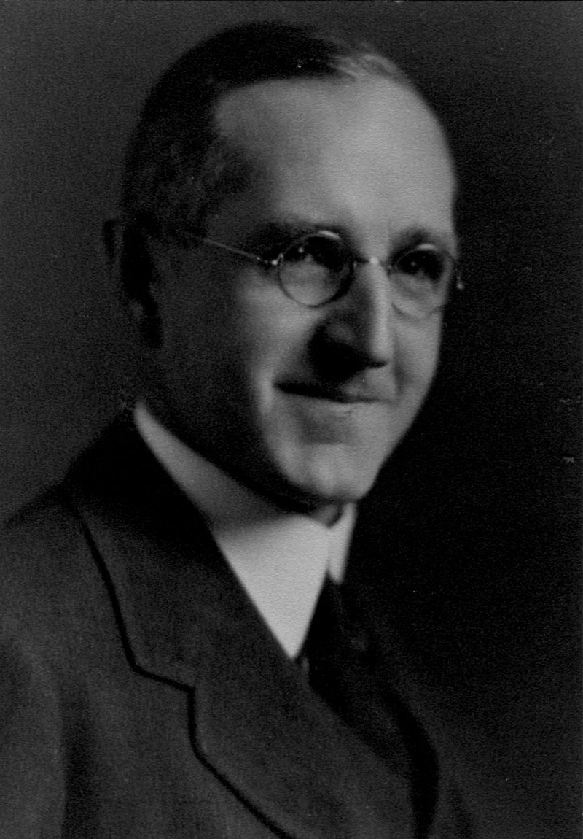
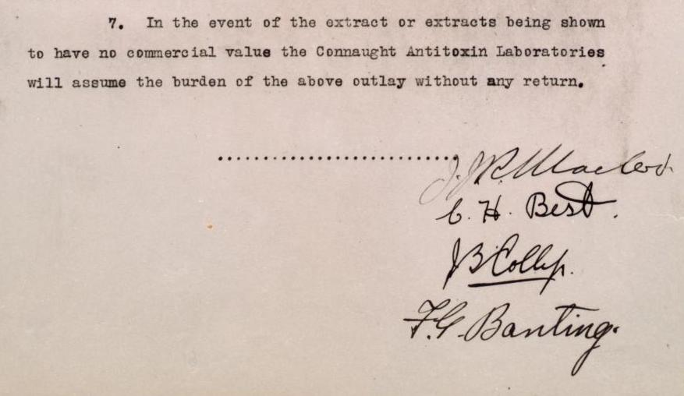
Developing Insulin in Toronto
https://insulin.library.utoronto.ca/
Jan 25, 1922 - Encouraged by Leonard Thompson's successful treatments, but concerned about the future control of the new extract's production, the director of U of T’s Connaught Laboratories, John FitzGerald (right), facilitated an agreement with Banting, Best, Collip and Macleod
He offered them funds and the Lab’s facilities in the Medical Building, not far from Banting & Best’s lab, to help develop methods to produce the extract for clinical trials
Sanofi Pasteur Canada Archives
C.J. Rutty – “The Discovery of Insulin: What is the Definitive History?” – Insulin 100th Webinar, Emirate Diabetes Society, World Diabetes Day, Nov 14, 2020

Slide 24
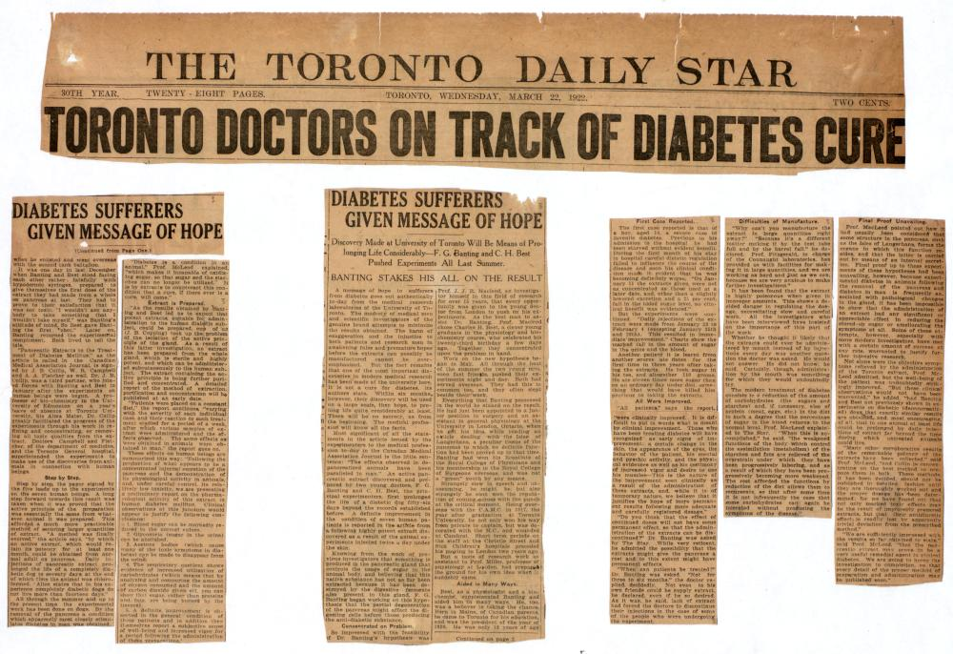
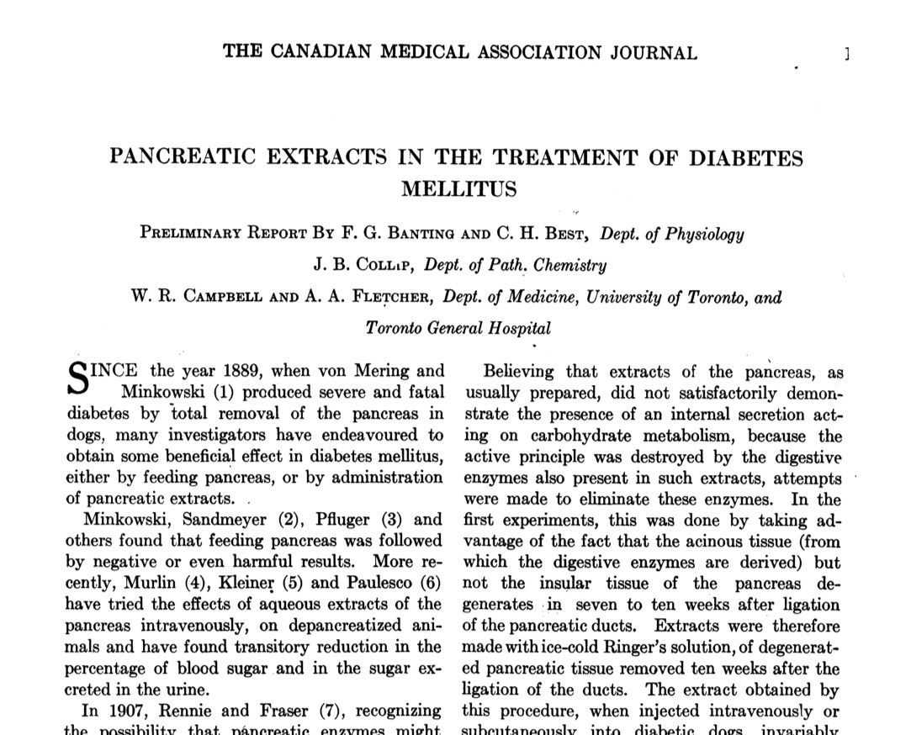
Developing Insulin in Toronto
CMAJ, 12 (March 1922), p. 141
March 22, 1922 – In the meantime, news of the extract and its successful human use was first reported the Canadian Medical Association Journal and in newspapers
C.J. Rutty – “The Discovery of Insulin: What is the Definitive History?” – Insulin 100th Webinar, Emirate Diabetes Society, World Diabetes Day, Nov 14, 2020

Slide 25
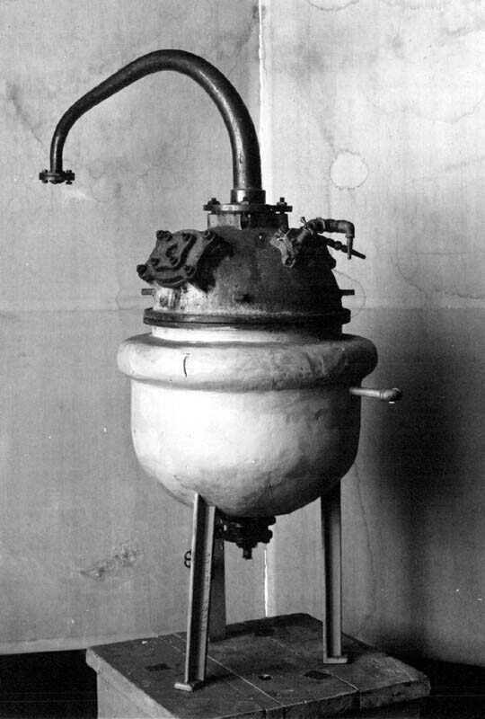
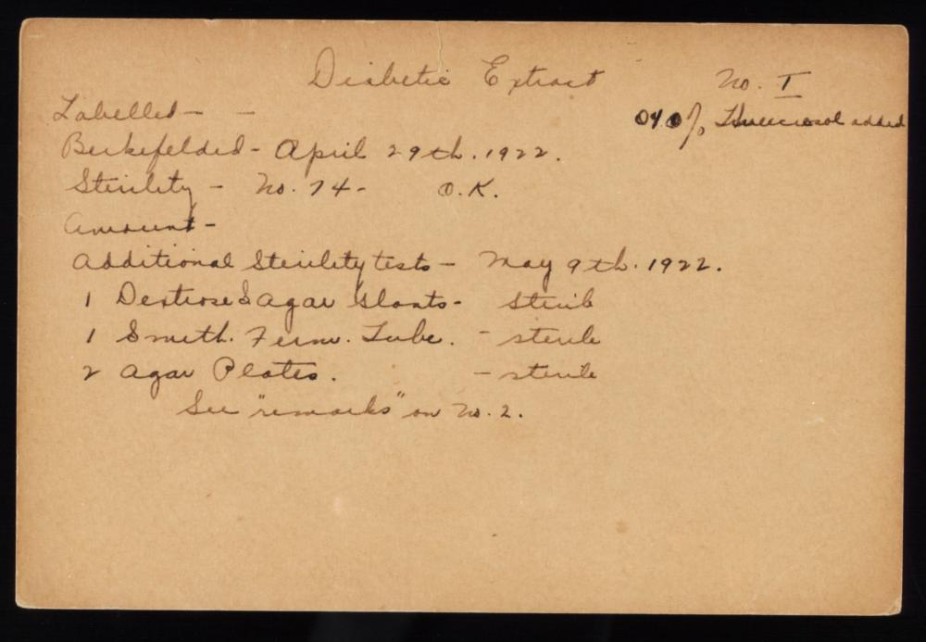
Developing Insulin in Toronto
Moving from lab to clinical trial scale, and then to large-scale production of the extract was a major challenge for Connaught Labs
March-May 1922 - After frustrating failures, production was restored under Best’s direction
Connaught then dedicated its full, though modest, resources to insulin production and output rose steadily
Sanofi Pasteur Canada Archives
May 1922 - The extract was given the name "Insulin”
C.J. Rutty – “The Discovery of Insulin: What is the Definitive History?” – Insulin 100th Webinar, Emirate Diabetes Society, World Diabetes Day, Nov 14, 2020

Slide 26
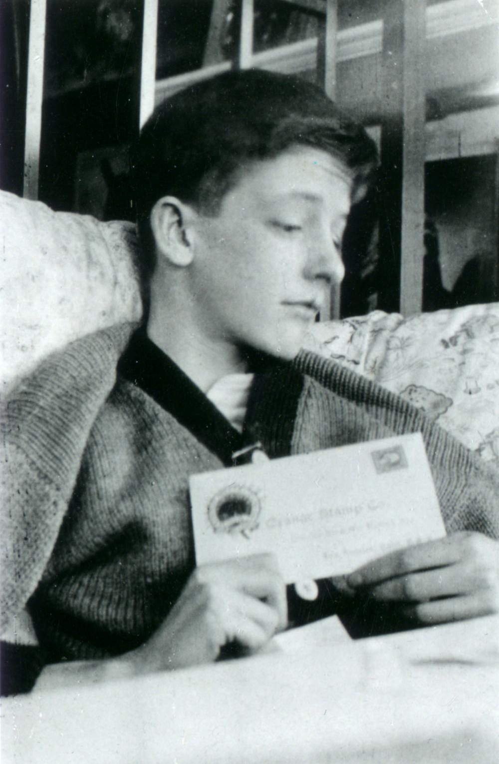
Developing Insulin in Toronto
https://insulin.library.utoronto.ca/
May 3, 1922 – The insulin success story with the first human diabetic cases – and the first public use of the “insulin” name – was told in a seminal presentation by Macleod in Washington, D.C. at a major conference attended by physicians and the leading diabetes specialists from across North America
Macleod’s presentation prompted a wave of letters to the Toronto team from physicians on behalf of their desperate diabetic patients, pleading for insulin, although the supply was very limited
May 21-26 - The first American treated with insulin was 22-year-old Jim Havens of Rochester, NY
C.J. Rutty – “The Discovery of Insulin: What is the Definitive History?” – Insulin 100th Webinar, Emirate Diabetes Society, World Diabetes Day, Nov 14, 2020

Slide 27
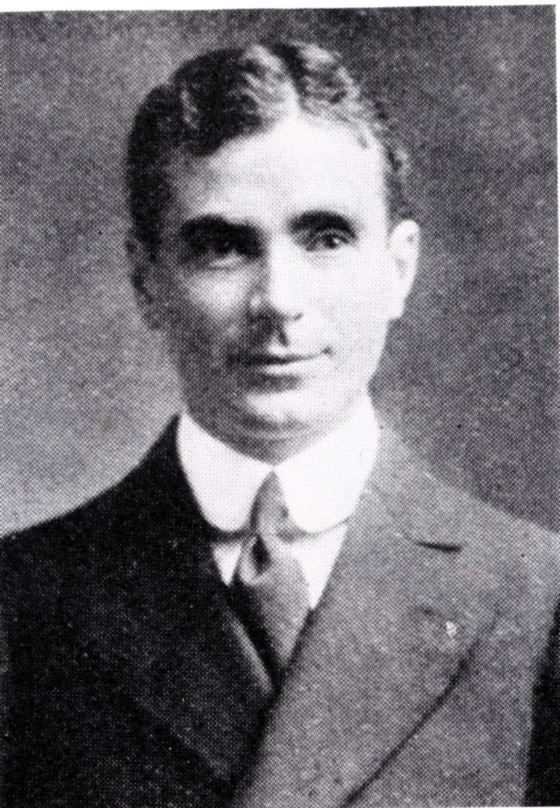
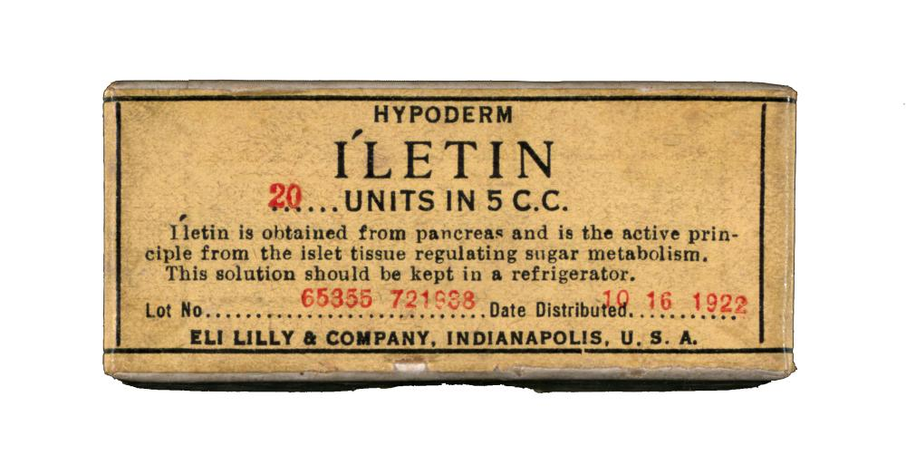
Developing Insulin in Toronto
May 30, 1922 - A unique collaboration agreement arranged between the University of Toronto and Eli Lilly & Co. of Indianapolis, designed to expedite the the development of large-scale insulin production methods
This and other agreements relating to insulin production, licensing and patent protection was negotiated by the University of Toronto’s Insulin Committee
Charles Best assumed leadership of Connaught’s Insulin production and worked closely with Eli Lilly, especially the company’s Research Director, Dr. G.H.A. Clowes (right)
The agreement granted Eli Lilly exclusive rights to supply Insulin (branded as “Iletin”) in the U.S. to diabetic specialists until June 1923
Sanofi Pasteur Canada Archives
C.J. Rutty – “The Discovery of Insulin: What is the Definitive History?” – Insulin 100th Webinar, Emirate Diabetes Society, World Diabetes Day, Nov 14, 2020

Slide 28
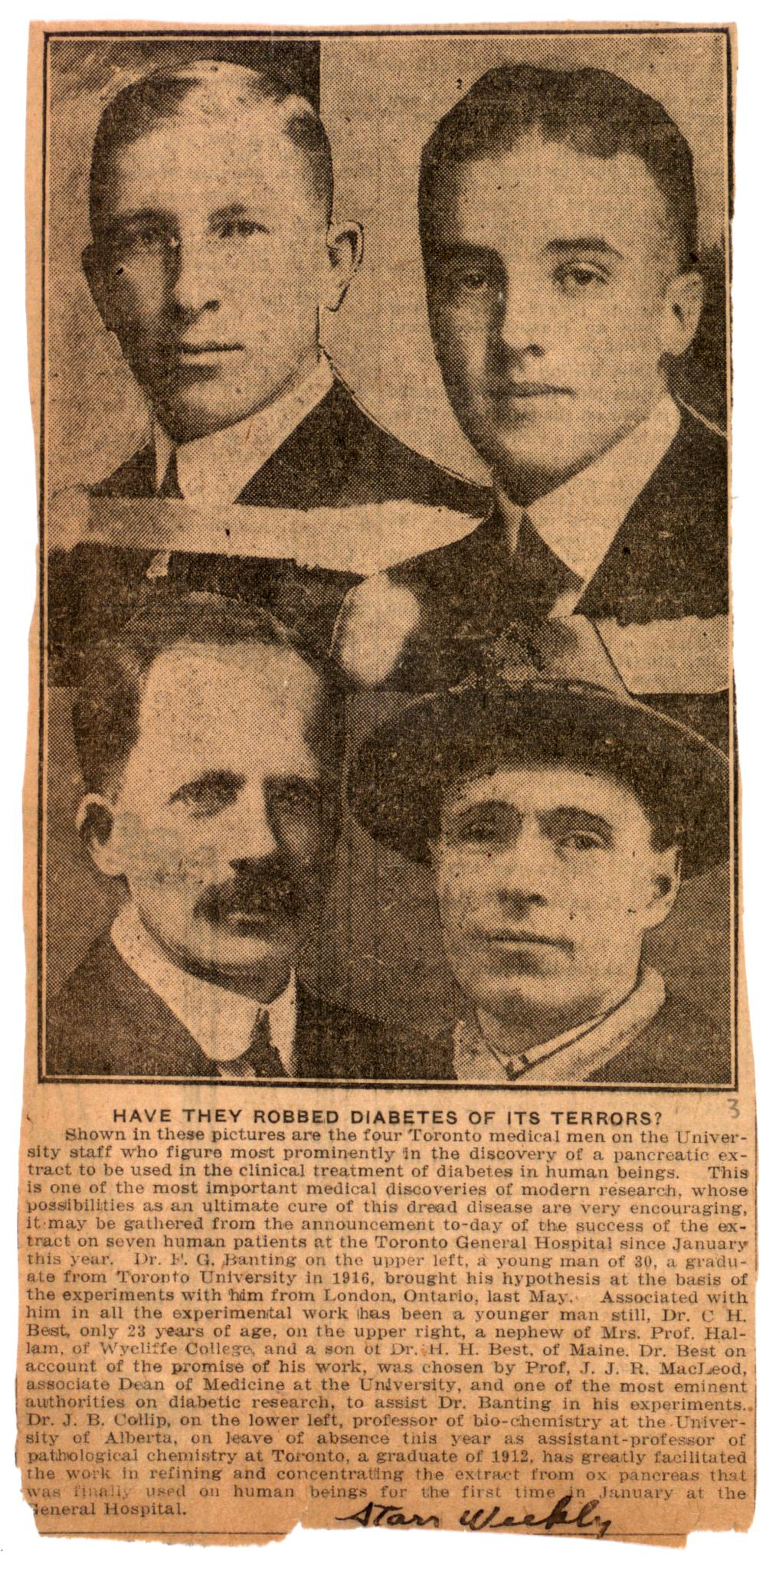
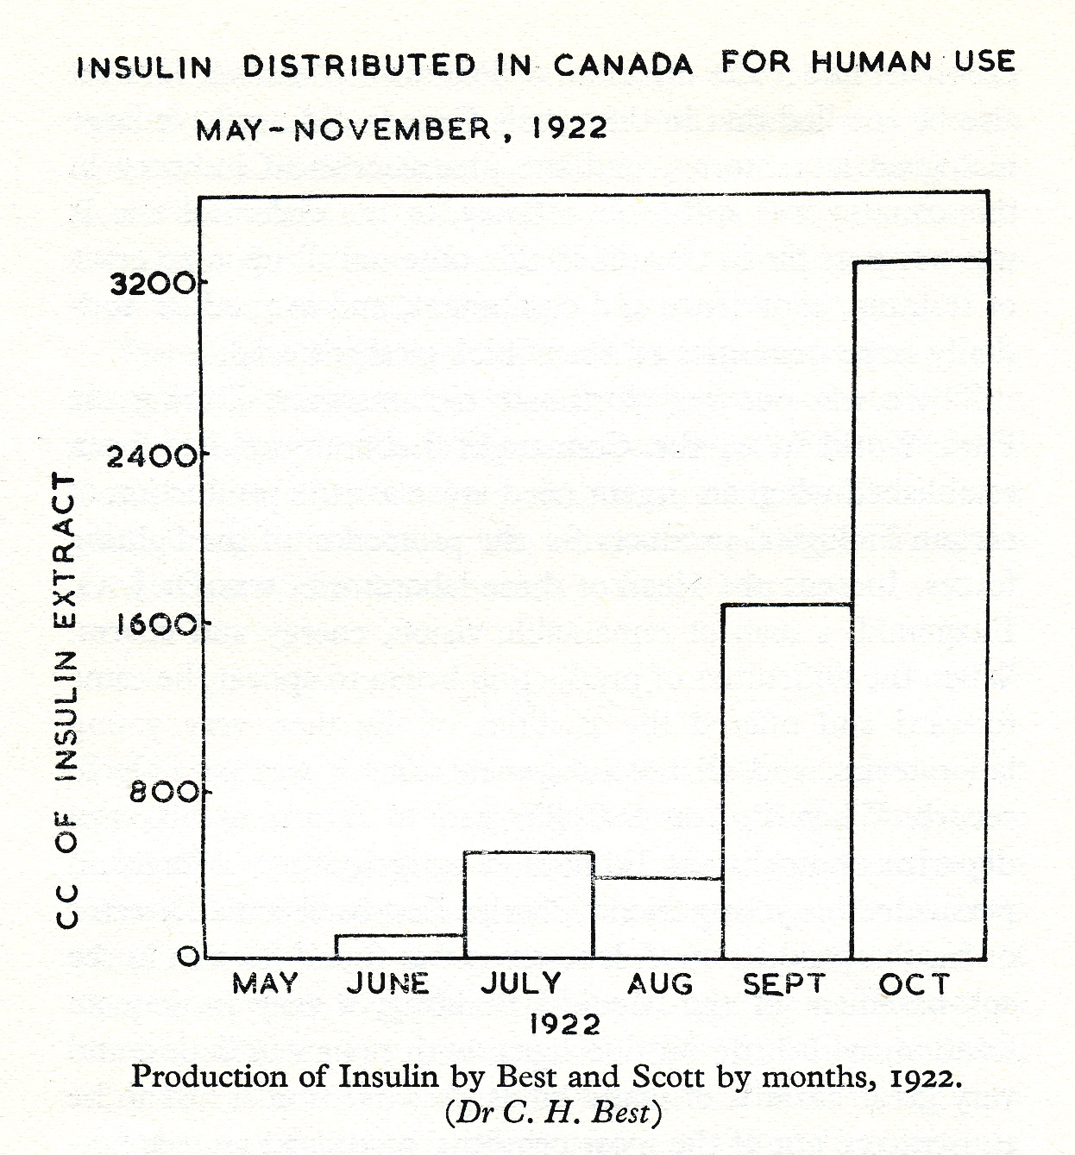
Developing Insulin in Toronto
The severe insulin supply challenges during the spring and summer of 1922 meant only a few critically ill patients, mostly children, could be treated
Toronto Star Weekly, March 26, 1922
C.J. Rutty – “The Discovery of Insulin: What is the Definitive History?” – Insulin 100th Webinar, Emirate Diabetes Society, World Diabetes Day, Nov 14, 2020

Slide 29
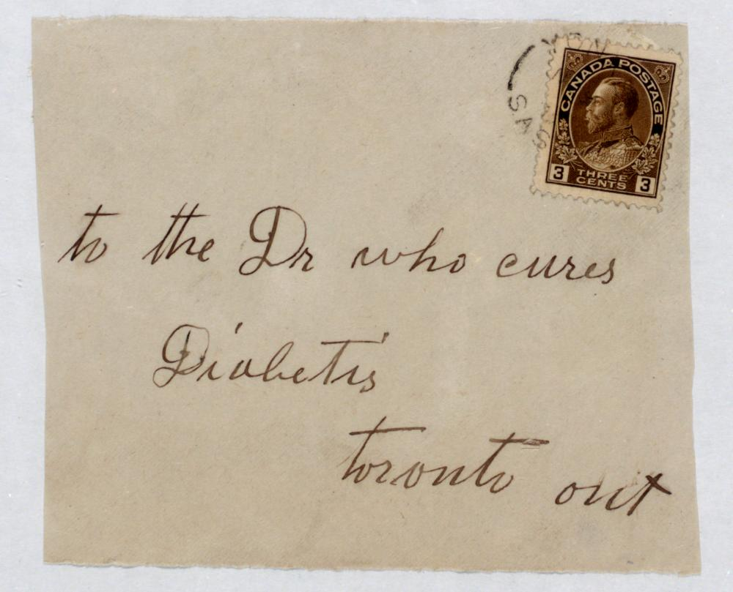
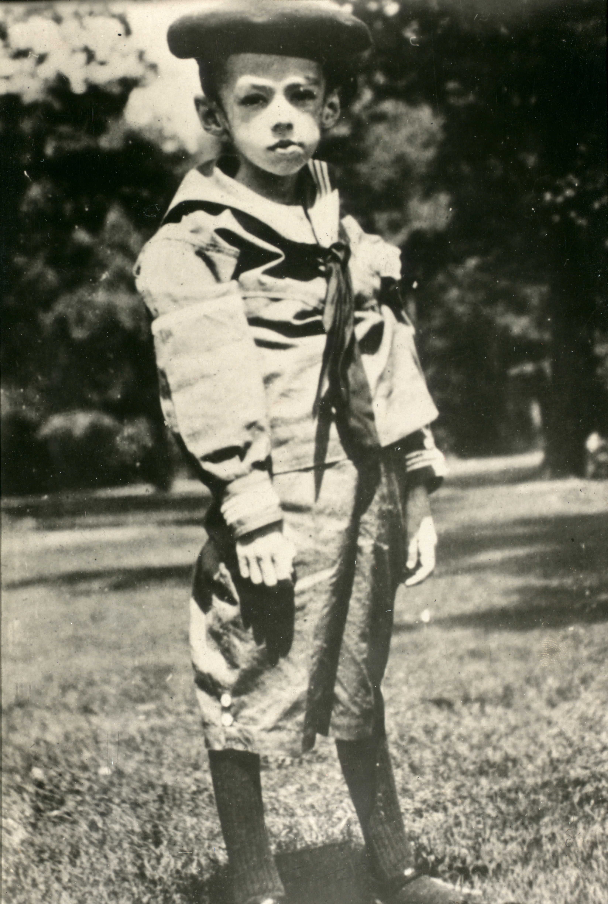
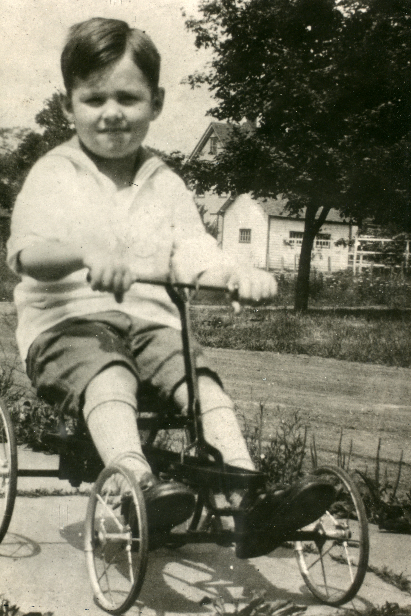
Insulin Resurrections
June - July 1922 – The rapidly growing attention to the Toronto insulin discovery brought desperate pleas from diabetics, their doctors and families, few of whom Banting could help due to a limited supply of insulin
However, Banting was able to help three severe diabetic cases who came to Toronto from the U.S. for insulin treatment
Ruth Whitehall (8 years old), treated in Toronto June 17 to the end of September
Myra Blaustein (11 years old), treated in Toronto July to the end of September
Teddy Ryder (6 years old), treated in Toronto July 8 through October
https://insulin.library.utoronto.ca/
C.J. Rutty – “The Discovery of Insulin: What is the Definitive History?” – Insulin 100th Webinar, Emirate Diabetes Society, World Diabetes Day, Nov 14, 2020

Slide 30
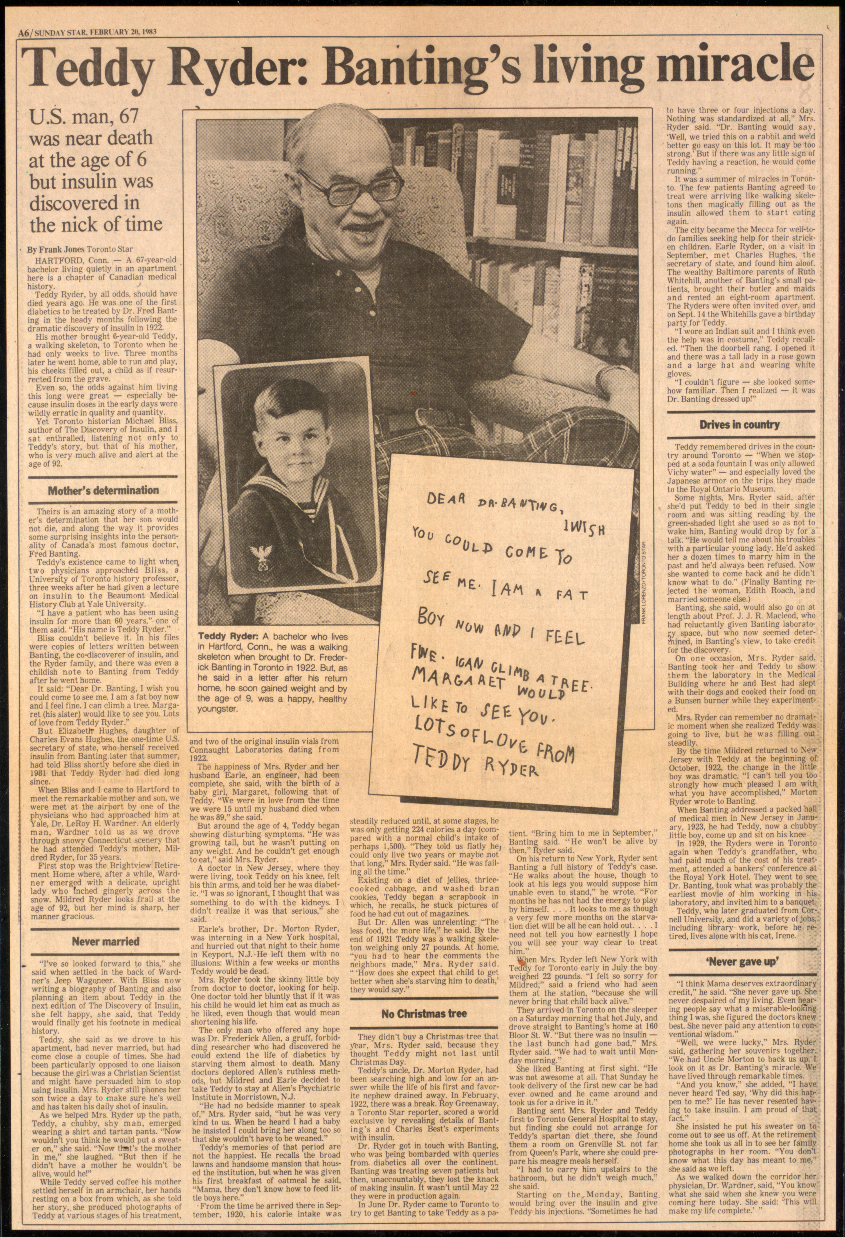
Insulin Resurrections
June - July 1922 – The rapidly growing attention to the Toronto insulin discovery brought desperate pleas from diabetics, their doctors and families, few of whom Banting could help due to a limited supply of insulin
However, Banting was able to help three severe diabetic cases who came to Toronto from the U.S. for insulin treatment
Ruth Whitehall (8 years old), treated in Toronto June 17 to the end of September
Myra Blaustein (11 years old), treated in Toronto July to the end of September
Teddy Ryder (6 years old), treated in Toronto July 8 through October
Teddy would live until March 1993
https://insulin.library.utoronto.ca/
Toronto Star, Feb 20, 1983
C.J. Rutty – “The Discovery of Insulin: What is the Definitive History?” – Insulin 100th Webinar, Emirate Diabetes Society, World Diabetes Day, Nov 14, 2020

Slide 31
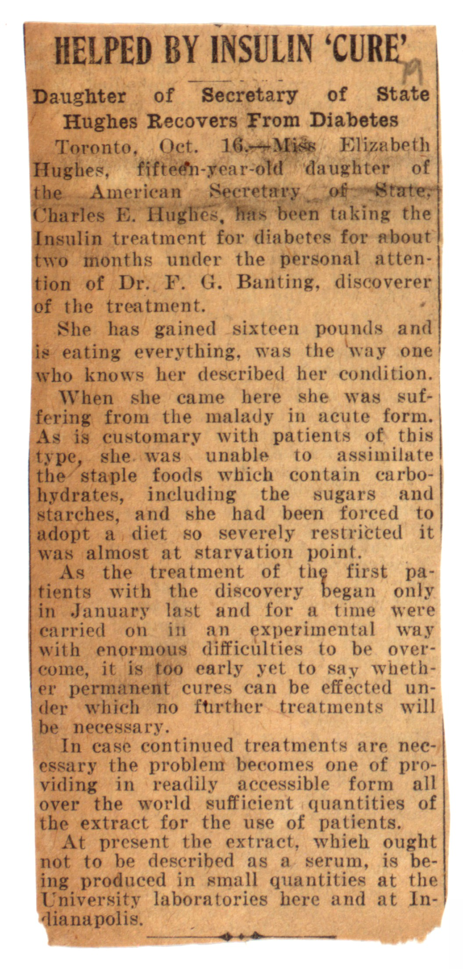
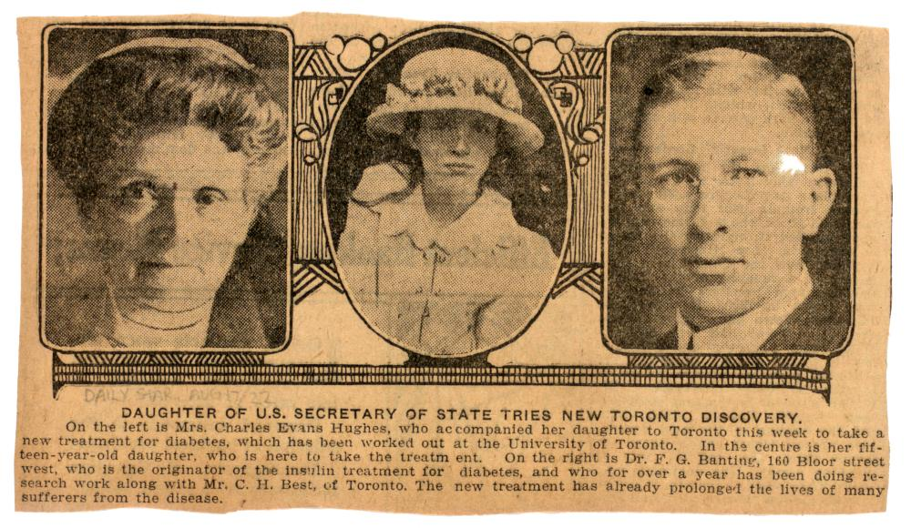
Insulin Resurrections
August 15 – November 30 – Banting’s most famous diabetic patient was 15-year-old Elizabeth Hughes, press attention to her heighted by her being the daughter of the U.S. Secretary of State, Charles Evans Hughes
Toronto Star, Aug 17, 1922
C.J. Rutty – “The Discovery of Insulin: What is the Definitive History?” – Insulin 100th Webinar, Emirate Diabetes Society, World Diabetes Day, Nov 14, 2020

Slide 32
https://insulin.library.utoronto.ca/
Insulin Resurrections
August 15 – November 30 – Banting’s most famous diabetic patient was 15-year-old Elizabeth Hughes, press attention to her heighted by her being the daughter of the U.S. Secretary of State, Charles Evans Hughes
Toronto Star, Aug 17, 1922
Elizabeth documented her recovery story in many letters she wrote from Toronto to her parents
C.J. Rutty – “The Discovery of Insulin: What is the Definitive History?” – Insulin 100th Webinar, Emirate Diabetes Society, World Diabetes Day, Nov 14, 2020

Slide 33
Insulin: From Toronto To The World
Oct 1922 – Banting, Best & Collip assign Insulin patent to the University of Toronto Board of Governors for $1 as a public trust, “so as to prevent commercial exploitation of the product and to safeguard the production of a standardized product”
Jan 1923 – Canadian and U.S. patents for insulin granted
April 1923 – Unique “patent pooling” policy established by Insulin Committee to assure the sharing of any insulin production advancements among licensed producers
https://insulin.library.utoronto.ca/
The Globe, Oct. 21, 1922, p. 23
C.J. Rutty – “The Discovery of Insulin: What is the Definitive History?” – Insulin 100th Webinar, Emirate Diabetes Society, World Diabetes Day, Nov 14, 2020

Slide 34
Insulin: From Toronto To The World
August 1923 - Canada’s insulin supply found a firm foothold with a larger insulin production plant for Connaught Labs, thanks to funds from the Ontario government and the Labs’ reserves; the plant established in U of T’s vacant YMCA building on campus
1927 – A larger insulin facility established
Sanofi Pasteur Canada Archives
Connaught was supplying insulin for all of Canada, and exporting it to many countries without their own production facility
C.J. Rutty – “The Discovery of Insulin: What is the Definitive History?“ – Insulin 100th Webinar, Emirate Diabetes Society, World Diabetes Day, Nov 14, 2020

Slide 35
Insulin: From Toronto To The World
Sanofi Pasteur Canada Archives
As Insulin production steadily grew in Canada and the U.S., the University of Toronto Insulin Committee facilitated insulin patents and the licensing of production in other countries
The Insulin Committee oversaw insulin quality control and licensing rights in North America
In Canada, Connaught Laboratories held excusive insulin production and distribution rights (until 1980); Connaught remained part of U of T until 1972 and today its legacy is part of Sanofi Pasteur Canada/Sanofi Canada
Eli Lilly held sole U.S. rights until June 1923, when other firms were able to apply to the U of T Insulin Committee for licenses
C.J. Rutty – “The Discovery of Insulin: What is the Definitive History?” – Insulin 100th Webinar, Emirate Diabetes Society, World Diabetes Day, Nov 14, 2020

Slide 36
Insulin: From Toronto To The World
Sanofi Pasteur Canada Archives
U of T Insulin Committee also granted patent/licensing authority to carefully selected public bodies in several countries, i.e.:
Nov 1922 – U.K. Medical Research Council (first insulin prepared in hospitals Jan 1923, then Burroughs Wellcome main producer April 1923)
Nov 1922 – Nordisk Insulin Laboratory (Scandinavia) (first Nordisk insulin late 1923)
July 1923 – German Insulin Committee (Hoechst first insulin Oct 1923)
July 1923 – Gov’t of Australia (Commonwealth Serum Laboratories first insulin Sept 1923)
By 1926, insulin was patented and trademarked in 44 countries, with the Insulin Committee carefully regulating who produced it
C.J. Rutty – “The Discovery of Insulin: What is the Definitive History?” – Insulin 100th Webinar, Emirate Diabetes Society, World Diabetes Day, Nov 14, 2020

Slide 37
Insulin: Honouring the Discoverers
The insulin story attracted significant international attention to Toronto, most notably,
Oct. 25, 1923 – The greatest global honour came when Banting and Macleod won the Nobel Prize for Medicine for the discovery of insulin
However, recognizing that two others were similarly deserving, Banting shared his half of the Prize with Best, while Macleod shared his with Collip
C.J. Rutty – “The Discovery of Insulin: What is the Definitive History?” – Insulin 100th Webinar, Emirate Diabetes Society, World Diabetes Day, Nov 14, 2020

Slide 38
Epilogue: Discoverers After Discovery
Frederick Banting would focus on medical research, but was drawn to a growing interest in art, especially painting
There were great expectations that Banting would make another major medical discovery, which proved quite frustrating, and art provided an important escape
When World War II started, Banting became involved with aviation medicine studies
He also worked closely with the British Air Force and was on a secret flight to Britain on February 20, 1941, when his small plane crashed shortly after taking off from Gander, Newfoundland; he died the next day
C.J. Rutty – “The Discovery of Insulin: What is the Definitive History?” – Insulin 100th Webinar, Emirate Diabetes Society, World Diabetes Day, Nov 14, 2020

Slide 39
Epilogue: Discoverers After Discovery
1925 – Charles Best completed his M.D. amidst the insulin development period and then pursued postgraduate studies in Europe
1927 - Best returned to Toronto to continue as Connaught’s Assistant Director until 1929, and to also serve as Head of the Department of Physiological Hygiene at the School of Hygiene
Late 1920s - Best also initiated studies of liver extract as a treatment of anemia, and he focused especially on the development of Heparin to control blood coagulation, this work very much involving Connaught; Best died in 1978
C.J. Rutty – “The Discovery of Insulin: What is the Definitive History?” – Insulin 100th Webinar, Emirate Diabetes Society, World Diabetes Day, Nov 14, 2020

Slide 40
Discover More About the Discovery of Insulin
To learn more about the discovery and development of insulin, and the discovery team, explore the Defining Moments Canada ”Insulin 100” national digital commemoration project, the first phase of which recently launched,
http://definingmomentscanada.ca
C.J. Rutty – “The Discovery of Insulin: What is the Definitive History?” – Insulin 100th Webinar, Emirate Diabetes Society, World Diabetes Day, Nov 14, 2020

Slide 41
Discover More About the Discovery of Insulin
Thank You!
To learn more about the discovery and development of insulin, and the discovery team, explore the Defining Moments Canada ”Insulin 100” national digital commemoration project, the first phase of which recently launched,
http://definingmomentscanada.ca
C.J. Rutty – “The Discovery of Insulin: What is the Definitive History?” – Insulin 100th Webinar, Emirate Diabetes Society, World Diabetes Day, Nov 14, 2020

